Slide 1
Acute Respiratory Distress Syndrome (ARDS)
Joseph esherick, md, faafp, fhm
NOVEMBER 18, 2025

Slide 2
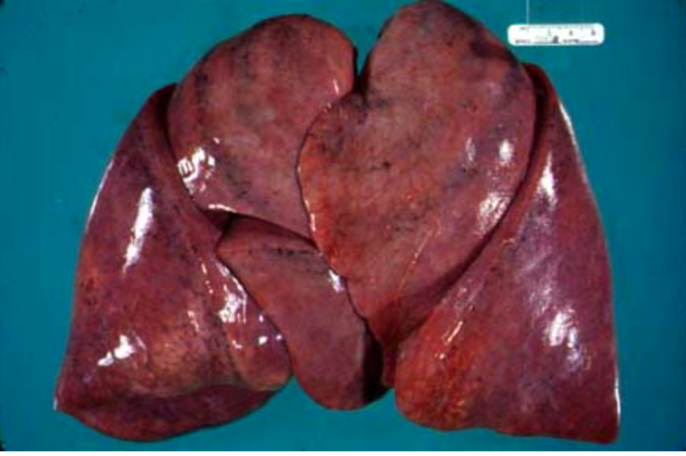
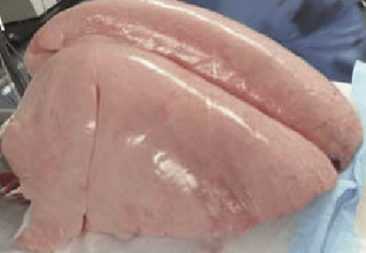
Origins of ARDS
Informal descriptions of this syndrome since 1816 as a condition manifested by pulmonary edema in association with sepsis or toxic syndromes
  Gross pathology of “congested lung”
First formally described by Ashbaugh and Petty in 1971 as “adult respiratory distress syndrome”
Variably called “double pneumonia”, “shock lung”, ”post-traumatic lung” and “respirator lung”

Slide 3
Etiologies of ARDS
Direct Lung Injury | Indirect Lung Injury | Toxic Exposures
Pneumonia | Sepsis | Drug overdose
Pulmonary contusion | Non-thoracic trauma | Blood product transfusions
Aspiration pneumonitis | Hemorrhagic shock | Cardiopulmonary bypass
Drowning | Pancreatitis | Reperfusion injury after lung transplantation or thrombectomy
Inhalation injury | Major burns
Air embolism | Heat stroke
Fat or amniotic fluid embolism | Envenomations | Meds: amiodarone, NFN, infliximab, CTX agents
Vaping
Notes:
Pneumonia, sepsis and aspiration account for 85% of all cases – severe necrotizing pancreatitis, major burns and polytrauma patients also at high risk

Slide 4
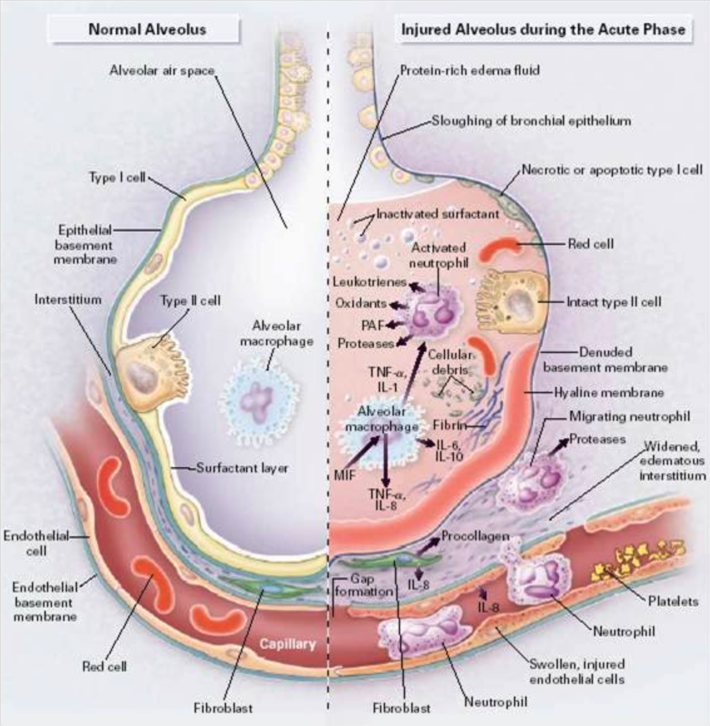
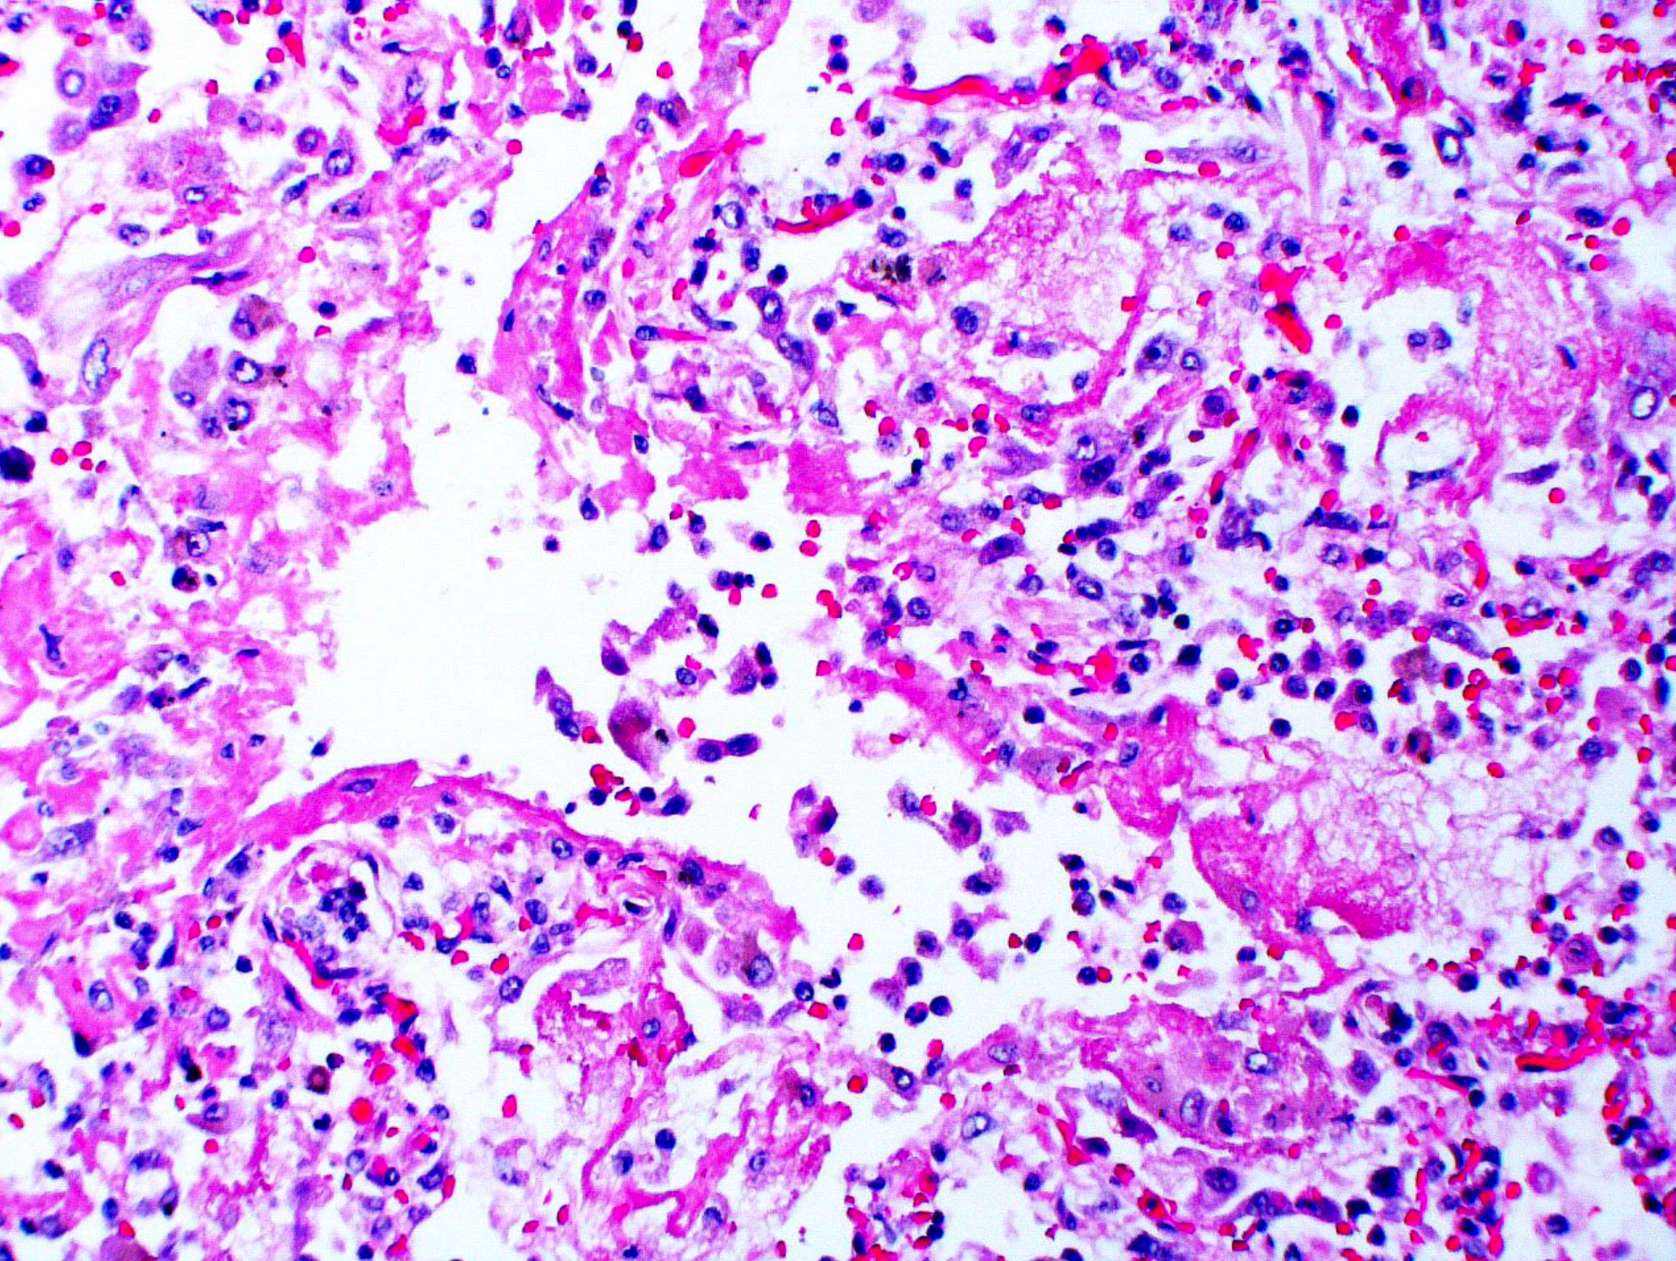
Pathophysiology of ARDS
Diffuse Alveolar Damage
N Engl J Med 2000; 342:1334-1349.
Notes:
Proliferative phase until day 14 and fibrotic phase after 2 weeks

Slide 5
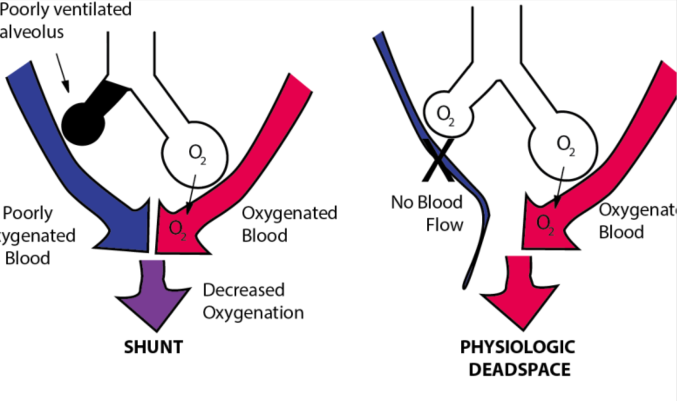
V/Q MISMATCH AND SHUNTING
ARDS V/Q mismatch
Increased shunting
Increasing FiO2 increases PaO2 in deadspace ventilation > shunting
Need to recruite lung in shunting
ARDS, CHF, Pneumonia
PE, Air/Fat embolism

Slide 6
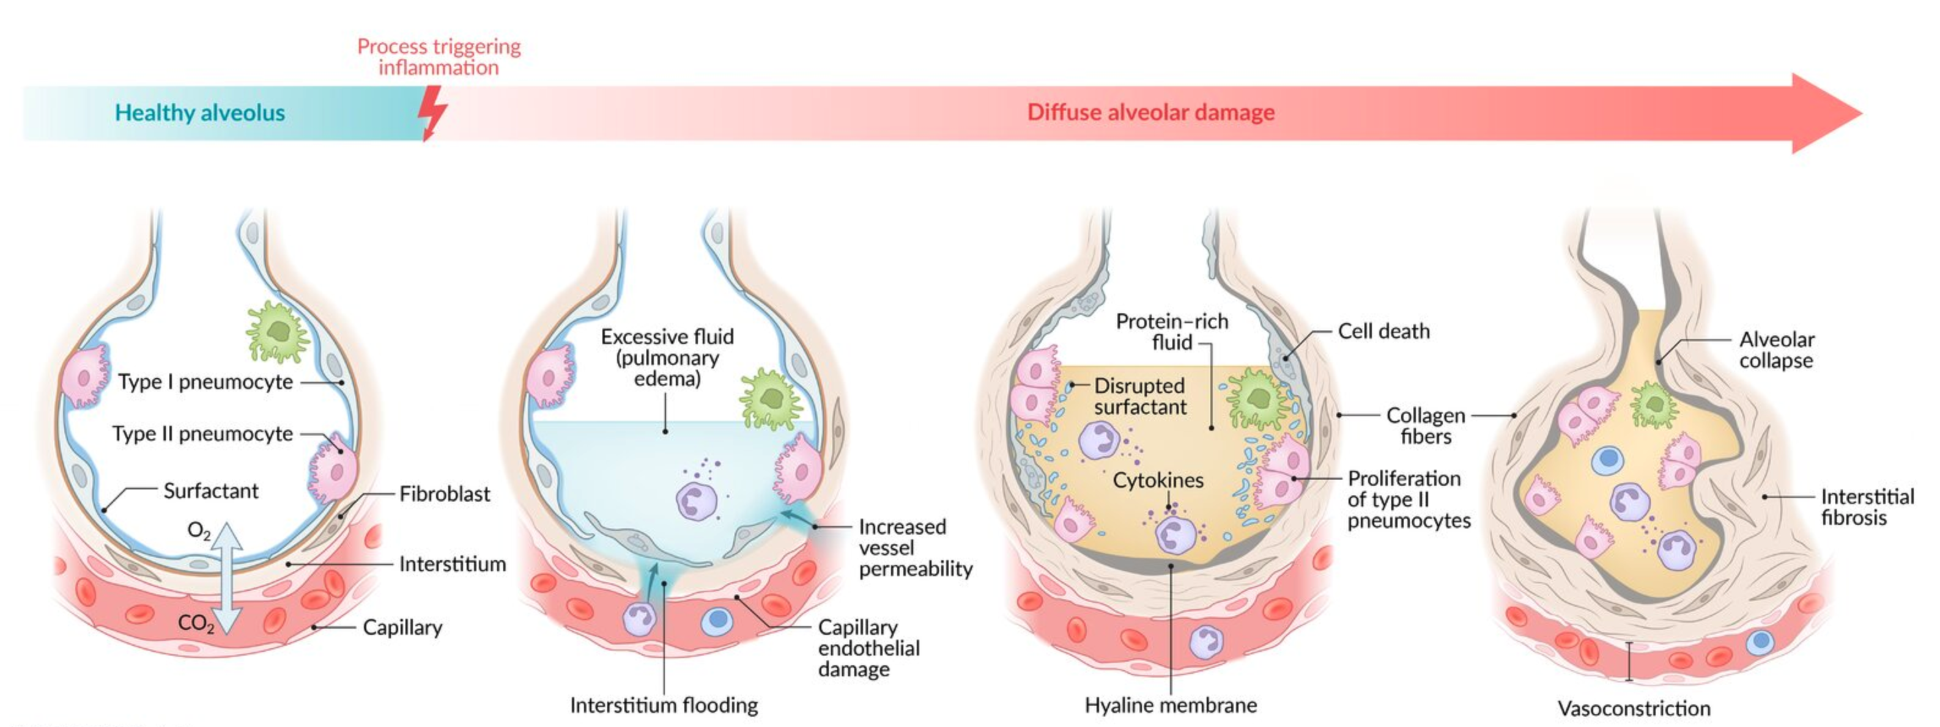
STAGES OF ARDS
EXUDATIVE PHASE
DAY 1-7
PROLIFERATIVE PHASE DAY 7-14
EXUDATIVE PHASE
WEEKS 2-4

Slide 7
ARDS DIAGNOSIS
ARDS
Acute hypoxia after insult (<1 week)
Ratio (P/F < 300 with PEEP≧5)
Diffuse Bilateral Pulmonary Infiltrates
Swan Ganz
PCWP < 18
Rule out cardiogenic pulmonary edema

Slide 8
Berlin Criteria for ARDS
Symptoms for less than a week after a known insult
Imaging: bilateral pulmonary opacities not fully explained by atelectasis, pleural effusions, lung collapse or nodules
  Lung ultrasound with diffuse B lines
Origin of edema not fully explained by CHF or fluid overload
PaO2/FiO2 <300 with CPAP or PEEP > 5
Severity
  Mild: P/F 201-300
  Moderate: P/F 101-200
  Severe: P/F < 100
Notes:
Updated definition could include patients on HFNC

Slide 9
Mimickers of ARDS
CHF
Diffuse interstitial lung disease
Diffuse alveolar hemorrhage (Goodpasture’s syndrome, SLE or ANCA-associated vasculitis)
Drug-induced lung injury (e.g., bleomycin or amiodarone)
Cancers (primary lung or metastatic cancers)

Slide 10
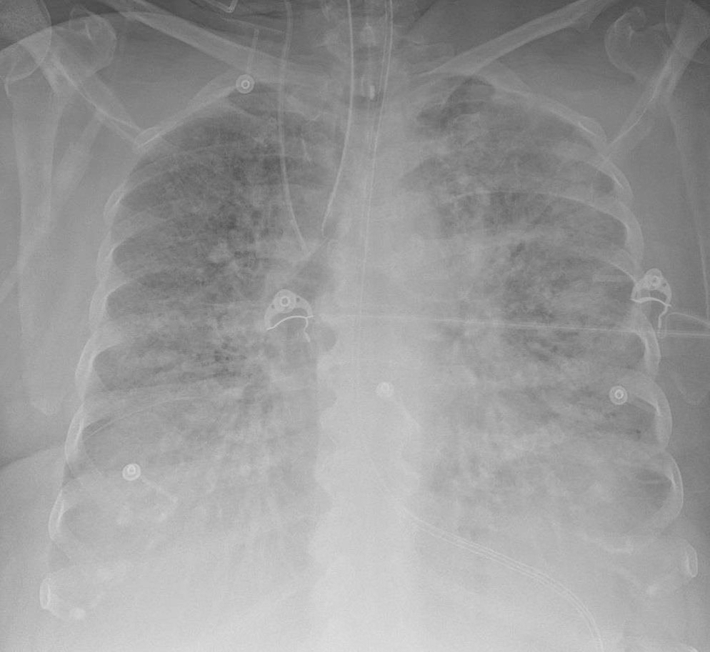
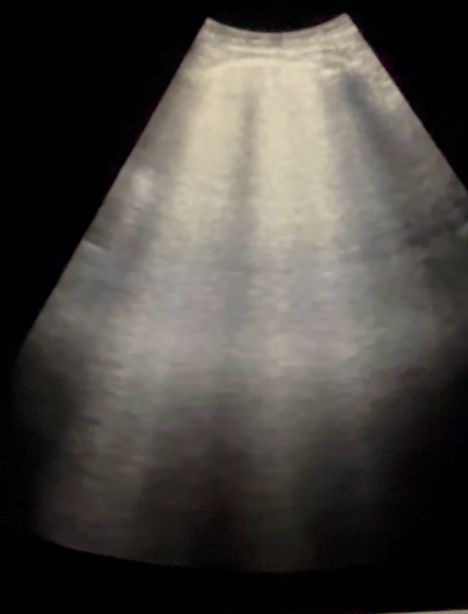
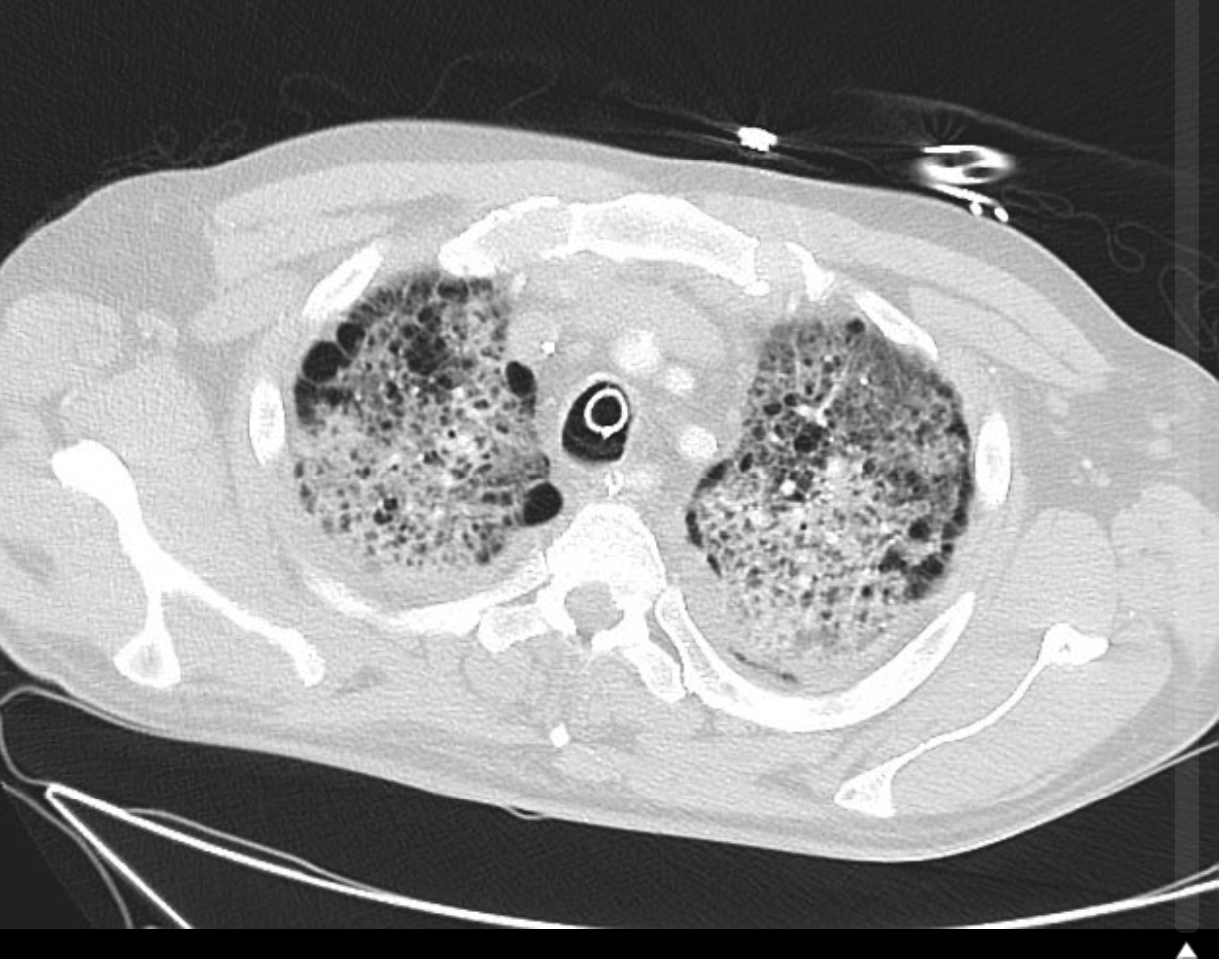
Epidemiology of ARDS
INCIDENCE
  10% of all ICU patients
  16% of ventilated patients
  33% of ventilated surgical/trauma patients
Under-recognized disorder
  49% of mild ARDS not recognized
  22% of severe ARDS not recognized
Global mortality ~40%
Notes:
Highest reported rates ARDS in U.S. and Australia

Slide 11
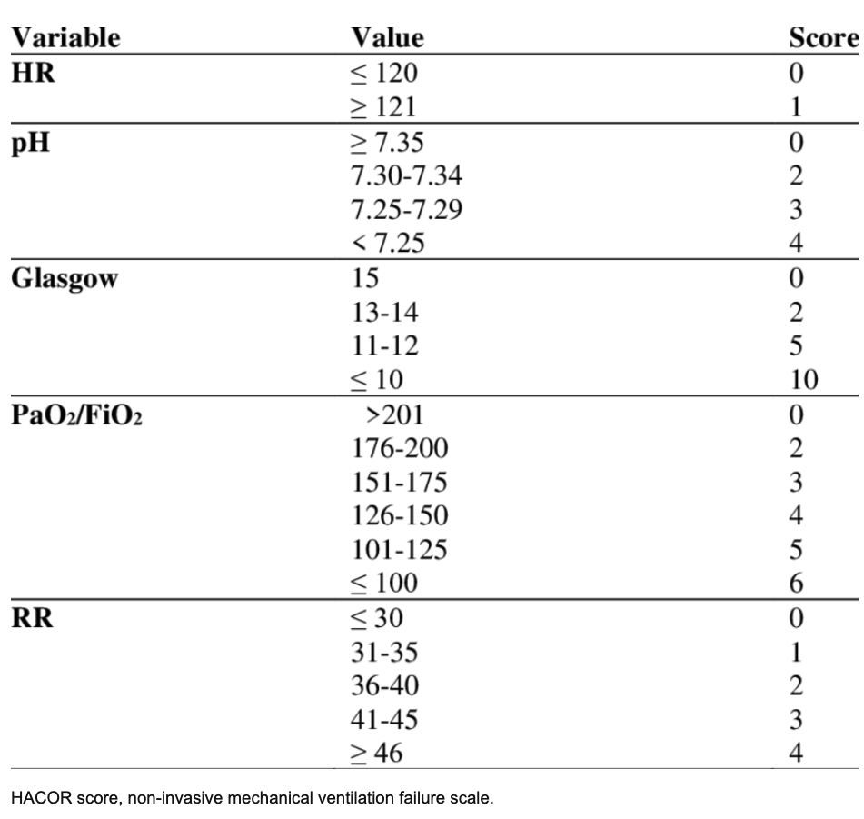
HFNC or NIV Management of ARDS
HACOR SCORE
NIV
HFNC
HACOR score > 5 after 1-2 hours NIV ventilation predicts >80% chance of NIV failure
Intensive Care Med. 2017: 43: 192.
Notes:
HACOR – HR, ACIDOSIS, CONSCIOUSNESS, OXYGENATION, RR

Slide 12
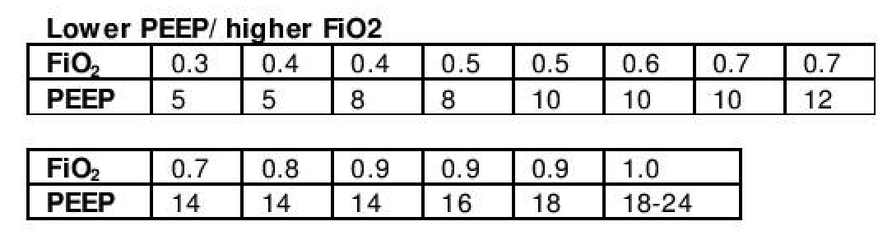
Ventilator Management in ARDS
Lung-protective ventilation
  Vt = 6 ml/kg PBW (4-8 ml/kg)
  Pplat < 30 cmH20
  DP: Driving pressure <15 (Pplat – PEEP)
Maximize lung recruitment
  Titrate PEEP based on FiO2:PEEP tables
  Prone positioning
  Minimize ventilator dysynchrony
Minimize oxygen toxicity
  Titrate FiO2 <60% if possible to keep PaO2 55-75 (SpO2 88-92%)
Minimize VILI: minimize atelectrauma and volutrauma → both increase cytokine release and capillary leak
Emerg Med. 2021; 38: 170, J Intensive Care. 2023; 11:10, Am J Med Sci. 2021; 362 (1): 13-23, Intensive Care Med. 2020; 46: 2252-2264
Notes:
LPV – 6 ml/kg vs 12 ml/kg had ARR = 9%

Slide 13
Conservative Fluid Management in ARDS
FACTT trial
  Multi-center randomized study of 1,000 intubated patients
  Liberal vs conservative fluid strategy (Cumulative fluid balance = 360 ml vs 7400 ml over 7 days)
  Conservative fluid strategy aimed for PAOP<8 or CVP<4
  No difference in 60-day mortality; improved oxygenation and decreased ventilator-free days (3.5 days) in conservative group
When Shock-free
  No maintenance fluids
  Diuretics to normalize cumulative fluid balance
  Hold diuretics for increases in creatinine, signs of tissue hypoperfusion or hypotension
NEJM. 2006; 354, 75, Intensive Care Med. 2020; 46: 2252-2264, Semin. Respir. Crit. Care Med. 2019; 40: 57–65.

Slide 14
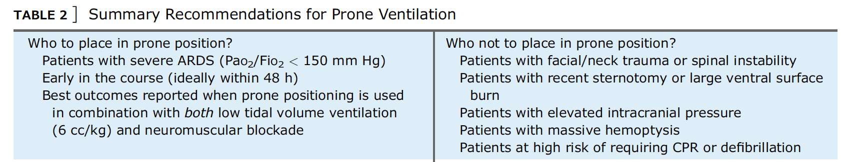
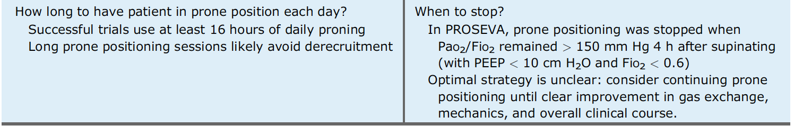
Prone Ventilation in ARDS
Outcome: 28 day mortality – 16% vs 32.8% (ARR = 16.8%)
Complications: ETT obstruction (RR = 1.76) and pressure sores (RR = 1.22)
Notes:
Only 16% of patients with severe ARDS were treated with prone positioning. Proseva trial 87% of pts on NMB drips and most on LPV
Meta-analysis of prone ARDS trials showed that mortality benefit only if LPV used (RR = 0.66 with 6 ml/kg but no mortality benefit for Vt >= 8 ml/kg)

Slide 15
Neuromuscular Blockade in Severe ARDS
ROSE trial
N = 1006 from 48 hospitals in U.S.
Inclusion criteria: PaO2/FiO2 <150 on PEEP>8 and <48 hours of ARDS
Cisatracurium gtt x 48 hours vs usual care
Protocolized: conservative fluid strategy, lung protective ventilation and high PEEP ventilator strategy
Primary end-point: 90 day mortality was equivalent (42.5% vs 42.8%)
  Trial stopped early secondary to futility
N Engl J Med 2019; 380:1997-2008
Notes:
Compared with the ACURASYS trial

Slide 16
Steroids in Moderate-Severe ARDS
Meta-analysis in Early Severe ARDS
DEXA-ARDS trial
Multicentre RCT in 17 ICUs in Spain
N = 277
Inclusion criteria: P/F <200 with PEEP>10 and FiO2>0.5 with ARDS <24h
Intervention: dexamethasone 20 mg IV daily (d1-5) then 10 mg/day (d6-10)
Outcome:
  Ventilator-free days 4.8 days more in dexamethasone group (p<0.001)
  60 day mortality: 21% vs 36% (p = 0.0047)
  ARR = 15% and NNT = 7
2740 patients
16 RCTs with non-COVID Early Mod-Severe ARDS (P/F <200)
Corticosteroid use vs placebo
  28-day mortality reduction with steroids
  RR 0.82, 95% CI 0.72 – 0.95
  ARR 8.0%
  NNT = 13
No benefit for late ARDS
Notes:
77% of patient had ARDS from pneumonia or sepsis
Dexamethasone 20 mg = methylprednisolone 120 mg daily
MA/SR – 9 trials with 1371 patients – decreased mortality RR = 0.83, increased ventilator-free days at 28 days 3.7 days

Slide 17
Complications of ARDS
Mortality
  20-60% in-house
  additional 15-20% mortality within 12 months
Increased morbidity
  Slow functional recovery in ARDS survivors
  Significantly decreased VC and 6-minute walk distance 12-months after ARDS
  50% of ARDS survivors return to work within 6 years
  ARDS survivors have significant cognitive impairment 12 months after discharge

Slide 18
ARDS Summary
Affects about 10% of ICU patients and 16% of ventilated ICU patients
Multiple etiologies but infection and aspiration account for ¾ of all cases
Treat underlying etiology
Lung-protective ventilator strategy
  Low Vt, High PEEP, low driving pressure, PEEP titrated to PEEP:FiO2 tables
Conservative fluid strategy
Prone ventilation
Consider steroids for early severe ARDS

