Slide 1
Neurologic Support

Slide 2
Goals
Review principles of brain insult and mechanisms of neuronal injury
Review the assessment of a brain-injured patient
Review treatment principles common in different types of brain injury
®

Slide 3
What is primary brain injury?
Neuronal injury directly related to the initial insult and occurs at the time of event
  Mechanisms:
    Trauma
    Ischemia
    Inflammation
    Compression
    Metabolic
    Drugs/Toxins

Slide 4
What is secondary brain injury?
Neuronal injury due to the sequelae of the primary insult
  Mechanisms:
    Hypoperfusion: global and regional
    Intracranial hypertension
    Cerebral edema
    Hematoma expansion
    Hypoxia
    Hypercapnia
    Fever
    Seizure
    Electrolyte/acid-base changes
    Hypoglycemia
    Reperfusion injury

Slide 5
Secondary brain injury
Minimizing and preventing secondary injury is key to optimal care

Slide 6
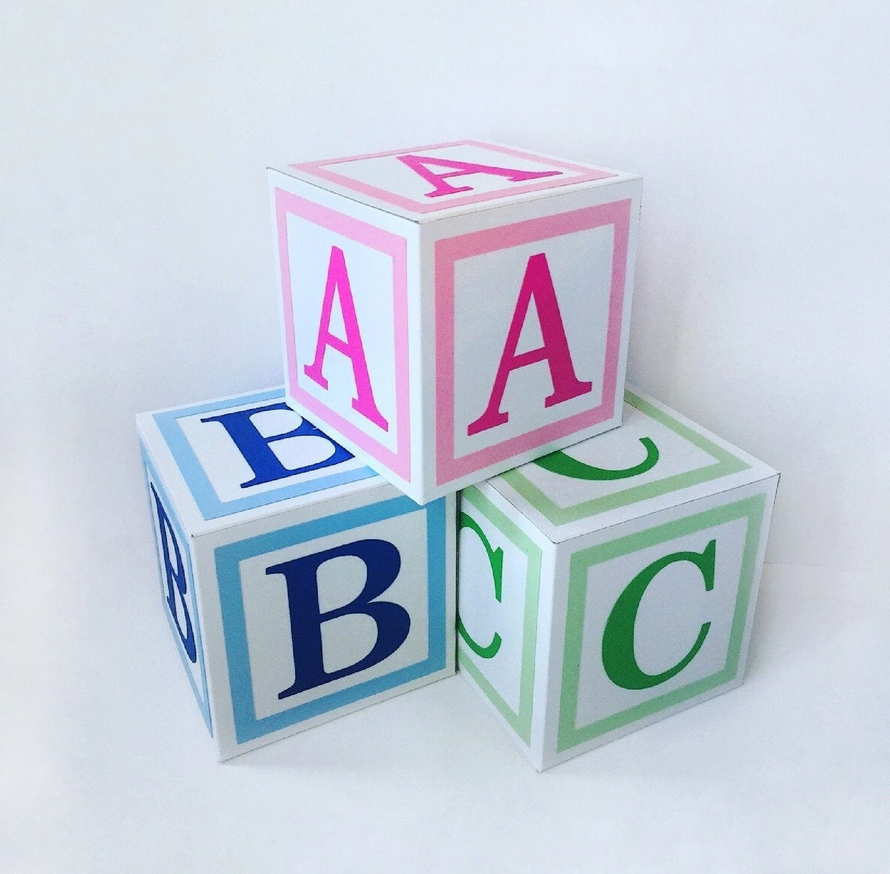
Assessment
Airway/Access
Breathing
Circulation/C-spine immobilization
Disability (GCS & neuro exam)
Exposure/environment
Frequency (POCUS)
Glucose

Slide 7
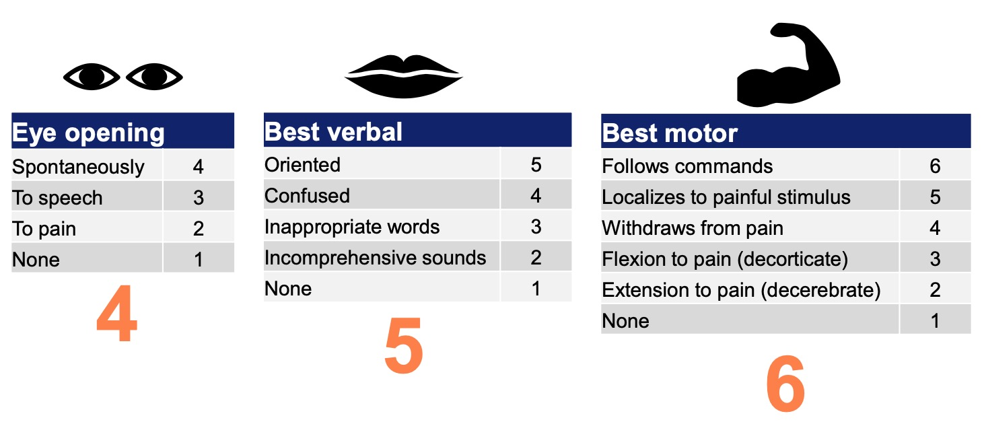
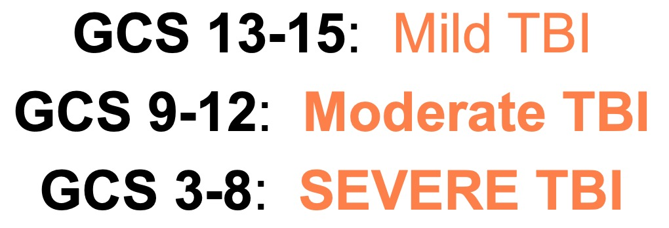
Glasgow Coma Scale

Slide 8
Traumatic Brain Injury
Is a heterogeneous disease

Slide 9
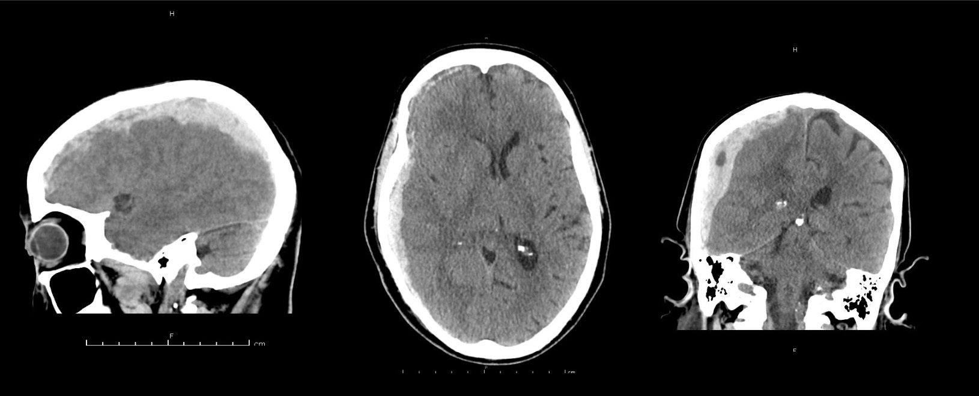
Notes:
Subdural Hematoma
Homogenous hyperdense concave or crescent-shaped mass that cross suture lines

Slide 10
Subdural Hematoma
Notes:
Subdural Hematoma
Homogenous hyperdense concave or crescent-shaped mass that cross suture lines

Slide 11
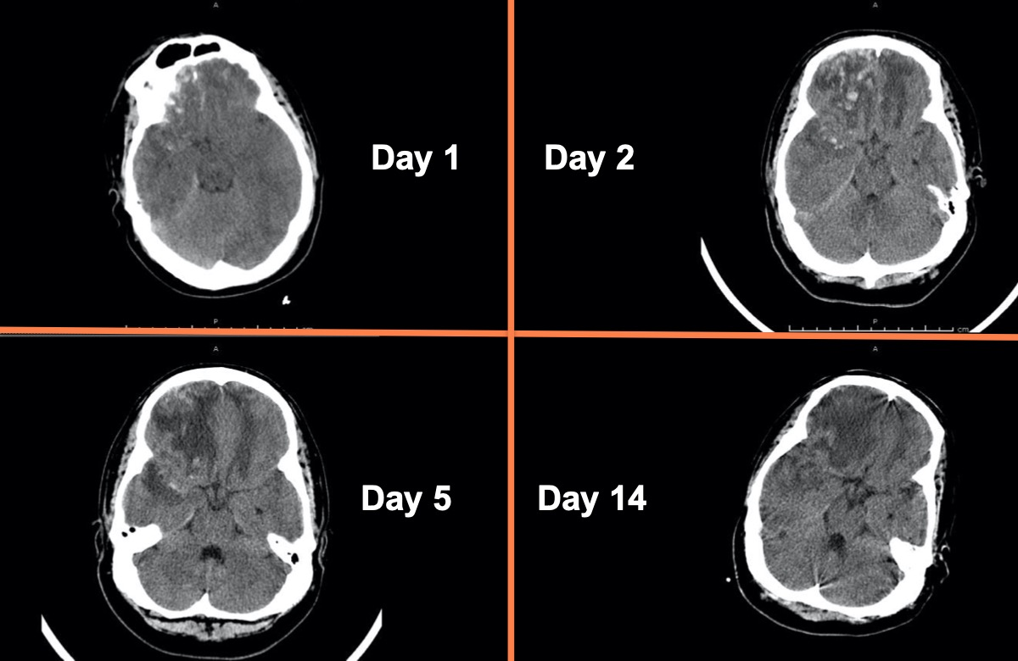
Notes:
“Salt and pepper” appearance with mixed density acute blood. Typically seen in the frontal or anterior temporal lobes

Slide 12
Hemorrhagic cerebral contusion
Notes:
“Salt and pepper” appearance with mixed density acute blood. Typically seen in the frontal or anterior temporal lobes

Slide 13
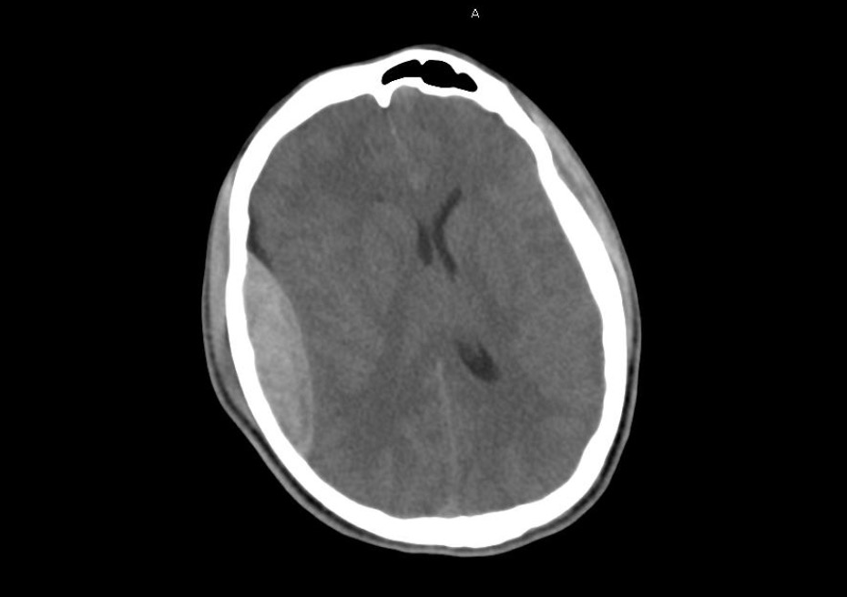
Notes:
Lentiform and does not cross suture lines

Slide 14
Epidural Hematoma
Notes:
Lentiform and does not cross suture lines

Slide 15
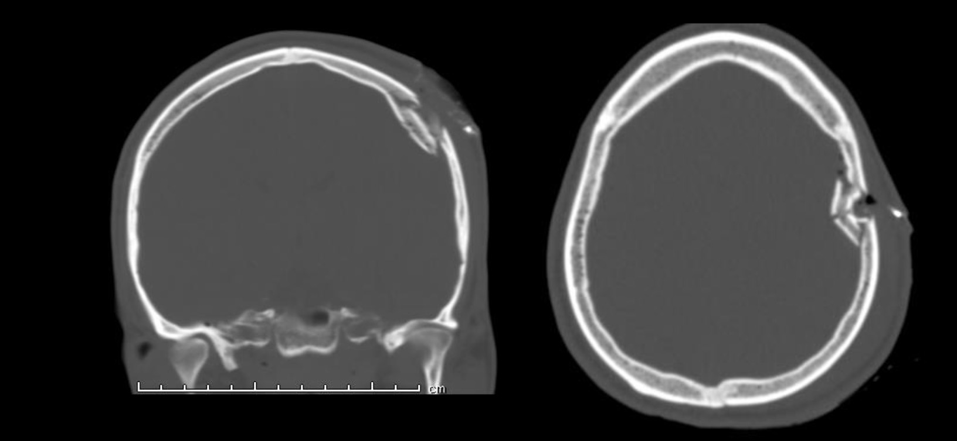
Notes:
Depressed skull fracture, might see intracranial air

Slide 16
Depressed Skull Fracture
Notes:
Depressed skull fracture, might see intracranial air

Slide 17
Initial Interventions for TBI
Keep head of bed ≥ 30 degrees
Avoid jugular vein compression
Use Normal Saline as primary fluid; avoid hypotonic fluids
Sedation if needed
Prophylactic anticonvulsants, usually levetiracetam (Keppra)
Mannitol, hypertonic saline for signs of herniation
Consider ICP monitoring
Maintain CPP 60-70 mmHg
Steroids are contraindicated

Slide 18
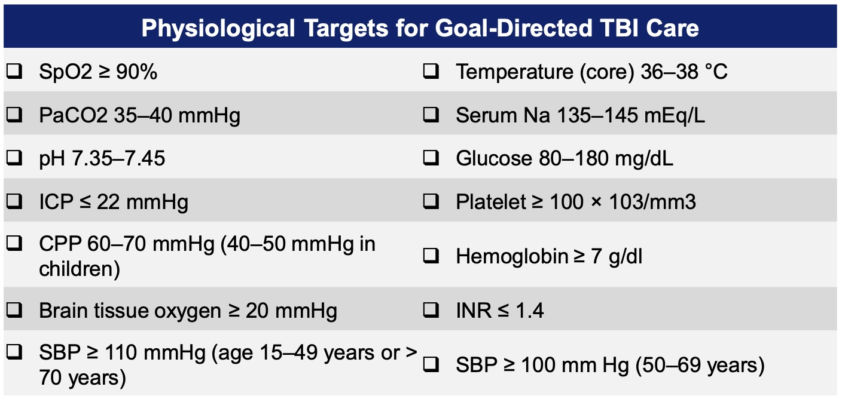
TBI – Initial Interventions

Slide 19
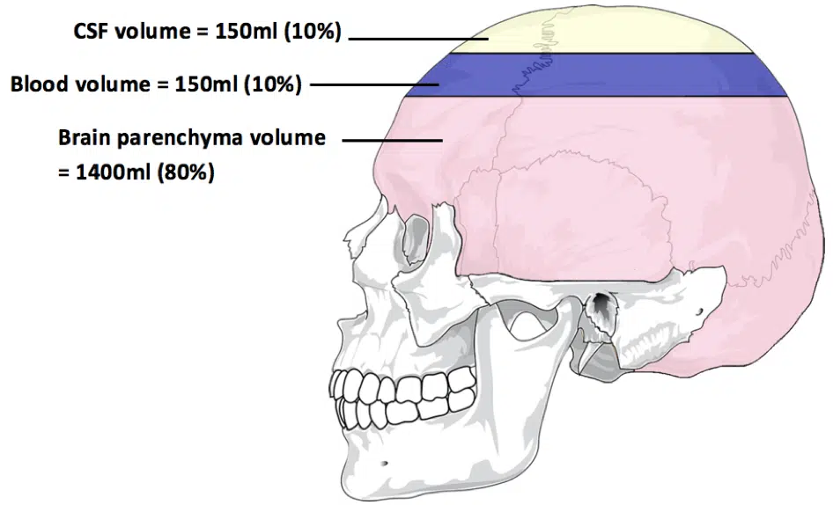
Monro-Kellie Doctrine

Slide 20
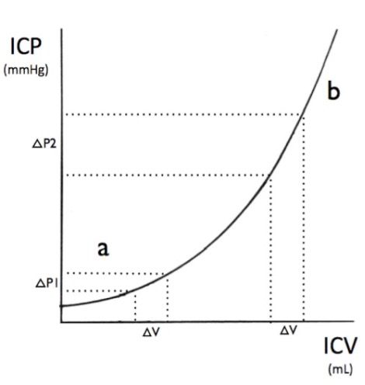
Monro-Kellie Doctrine
Monro-Kellie hypothesis: ICP is the sum of pressures from the intracranial vault contents
  Blood, CSF, and tissue
  ICP rises after 150 mL of additional volume is added
    An increase in venous and CSF outflow allows for initial compensation but can become overwhelmed, producing an abrupt increase in ICP
Elevated ICP: ICP > 22 mmHg sustained for > 5 min
Cerebral PERFUSION pressure CPP = MAP - ICP

Slide 21
Management of Elevated ICP
Elevated ICP: ICP > 22 mmHg sustained for > 5 min
Refer to CPG.113
ICU Management of Patients with
Severe Traumatic Brain Injury
3-Tiered Approach

Slide 22
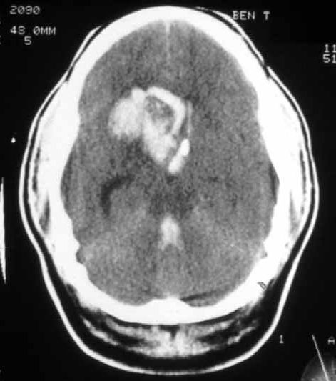
Rapid fire cases
70 year old hypertensive man with sudden onset of left hemiparesis
BP 170/102 mmHg
Notes:
Diagnosis: Intracerebral Hemorrhage

Slide 23
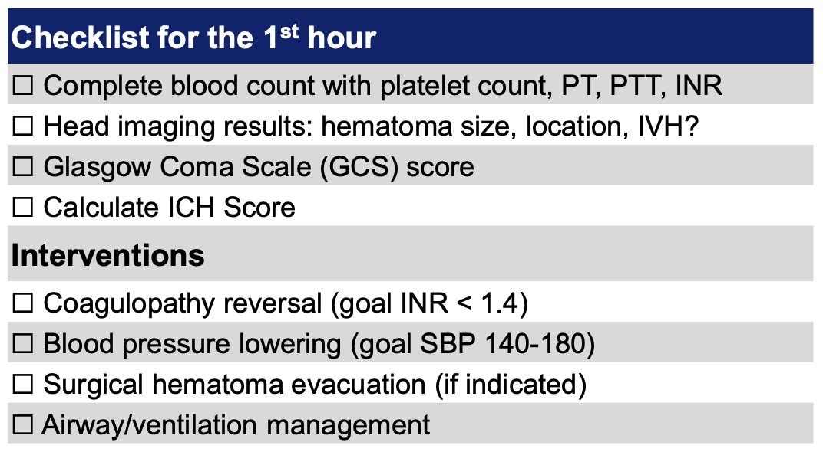
Intracerebral Hemorrhage
Start with ABCs

Slide 24
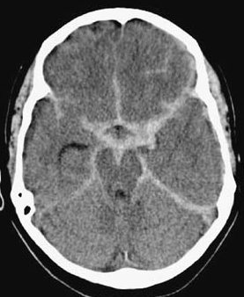
Rapid fire cases
39 year old woman presents with severe headache, uncertain time of onset, +nausea. Takes warfarin.
BP 170/95, RR 24, HR 98
Exam: Sleepy, yet follows commands, left eye droop and dilated pupil, moving all extremities
Notes:
Diagnosis: Subarachnoid Hemorrhage

Slide 25
Subarachnoid Hemorrhage
Abrupt severe onset of headache (thunderclap headache)
Perform LP if HCT is negative and history is suggestive for SAH.
  Xanthrochromia and elevated RBC count is pathognomonic.
Correct coagulopathy if present
Treat hydrocephalus if present
Monitor for rebleeding
Target SBP < 160 mmHg
Aneurysm treatment within first 24 hours
Initiate enteral nimodipine within 24 hours of admission

Slide 26
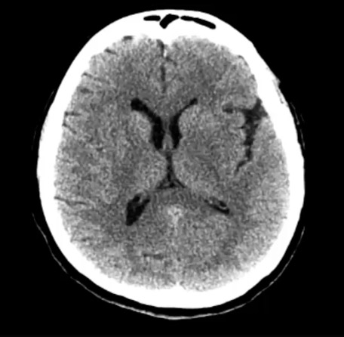
Rapid fire cases
65 year old right handed man with a history of HTN and HLD presents to the ED in a delayed fashion after the sudden onset of right sided weakness.
He was last seen normal at 1pm and it is now 6pm
BP 160/90, HR 95, RR 18, SpO2 98%
Exam shows an expressive aphasia, R face and arm weakness, R visual field cut and L gaze deficit
Notes:
Diagnosis: Acute Ischemic Stroke

Slide 27
Acute Ischemic Stroke
You are 5 hours out from initial symptoms
CTA reveals LVO
What is your treatment plan?
IV t-PA alone
IV t-PA followed by embolectomy
Embolectomy alone
IV heparin
Antiplatelets

Slide 28
Acute Ischemic Stroke
You are 5 hours out from initial symptoms
What is your treatment plan?
IV t-PA alone
IV t-PA followed by embolectomy
Embolectomy alone
IV heparin
Antiplatelets

Slide 29
Acute Stroke Timeline
Time of onset = Last Known Well (LKW) time
Head imaging = CT, CTA, and CTP
Mechanical embolectomy for some
IV-tPA
6 – 24 hrs
0 – 4.5hrs
0 - 6hrs
6 - 24hrs
Mechanical embolectomy for all

Slide 30
Management of acute stroke
BP management
  If no stroke intervention: permissive HTN for 24-48hrs, BP < 220/110
  If thrombolysis performed: BP < 180/105 for first 24hrs
  After thrombectomy: Lower BP goal (SBP < 160) if recanalized to reduce risk of hemorrhagic transformation
  Avoid hypotension: use NS and vasopressors as needed
If t-PA is given:
  No anticoagulation or antiplatelets for 24hrs
  Avoid placing lines and tubes for 4hrs
    I.E., indwelling urinary catheters, NGT/OGT, and intra-arterial catheters

Slide 31
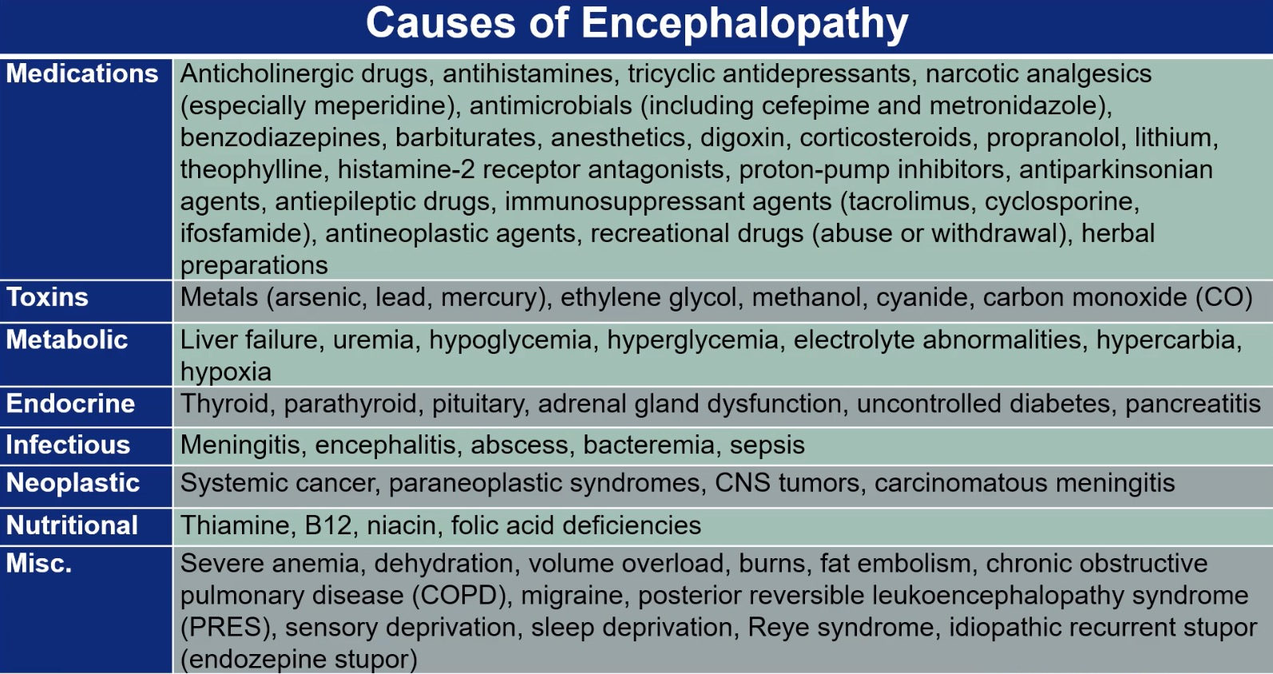

Slide 32
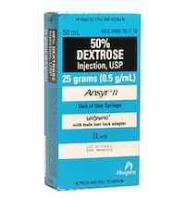
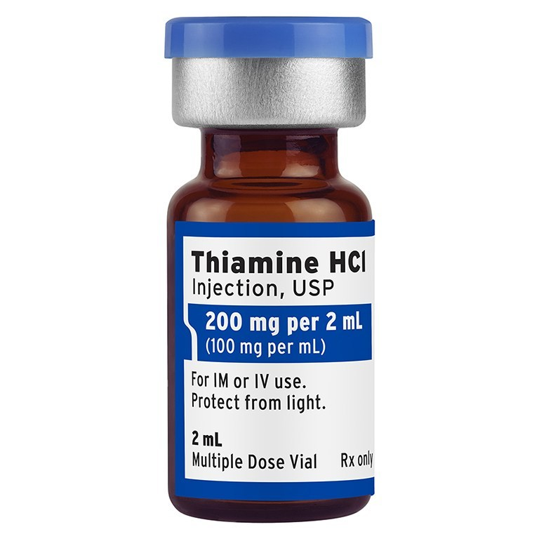
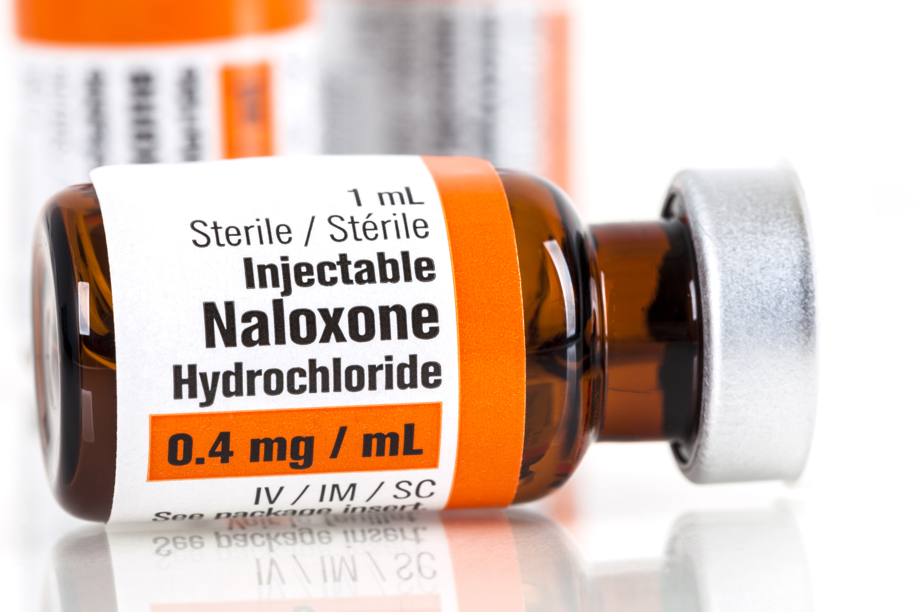
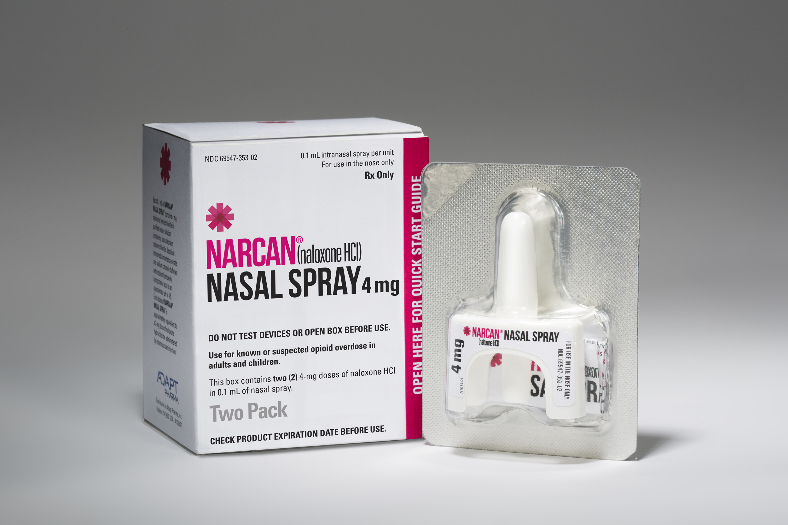
Metabolic and Toxins
If opiate overdose is a concern
Hypoglycemia
Wernicke’s: Give thiamine before dextrose in at-risk patients

Slide 33
Metabolic and Infectious Disorders
A 24-year-old man presents with progressive altered mental status, headache, and difficulty talking.
Difficult to arouse and non-verbal
T 101˚F, HR 112, BP 124/70, RR 24
Not following commands
Not withdrawing his left arm, except to painful stimuli
Has a focal seizure in the ED
Notes:
Diagnosis: Acute bacterial or viral meningitis

Slide 34
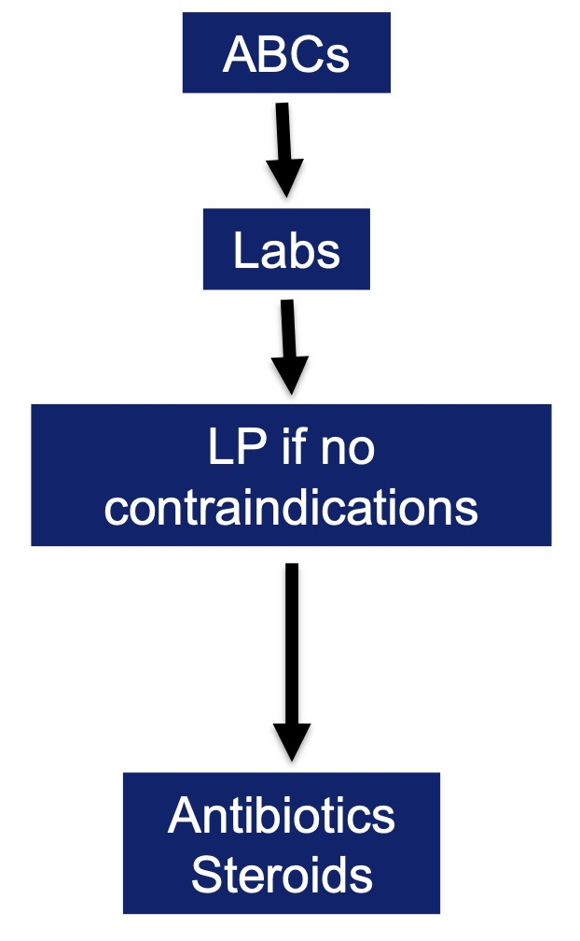
Metabolic and Infectious Disorders
A 24-year-old man presents with progressive altered mental status, headache, and difficulty talking.
Difficult to arouse and non-verbal
T 101˚F, HR 112, BP 124/70, RR 24
Not following commands
Not withdrawing his left arm, except to painful stimuli
Has a focal seizure in the ED
Notes:
Diagnosis: Acute bacterial or viral meningitis

Slide 35
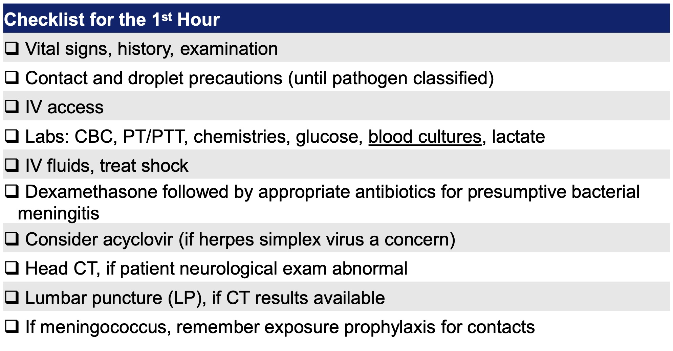
Metabolic and Infectious Disorders
Diagnosis: Acute bacterial or viral meningitis

Slide 36
Seizures
A 21-year-old with a subdural hematoma develops generalized seizures
What do you do?
How do you define status epilepticus?
5 minutes or more of:
Continuous seizure activity, OR
Recurrent seizure activity without return to baseline

Slide 37
Acute management of seizures

Slide 38
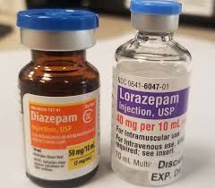
Acute management of seizures

Slide 39
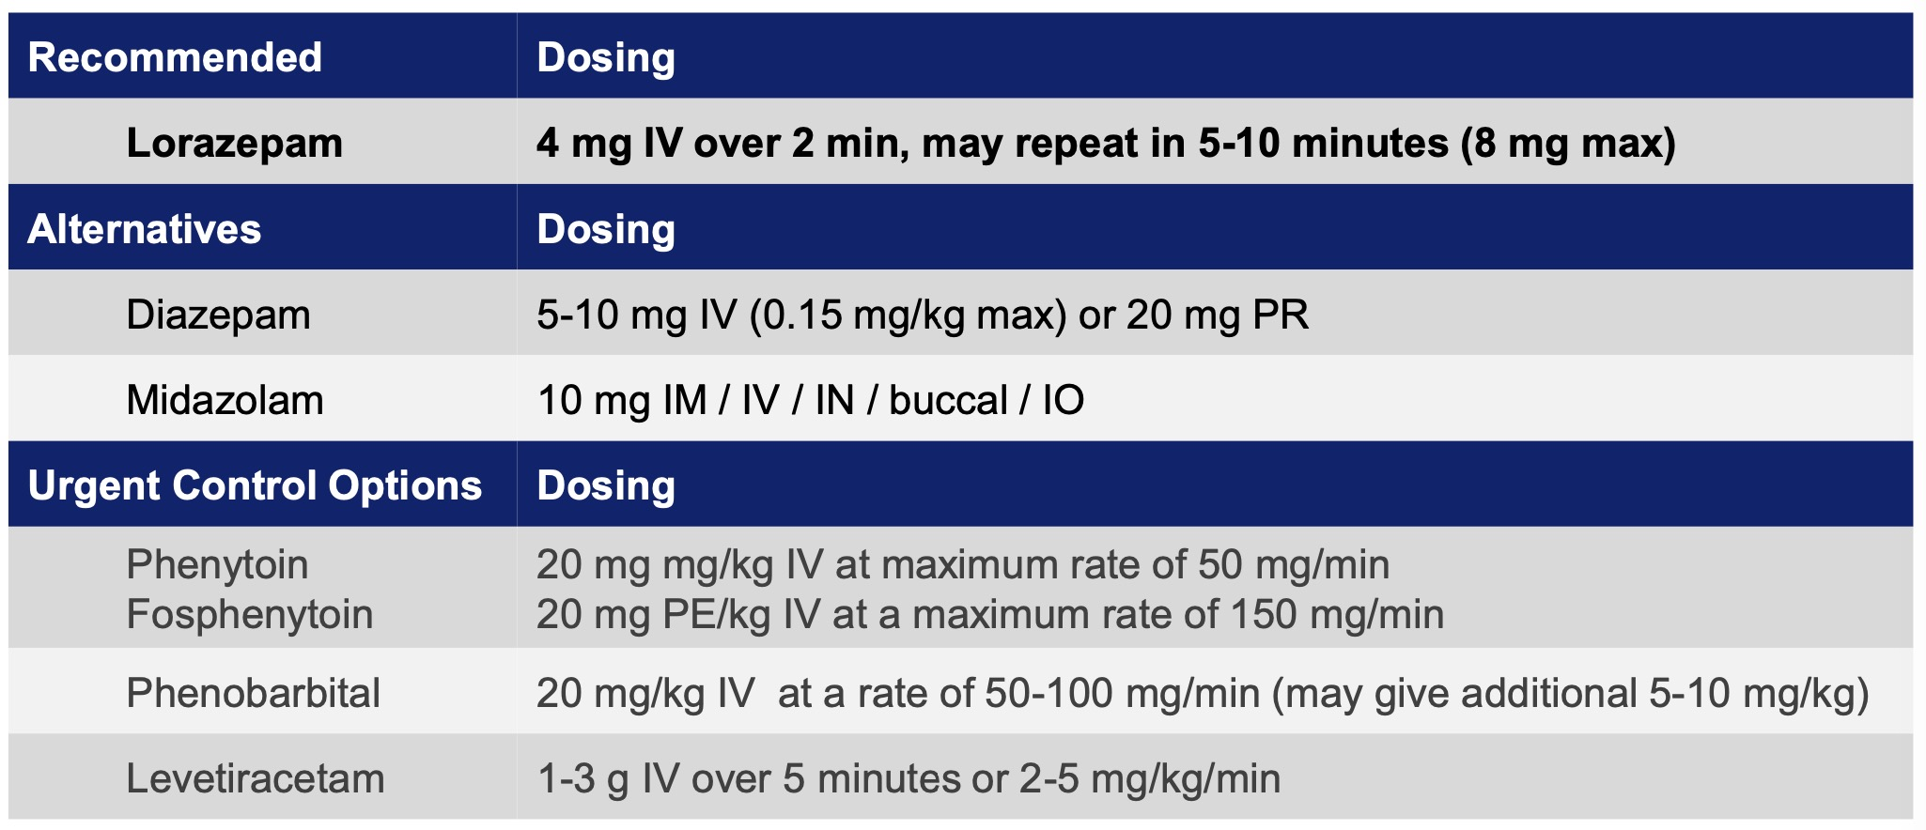
Acute management of seizures

Slide 40
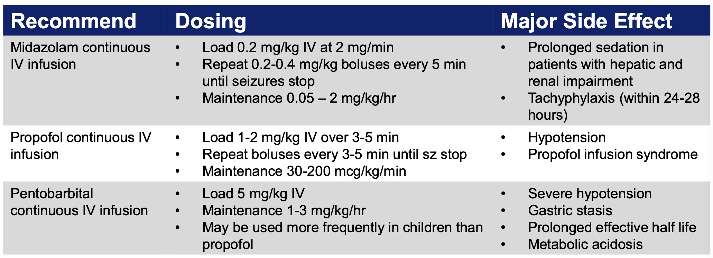
Treatment of Refractory SE

Slide 41
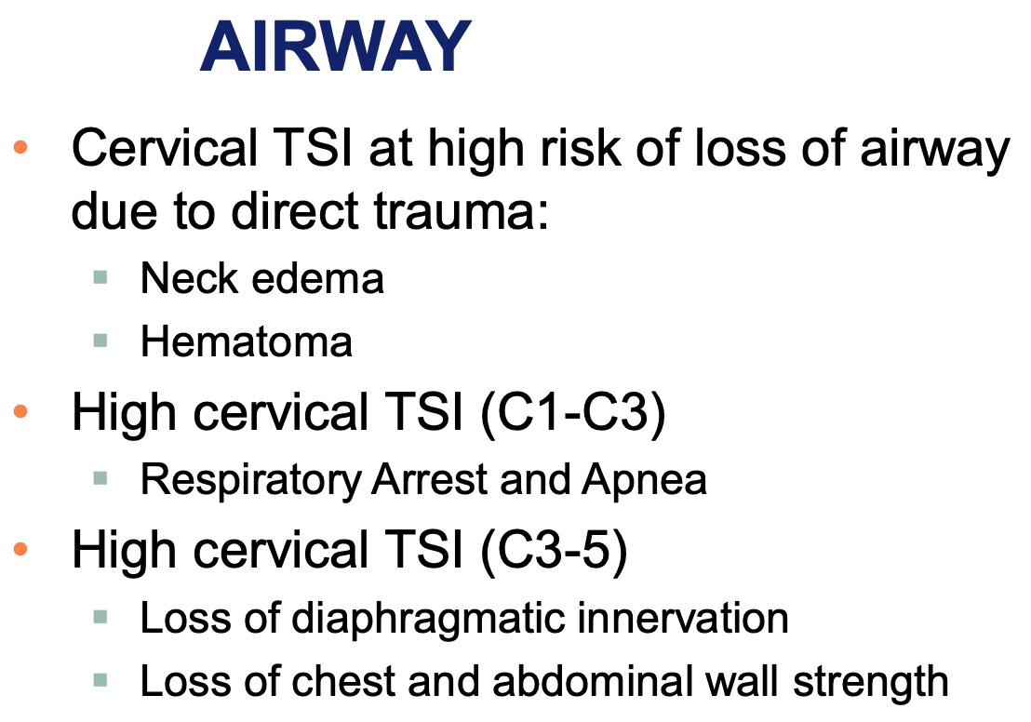
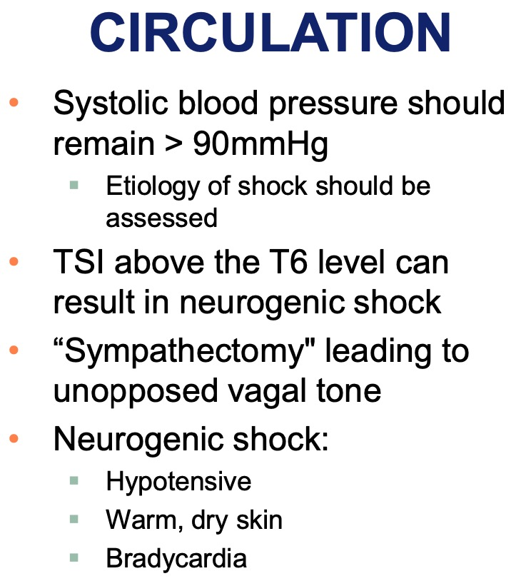
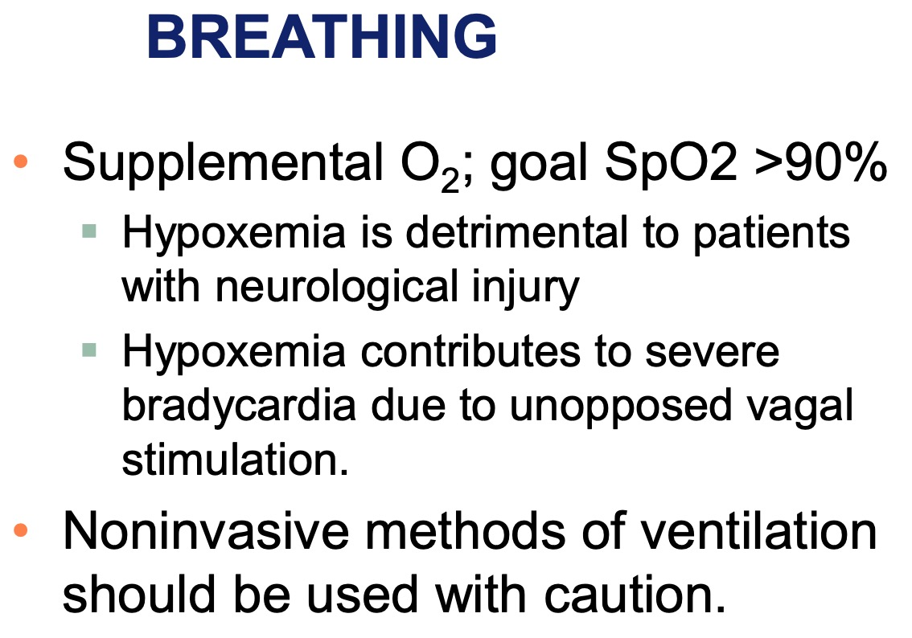
Spinal Cord Injury

Slide 42
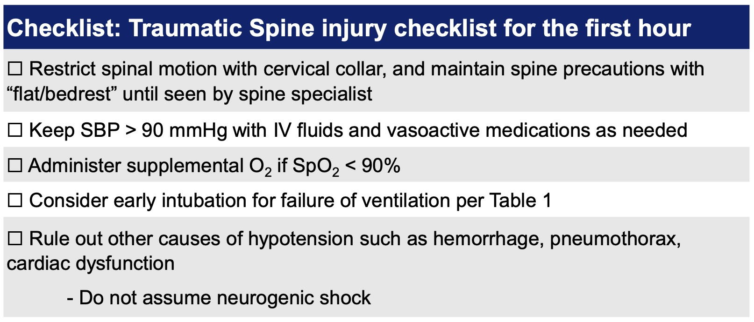
Spinal Cord Injury

Slide 43
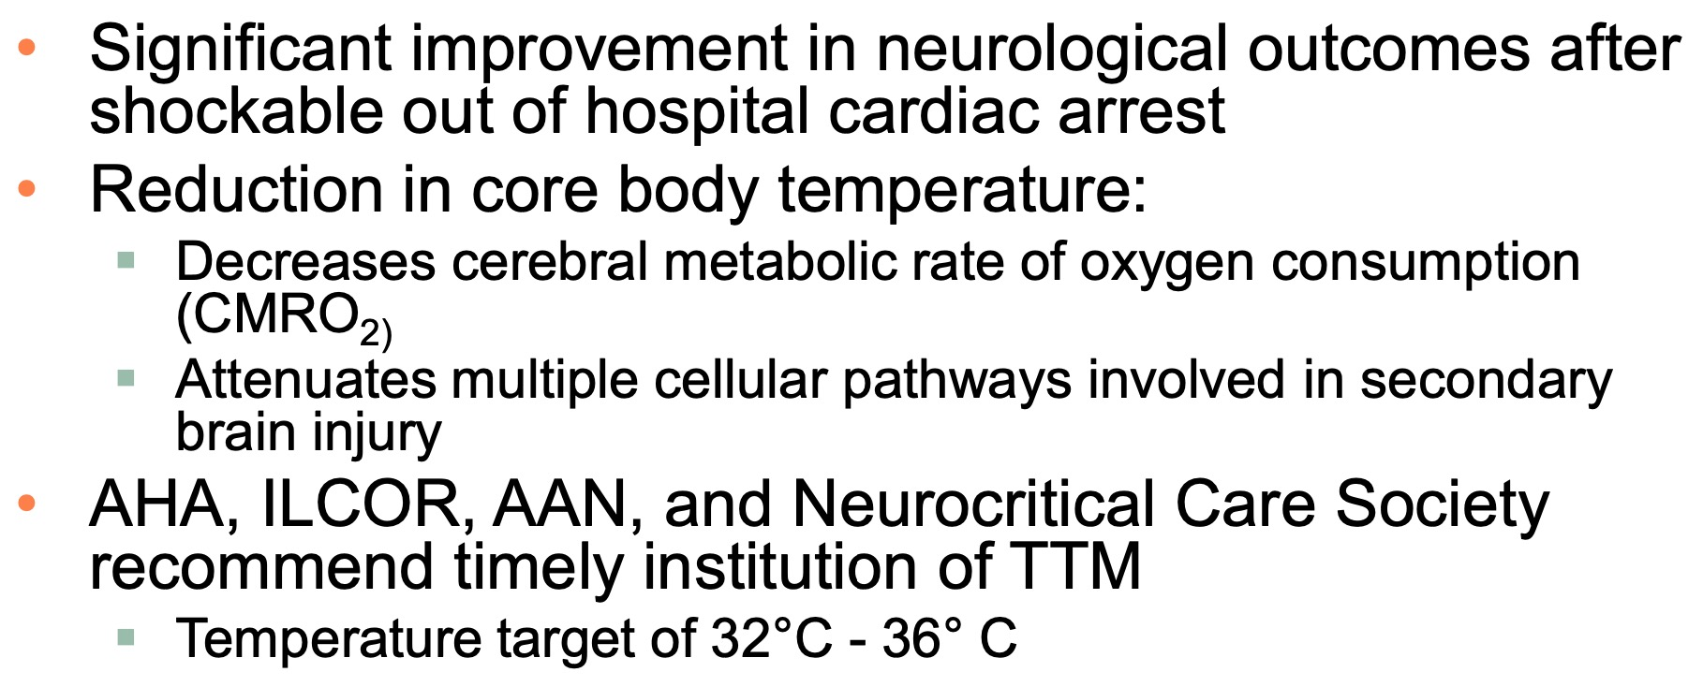
Targeted Temperature Management

Slide 44
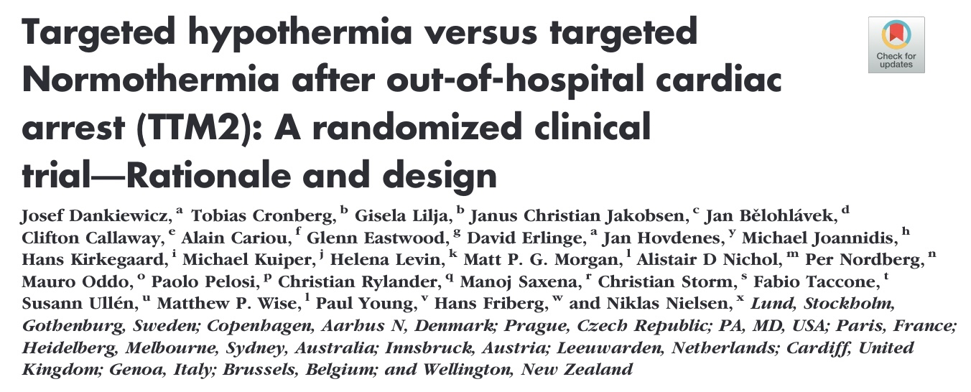
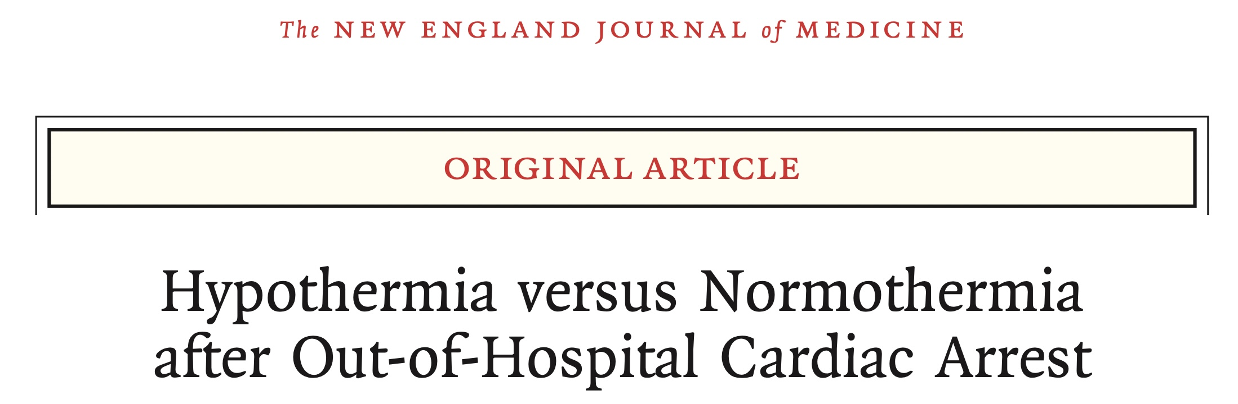
But then came TTM2

Slide 45
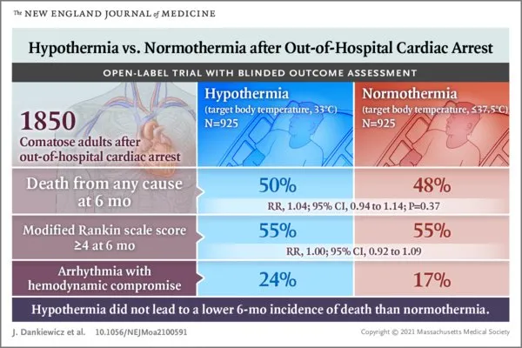
TTM2
Now recommend targeting normothermia and employing TTM for temperature > 37.8°C

Slide 46
Take away points
Brain injury occurs from a primary insult and secondary injury
Minimizing and preventing secondary brain injury is key
BP management is dependent on the initial brain injury
Use goal-directed TBI care. Utilize checklists.
Benzos for acute seizure and load with antiepileptic such as levetiracetam (Keppra)
TTM after shockable cardiac arrest targeting a temperature of 32°C – 36°C for the FCCS and the test
  BUT TTM2 argues for normothermia and TTM for T > 37.8°C

