Slide 1
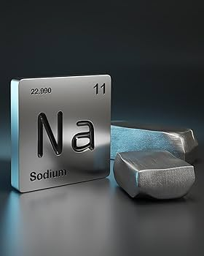

Slide 2
Hyponatremia
&
Hypernatremia

Slide 3
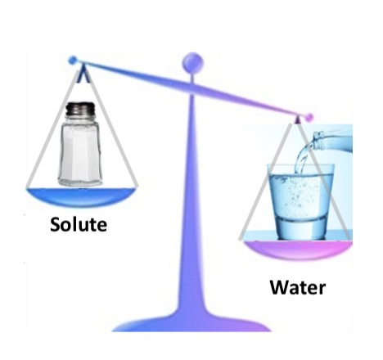
Disorders of Water Metabolism

Slide 4
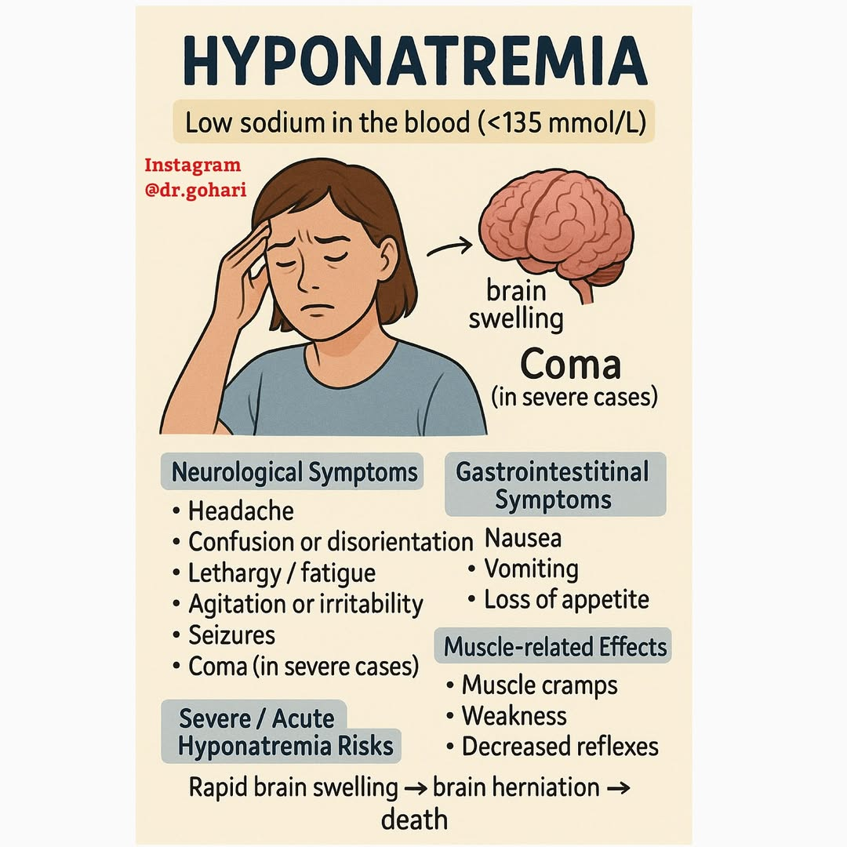

Slide 5
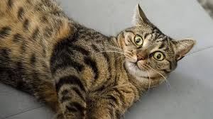

Slide 6
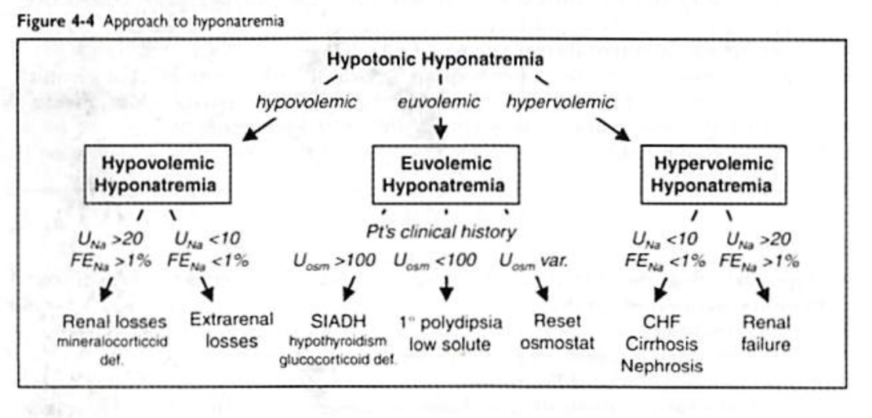

Slide 7
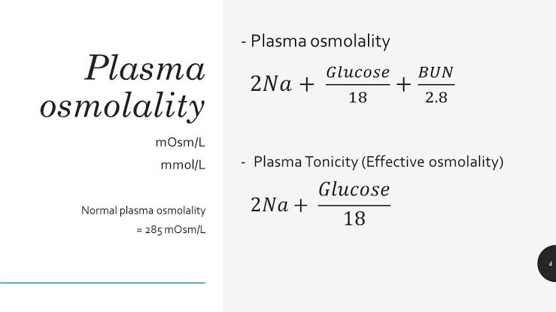

Slide 8
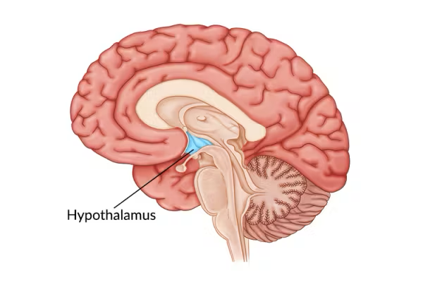
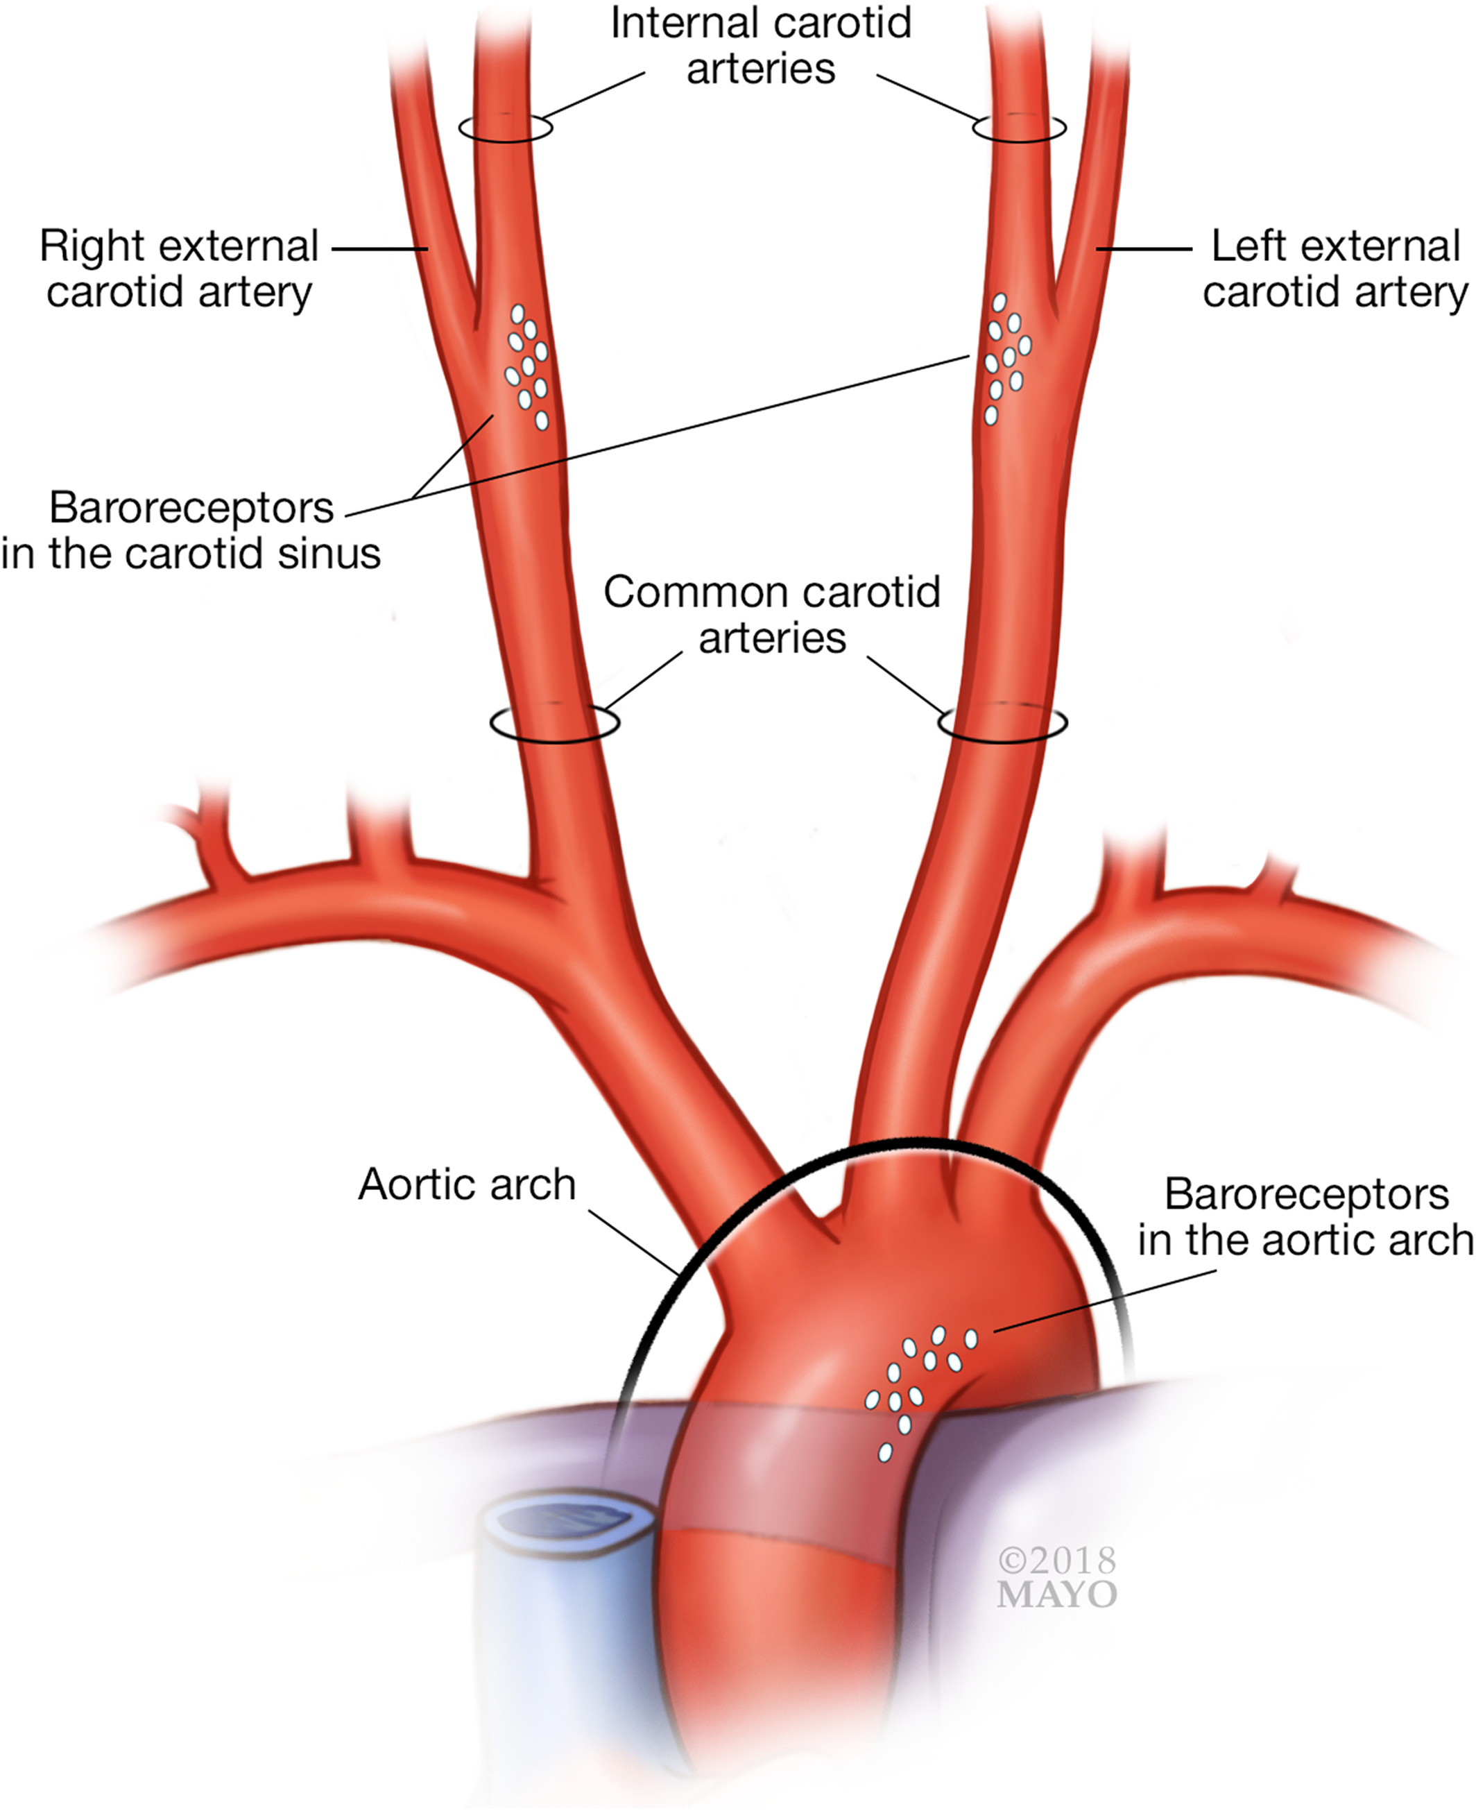
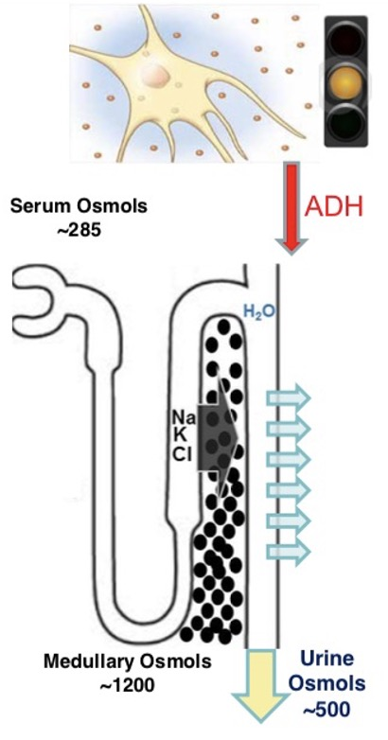
~ Serum osmolality
Water Metabolism
~ Effective Arterial Volume (EAV)
Osmoreceptors
Baroreceptors
ADH Nuclei
“adding hydration”
~ EAV
Collecting Ducts
~ Urine Osmolality

Slide 9
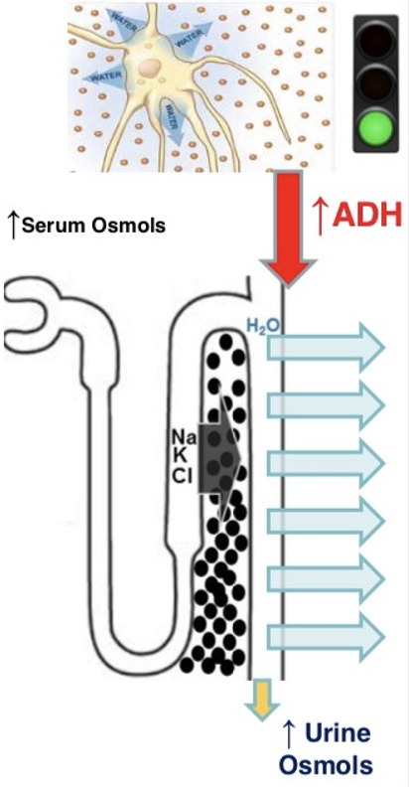
↑ Serum osmolality
Water Metabolism
↓ Effective Arterial Volume (EAV)
Osmoreceptors
Baroreceptors
ADH Nuclei
“adding hydration”
↓ EAV
Collecting Ducts
↑ Urine Osmolality

Slide 10

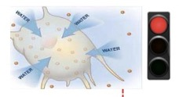
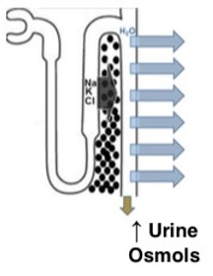
↓ Serum osmolality
Water Metabolism
↓ Effective Arterial Volume (EAV)
Osmoreceptors
Baroreceptors
No ADH
ADH Nuclei
“adding hydration”
↓ EAV
Collecting Ducts
↑ Urine Osmolality

Slide 11
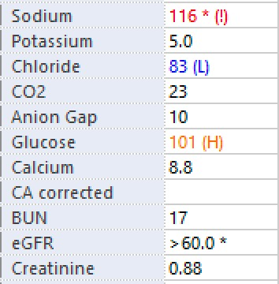

Slide 12
So your patient has hyponatremia
Good history & physical exam
    Med list (psych meds, diuretics, opioids, illicit drugs)
    Volume status
    Consider rechecking Na level to confirm
    If suspect endocrine cause, check TSH, cortisol
Check serum osmolality
  Is hypoNa true or false?
  Hypotonic (<280), isotonic (280-300), hypertonic (>300)
Check urine osmolality
  Assess ADH activity
  If low (<100-200), ADH is inactive, skip step 4, and eval for ADH independent causes
If ADH is active (urine osm > 100-200), and eval for ADH dependent causes
  Is ADH appropriate or inappropriate?
  Assess Effective Arterial Volume (EAV)
    UNa, BUN/Cr, Hct, FeNa, FeUrea, FeUric Acid, ?Hemoconcentration, ?Response to NS
Diagnose & Treat
Confirm:
Low serum osm
Assume:
No elevated glucose, protein, lipids

Slide 13
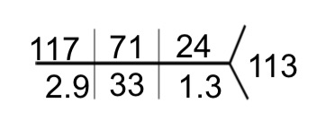
Case
72F h/o tobacco use
Depression on SSRI
HTN on HCTZ
Mild memory impairment
Recent N/V/D, wt loss
Admitted with AMS, falls
Appears frail, dry, no edema
Serum Osm 258
Urine Osm 660
Ur sp grav 1.021
TSH 3.8
AM cortisol 21
Ca 10.1, Alb 4.3, Hct 48
Urine Na 41 mEq/L
Urine Cr 40
Urine Urea 200
Serum uric acid 6.8 (2.3-6.6mg/dL)
Urine uric acid 17
Fe Na 1.1%
Fe Uric acid 6.5%
Fe Urea 27%

Slide 14
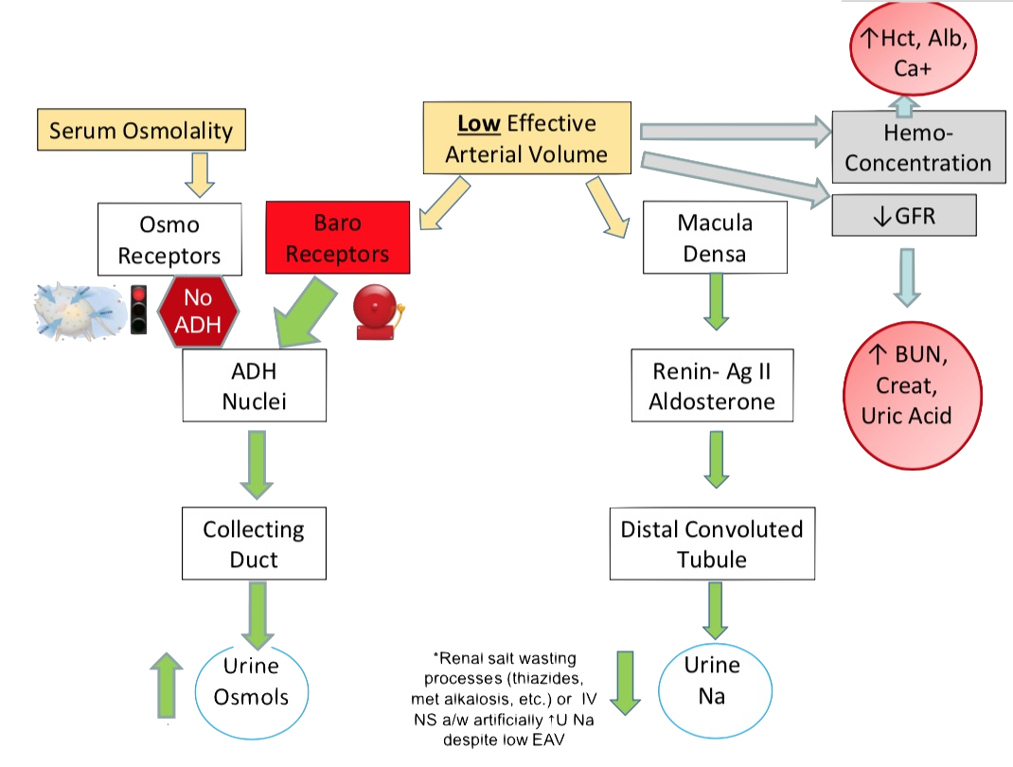
Baroreceptors > Osmoreceptors

Slide 15
Case
72F h/o tobacco use
Depression on SSRI
HTN on HCTZ
Mild memory impairment
Recent N/V/D, wt loss
Admitted with AMS, falls
Appears frail, dry, no edema
Serum Osm 258
Urine Osm 660
Ur sp grav 1.021
TSH 3.8
AM cortisol 21
Ca 10.1, Alb 4.3, Hct 48
Urine Na 41 mEq/L
Urine Cr 40
Urine Urea 200
Serum uric acid 6.8 (2.3-6.6mg/dL)
Urine uric acid 17
Fe Na 1.1%
Fe Uric acid 6.5%
Fe Urea 27%

Slide 16
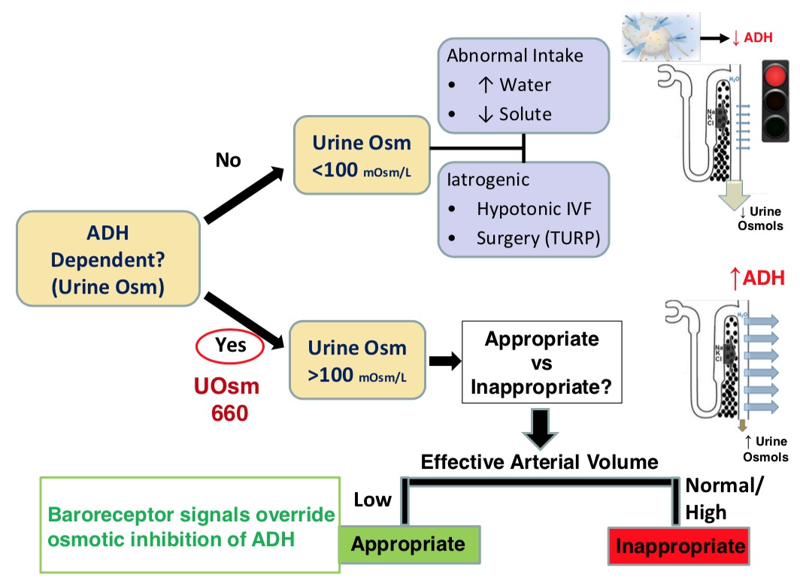
Is ADH active?

Slide 17
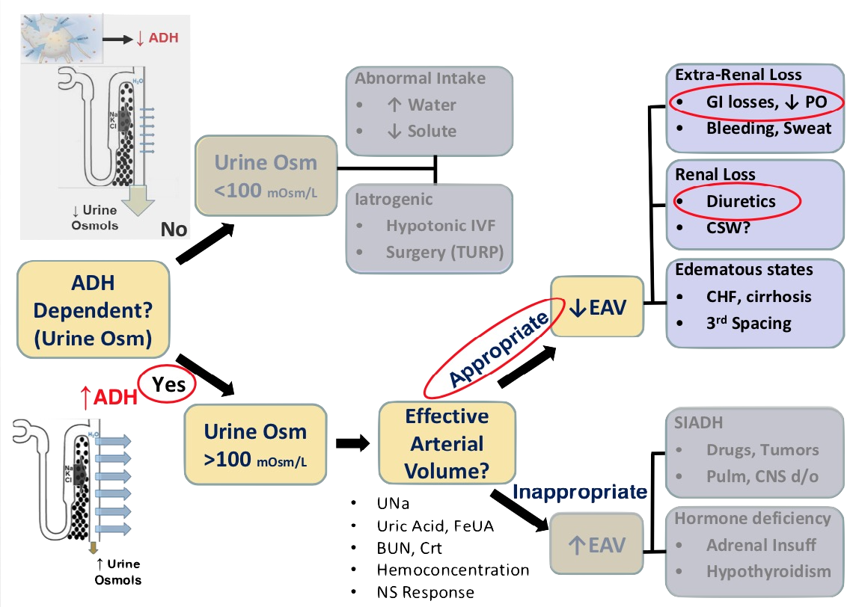
Hypotonic Hyponatremia
Nephrotic syndrome
ESRD
Is ADH appropriate or inappropriate?

Slide 18
Hyponatremia
72F h/o tobacco use
Question
Depression on SSRI
HTN on HCTZ
Mild memory impairment
Recent N/V/D, wt loss
Admitted with AMS, falls
Appears frail, dry, no edema
What is the best test to determine the cause of her hyponatremia?
Urine Na
Renin & Aldosterone
Fe Uric Acid
Fe Urea
ACTH
Urine Na 41 mEq/L
Urine Cr 40
Urine urea 200
Serum uric acid 6.8 (2.3-6.6mg/dL)
Urine uric acid 17
FeNa 1.1%
Fe Urea 27%
Fe Uric acid 6.5%
Dx: Hypotonic hyponatremia 2.2 low effective arterial volume
Likely from diuretic use, GI illness, decreased PO intake
Tx: HCTZ dc’ed, start IVF

Slide 19
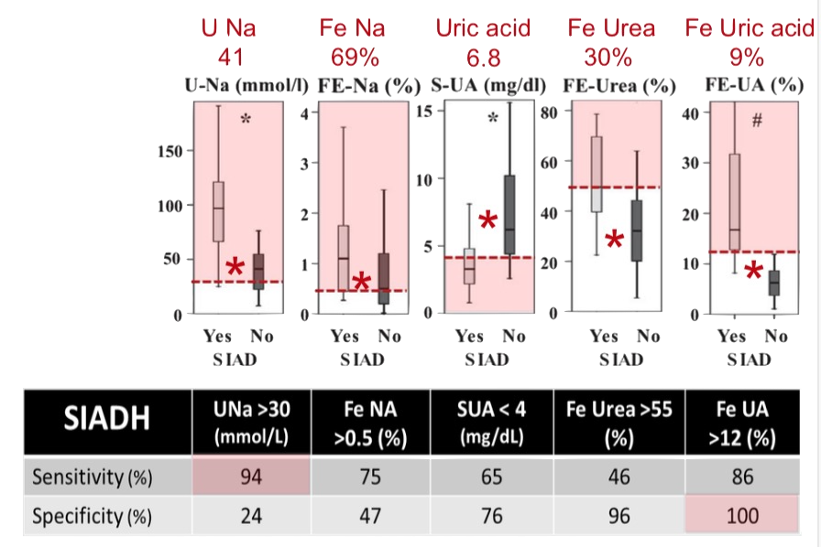
SIADH vs Low EAV with Diuretic Use
In patients on diuretics
- Fe Uric Acid > 12%
Had best discriminant function
Fenske. JECM. 2008

Slide 20
Treatment

Slide 21
HYPONATREMIA ALGORITHM
1. History and Medication List
2. Physical Exam & Volume Status
Check Serum osm
HYPOtonic hypoNa (Sosm < 280)
ISOtonic hypoNa (Sosm ~280-300)
AKA “pseudohyponatremia”:
Hyperproteinemia (myeloma, IVIG), lipemia, hypertriglyceridemia
HYPERtonic hypoNa (Sosm >300)
Hyperglycemia, ↑ osmolal gap (mannitol, sorbitol, IVIG stabilizers)
Check Uosm
ADH Active or Dependent States
Check UNa, UCr, Uurea, Serum uric acid, Urine uric acid, BUN, Cr, Hct
?Hemoconcentration
?Response to NS
Uosm < 100
(ADH inactive)
Uosm > 100
(ADH active)
ADH Appropriate
↓ Effective Arterial Volume (EAV)
UNa, ↑ BUN/Cr, ↑ Hct, FeNa < 1, FeUrea < 35, Ur Acid, FeUA < 10
ADH Inappropriate
↑ Effective Arterial Volume (EAV)
UNa > 30, ~BUN/Cr, ~Hct, FeNa > 1, FeUrea > 35, FeUA > 10
ADH Inactive or Independent States Abnormal Intake
1° polydipsia: psychogenic, marathoners, ecstasy use, multiple tap water enemas, fresh water drowning, dilute infant formula, sodium-free irrigant solutions (hysteroscopy, laparoscopy, TURP)
↓ solute intake: tea & toast, beer potomania
Iatrogenic: Hypotonic IVFs, surgery (TURP)
True hypovolemia (↓TBW, ↓EAV)
Renal losses: Diuretics, *CSW
Extra-Renal Loss: GI losses, ↓PO, bleeding, sweating, adrenal insufficiency
Hypervolemic States (↑ TBW, ↓EAV)
CHF, cirrhosis, nephrotic syndrome, ESRD
3rd spacing (pancreatitis, musc injury, cancer)
Etiology
SIADH: Drugs, meds, tumors/cancers such as small cell carcinoma, lung infections, CNS disease, idiopathic
Hormone deficiency: 2° adrenal insufficiency, severe hypothyroidism
Correct underlying cause
SIADH: fluid restrict (0.8L/d); consider NaCl tabs (1g TID) or if outpatient can Px urea (15-60gm/d); UOsm > 2x Sosm or if Una + UK > SNa → consider Lasix (10-20mg BID; ↓ corticomedullary gradient), vaptans
1° polydipsia: restrict fluids, psych eval/tx
↓ Solute intake: Slow introduction of solute, will correct rapidly, at very high risk for overcorrection
Iatrogenic: DC Hypotonic IVFs
Surgery (TURP): Hypertonic saline
Hypovolemia: Replete volume
Pancreatitis: Replete volume
CHF, nephrosis: Diuresis, HD for ESRD
Cirrhosis: Consider only correcting if Na < 120; fluid restrict, correct hypoK, consider vaptans/HTS only if severe or getting OLT
Treatment

Slide 22
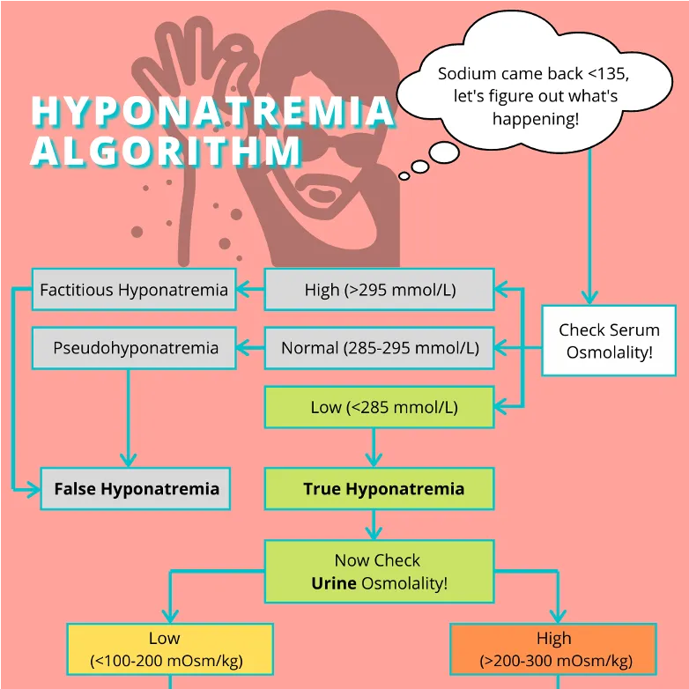

Slide 23
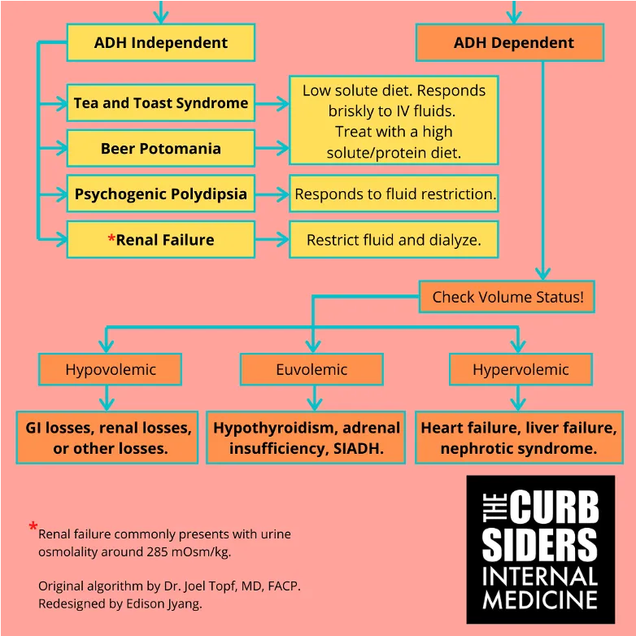

Slide 24
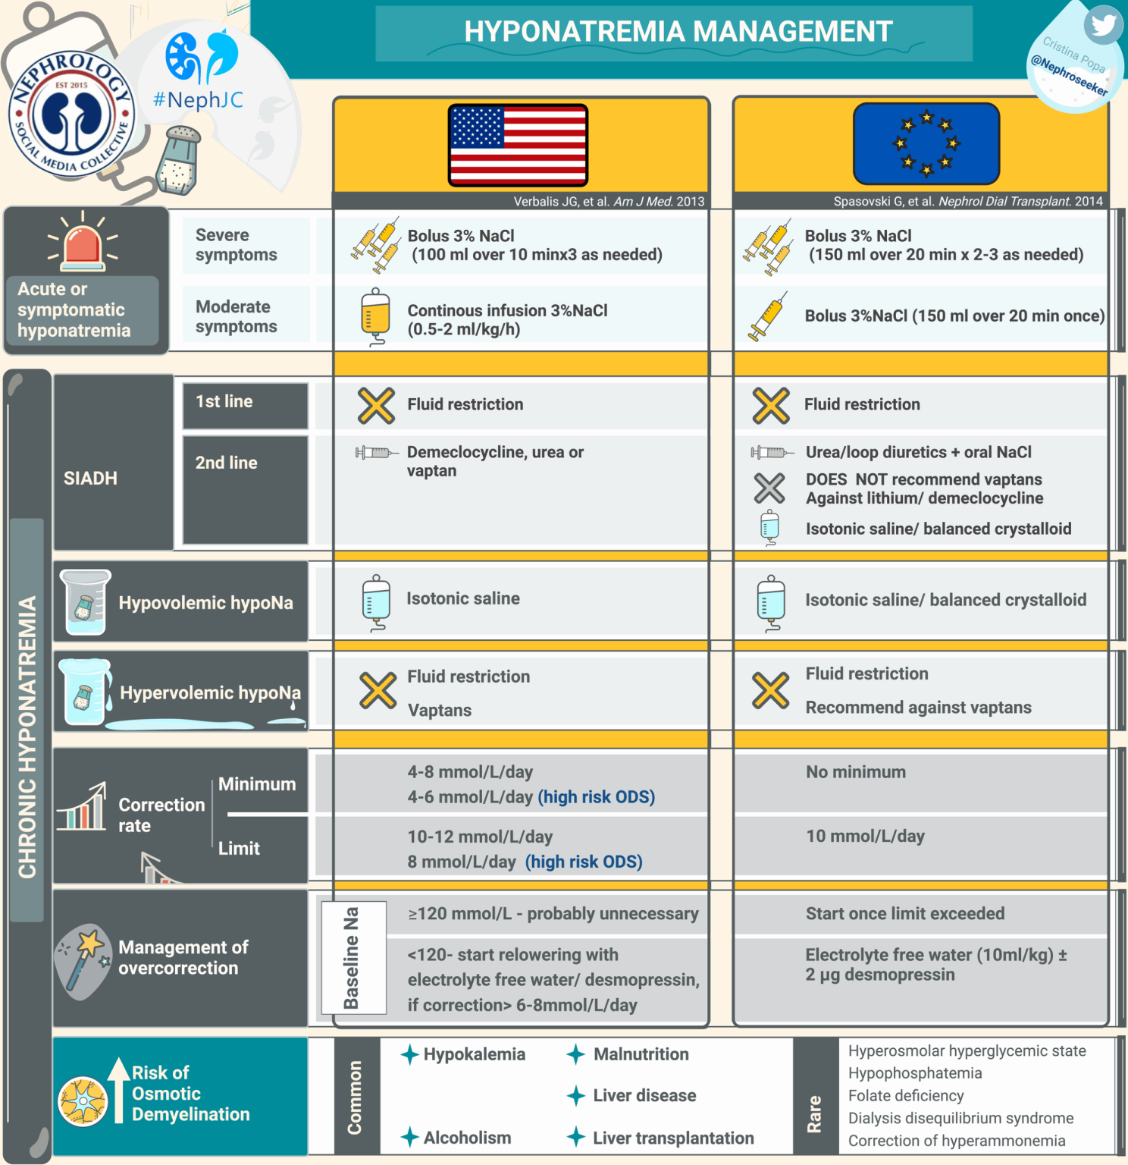

Slide 25
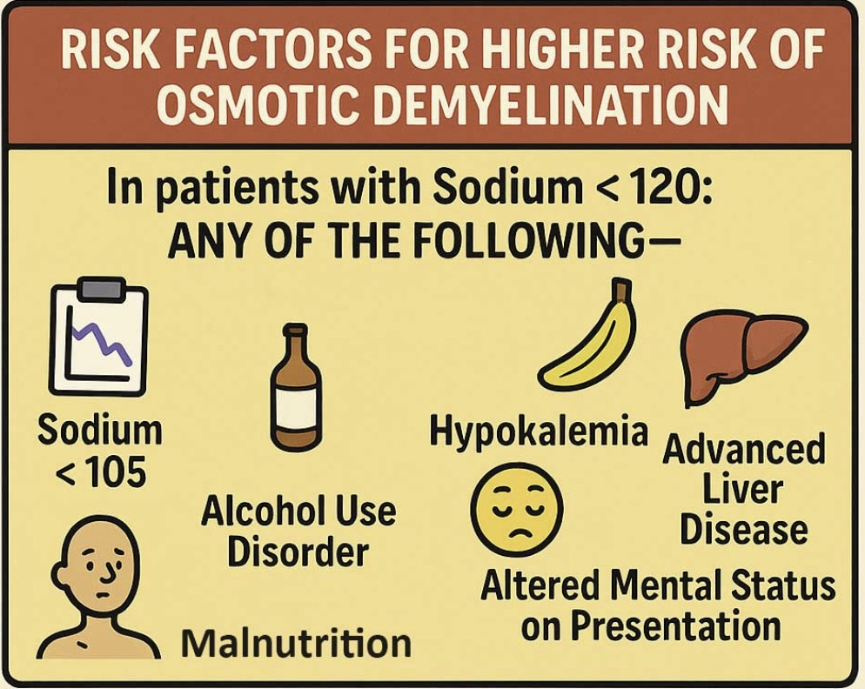

Slide 26
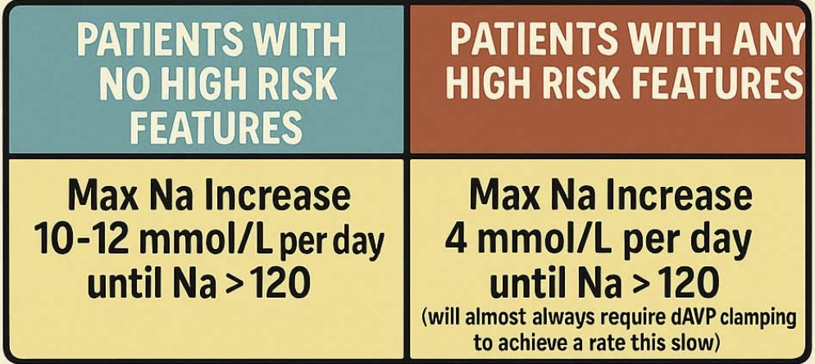

Slide 27
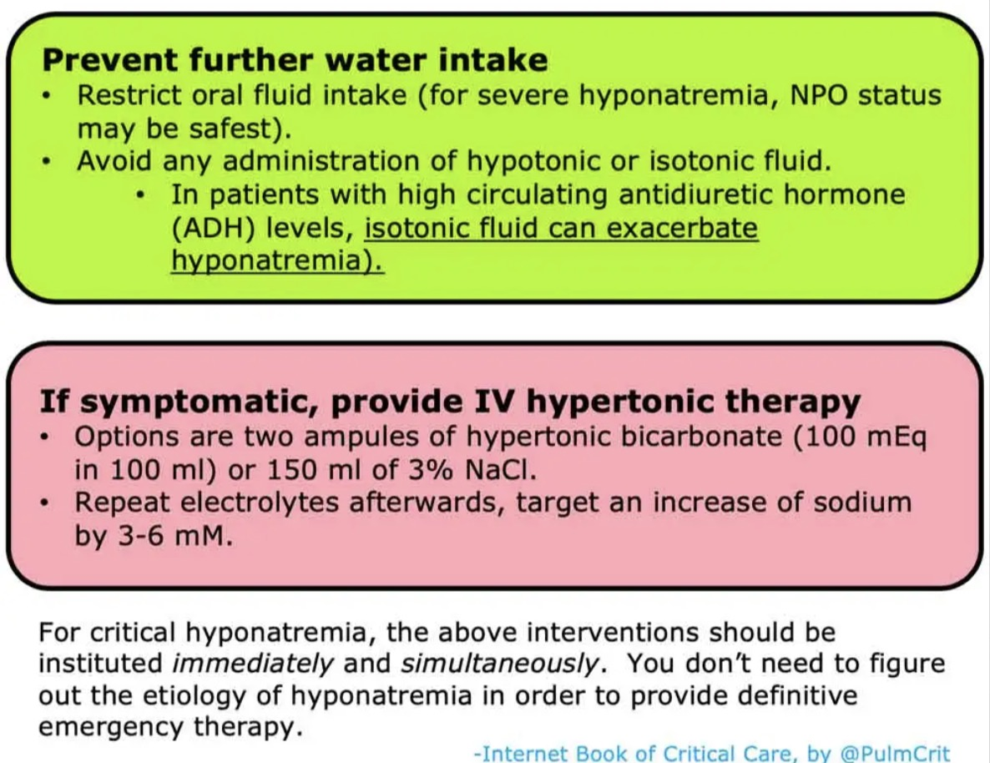
Emergency Treatment

Slide 28
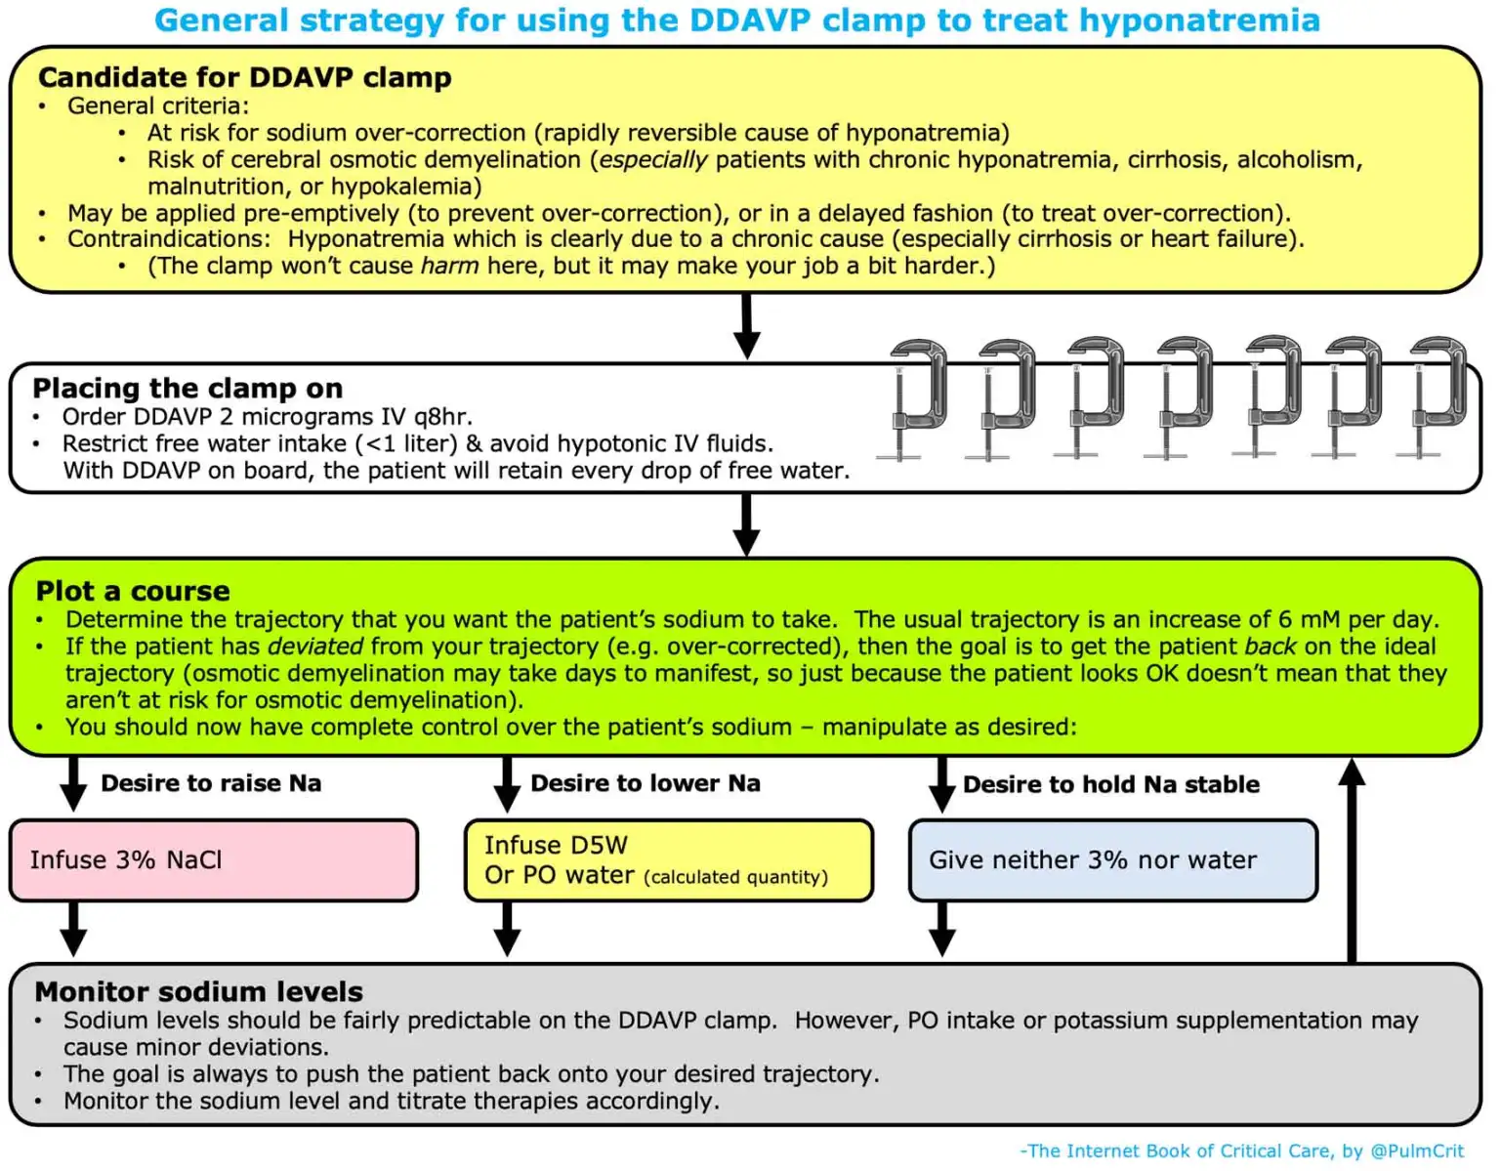
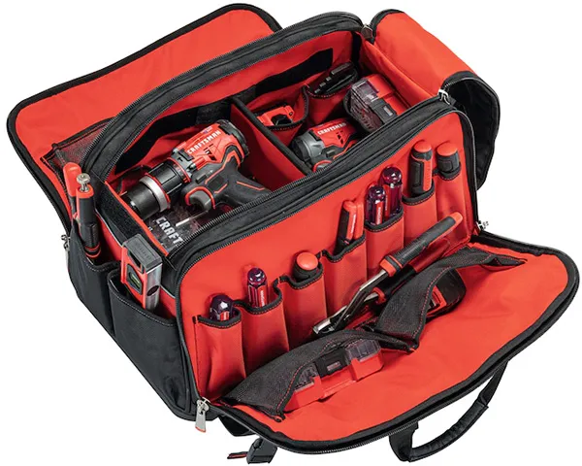
Hyponatremia Toolbag
DDAVP 1-2 mcg IV q8-12hr
3% HTS 0.5-1 ml/kg/hr
D5W
If symptomatic:
3% HTS bolus 100mL
2 amps NaHCO₃
Repeat up to max increase Na of 6 meq

Slide 29
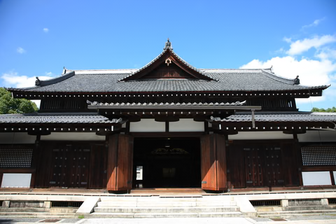

Slide 30
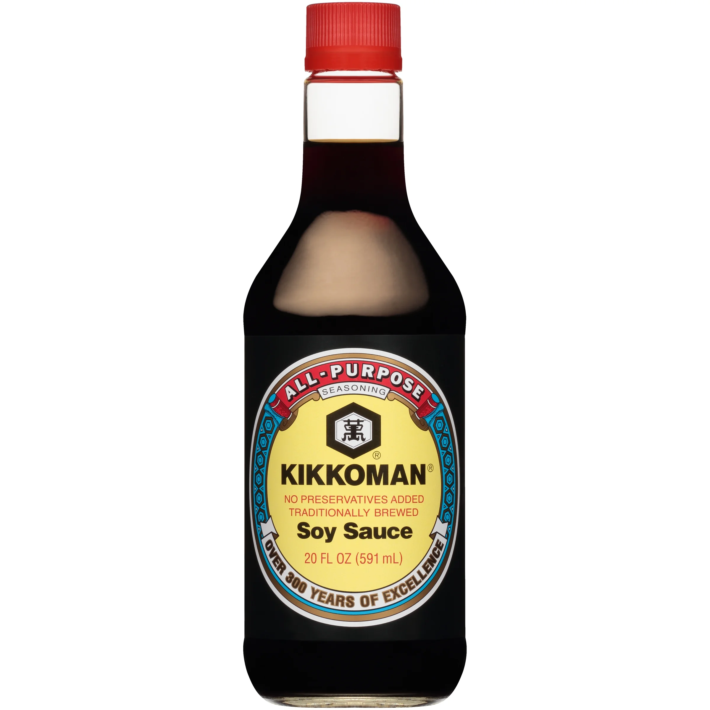
Emergency treatment of hyponatremia with oral soy sauce
Indications for enteral soy sauce
Need for emergent hypertonic therapy
Lack of IV access
Lack of access to HTS or NaHCO₃

Slide 31
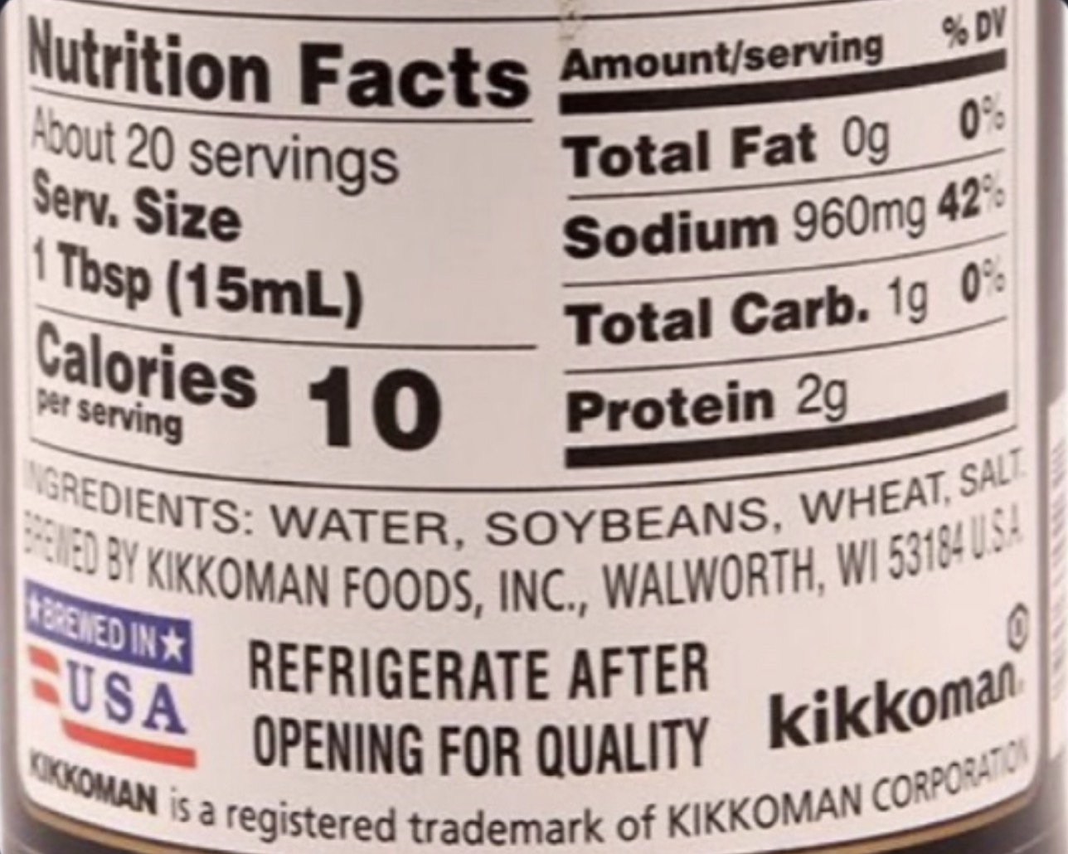
Kikkoman soy sauce serving size:
960mg of sodium per tbsp (15mL)
(960mg/15mL)(1000mL/1L) = 64g/L
(64g of Na)/(23g of Na per mol) = 2.78 mol of Na
2.78 mol of Na → 2.78 mol of NaCl
(2.78 mol of NaCl)/(1 mol of NaCl/58.5g NaCl) =
162g of NaCl
162g of NaCl/1L = 16.2% saline
Kikkoman soy sauce is equivalent to 16.2% saline
1 tbsp is equivalent to 82mL of 3% saline

Slide 32
Emergency treatment of hyponatremia with oral soy sauce
Indications for enteral soy sauce
Need for emergent hypertonic therapy
Lack of IV access
Lack of access to HTS or NaHCO₃
Standard Kikkoman soy sauce dosing
3 tbsp = 45mL soy sauce = 246mL 3% HTS
6 packets (6mL per packet) = 36mL soy sauce
= 197 mL 3% HTS
Give single large dose then check Na at a later time (no evidence of timing)

Slide 33
Rapid Fire Cases

Slide 34
Rapid Fire Cases
65 yo smoker presents with confusion.
Serum Na 115
Serum osm 242
Urine osm 550
Urine Na 120, Urine Cl 115
FeUA 15%, FeUrea 65%
Normal thyroid and adrenal labs
Dx: SIADH

Slide 35
Rapid Fire Cases
28 yo man presents with diarrhea
Serum Na 129
Serum osm 262
Urine osm 700
Urine Na 15, Urine Cl 12
FeNa 0.3%
Dx: Hypotonic hypovolemic hypoNa
2/2 GI loss (extra-renal)

Slide 36
Rapid Fire Cases
21 yo patient admitted from clinic
Na 121
Serum osm 249
Urine osm 75
Urine Na 12
Dx: Psychogenic polydipsia or Tea and Toast
Depends on history

Slide 37
Rapid Fire Cases
70 yo man with multiple myeloma admitted with hypoNa
Serum Na 128
Serum osm 282 (normal)
Total protein 12, IgG Kappa 7 grams
Dx: Isotonic hyponatremia
AKA pseudohyponatremia. Lab artifact.
Do not treat Na, treat underlying cause

Slide 38
Rapid Fire Cases
36 yo woman admitted with recurrent pancreatitis
Serum Na 130
Serum osm 282
Triglycerides 30,000
Dx: Isotonic hyponatremia
AKA pseudohyponatremia
Do not treat Na, treat underlying cause

Slide 39
Rapid Fire Cases
65 yo admitted with hyperglycemia. Glucose 700 mg/dL.
Na 125, Cl 95, bicarb 20, Alb 4
Corrected Na = 2[(glucose-1000/100)] + actual Na
= 2((700-100)/100)] + 125
= 137
AG = 125 – (95+20) = 10 OR
AG = 137 – (95+20) = 22
Is the patient in DKA?
  No, use the actual Na when calculating AG
  AG is 10
Dx: Hypertonic hyponatremia 2/2 hyperglycemia
Do not call this “pseudohyponatremia”

Slide 40
Rapid Fire Cases
45 yo with ARF and severe edema
Na 125. BUN 140, Cr 10, glucose 90
Serum osm 310
Is this patient really hyperosmolar?
  Osmolarity = 2Na + BUN/2.8 + glucose/18
  BUN is an ineffective osmole
  310 – 140/2.8 = 310 – 50 = 260
Dx: hypotonic hypervolemic hyponatremia
NOT hypertonic (hyperosmolar) hypoNa

Slide 41
Rapid Fire Cases
88 yo frail man with chronic serum Na level from 128-132 for 5 years
Serum osm 262
Urine osm 340
Urine Na 45
TFT and cortisol normal
FeUA 12%, FeUrea 55%
Dx: Probably reset osmostat. Mimics SIADH.
Reset osmostat– serum Na is unchanged if given water load
SIADH – Na would decrease with water load

Slide 42
Rapid Fire Cases
40 yo with severe SAH admitted to ICU
Serum Na 128
Serum osm 263
Urine osm 400
Urine Na 50
Urine output 7L per day
FeNa > 1%, FeUrea 30%, FeUA 12%
Dx: cerebral salt wasting (CSW)
Clue: low UOP in SIADH, not in CSW
Tx: Give IVFs, do not fluid restrict

Slide 43
Rapid Fire Cases
35 yo with depression on fluoxetine admitted with diarrhea
Na 121
Serum osm 248
Urine osm 450
Urine Na 13, Urine Cl 12
FeNa > 1%, FeUrea 20%, FeUA 8%
Treat with 3L NS, serum Na increases to 128
2 more liters of NS given. Serum Na decreases to 126
Repeat Urine Na 95, FeNa > 1%, FeUrea 60%, FeUA 13%
Dx: Mixed hypovolemia and SIADH
After volume expansion and correction of hypovolemia,
SIADH becomes apparent

Slide 44
Review: So your patient has hyponatremia
Good history & physical exam
    Med list (psych meds, diuretics, opioids, illicit drugs)
    Volume status
    Consider rechecking Na level
    If suspect endocrine cause check TSH, cortisol
Check serum osmolality
  Is hypoNa true or false?
  Hypotonic (<280), isotonic (280-300), hypertonic (>300)
Check urine osmolality
  Assess ADH activity
  If low (<100-200), ADH is inactive, skip step 4, and eval for ADH independent causes
If ADH is active (urine osm > 100-200), and eval for ADH dependent causes
  Is ADH appropriate or inappropriate?
  Assess Effective Arterial Volume (EAV)
    UNa, BUN/Cr, Hct, FeNa, FeUrea, FeUric Acid, ?Hemoconcentration, ?Response to NS
Diagnose & Treat
Confirm:
Low serum osm
Assume:
No elevated glucose, protein, lipids

Slide 45
HYPONATREMIA ALGORITHM
1. History and Medication List
2. Physical Exam & Volume Status
Check Serum osm
HYPOtonic hypoNa (Sosm < 280)
ISOtonic hypoNa (Sosm ~280-300)
AKA “pseudohyponatremia”:
Hyperproteinemia (myeloma, IVIG), lipemia, hypertriglyceridemia
HYPERtonic hypoNa (Sosm >300)
Hyperglycemia, ↑ osmolal gap (mannitol, sorbitol, IVIG stabilizers)
Check Uosm
ADH Active or Dependent States
Check UNa, UCr, Uurea, Serum uric acid, Urine uric acid, BUN, Cr, Hct
?Hemoconcentration
?Response to NS
Uosm < 100
(ADH inactive)
Uosm > 100
(ADH active)
ADH Appropriate
↓ Effective Arterial Volume (EAV)
UNa, ↑ BUN/Cr, ↑ Hct, FeNa < 1, FeUrea < 35, Ur Acid, FeUA < 10
ADH Inappropriate
↑ Effective Arterial Volume (EAV)
UNa > 30, ~BUN/Cr, ~Hct, FeNa > 1, FeUrea > 35, FeUA > 10
ADH Inactive or Independent States Abnormal Intake
1° polydipsia: psychogenic, marathoners, ecstasy use, multiple tap water enemas, fresh water drowning, dilute infant formula, sodium-free irrigant solutions (hysteroscopy, laparoscopy, TURP)
↓ solute intake: tea & toast, beer potomania
Iatrogenic: Hypotonic IVFs, surgery (TURP)
True hypovolemia (↓TBW, ↓EAV)
Renal losses: Diuretics, *CSW
Extra-Renal Loss: GI losses, ↓PO, bleeding, sweating, adrenal insufficiency
Hypervolemic States (↑ TBW, ↓EAV)
CHF, cirrhosis, nephrotic syndrome, ESRD
3rd spacing (pancreatitis, musc injury, cancer)
Etiology
SIADH: Drugs, meds, tumors/cancers such as small cell carcinoma, lung infections, CNS disease, idiopathic
Hormone deficiency: 2° adrenal insufficiency, severe hypothyroidism
Correct underlying cause
SIADH: fluid restrict (0.8L/d); consider NaCl tabs (1g TID) or if outpatient can Px urea (15-60gm/d); UOsm > 2x Sosm or if Una + UK > SNa → consider Lasix (10-20mg BID; ↓ corticomedullary gradient), vaptans
1° polydipsia: restrict fluids, psych eval/tx
↓ Solute intake: Slow introduction of solute, will correct rapidly, at very high risk for overcorrection
Iatrogenic: DC Hypotonic IVFs
Surgery (TURP): Hypertonic saline
Hypovolemia: Replete volume
Pancreatitis: Replete volume
CHF, nephrosis: Diuresis, HD for ESRD
Cirrhosis: Consider only correcting if Na < 120; fluid restrict, correct hypoK, consider vaptans/HTS only if severe or getting OLT
Treatment

Slide 46
Emergency Treatment

Slide 47
Hyponatremia Toolbag
DDAVP 1-2 mcg IV q8-12hr
3% HTS 0.5-1 ml/kg/hr
D5W
If symptomatic:
3% HTS bolus 100mL
2 amps NaHCO₃
Repeat up to max increase Na of 6 meq
Standard Kikkoman soy sauce dosing
3 tbsp = 45mL soy sauce = 246mL 3% HTS
6 packets (6mL per packet) = 36mL soy sauce
= 197 mL 3% HTS
Give single large dose then check Na at a later time (no evidence of timing)

