Slide 1
Critical Care management of Traumatic Spinal cord injuries
Lauren van sant, DO, FACS

Slide 2
CaSE: TA vanilla
HPI: Previously healthy 61M, driving a forklift at work. Forklift unexpectedly overturned causing the patient to strike the roll cage with his head with axial loading. No ejection. No prolonged extrication. Transported by air to VCMC. Vital signs normal en route. GCS 15.
  0/5 motor and sensation to BL UE. 4/5 motor and sensation intact to BL LE.
  CT C-spine revealed severe stenosis from C3-C7.
  Admitted to ICU.
  Taken to OR on hospital day 2 for decompression and posterior spinal fusion C2-C7.
Progressed to bradycardia
MAP pushes desired by NSX for 7 days
Continued hypotension after Day 7, unable to maintain MAP > 65 off pressors

Slide 3
Outline
Introduction and Epidemiology
Anatomy
Mechanism of Injury
Definition/Classification of Spinal Cord Injury
Evaluation
Pathophysiology
Physiologic Derangements seen in SCI
Specific Critical Care/Treatment
Prognosis

Slide 4
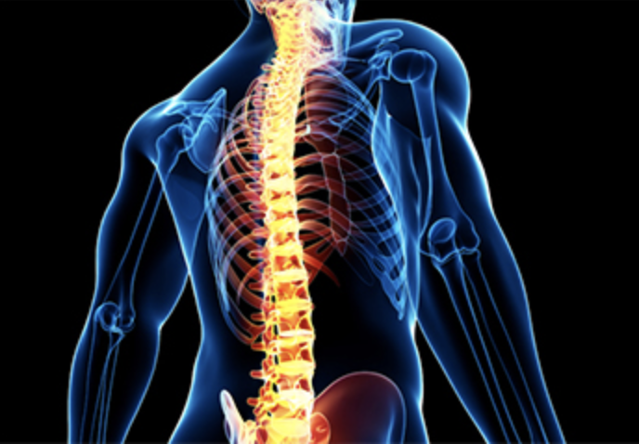
Intro and epidemiology
8,000-10,000 cases per year in the United States
  85% Traumatic
    MVC, falls, violence, recreational activities
Male: Female 5:1
Up to 80% of patients with SCI suffer multisystem trauma
Risk of secondary cord injury from hypoperfusion and hypoxemia
Notes:
*ISS- head, neck, face, chest, abdomen, extremities, external... (soft tissue?) → the spine is a part of neck or chest or abdomen calculation depending on the location of the SCI
*AIS- indirectly
*Revised trauma score? → more physiologic? CRAMS?
*the main reason we admit these patients to the ICU…?? → secondary injury/preservation

Slide 5
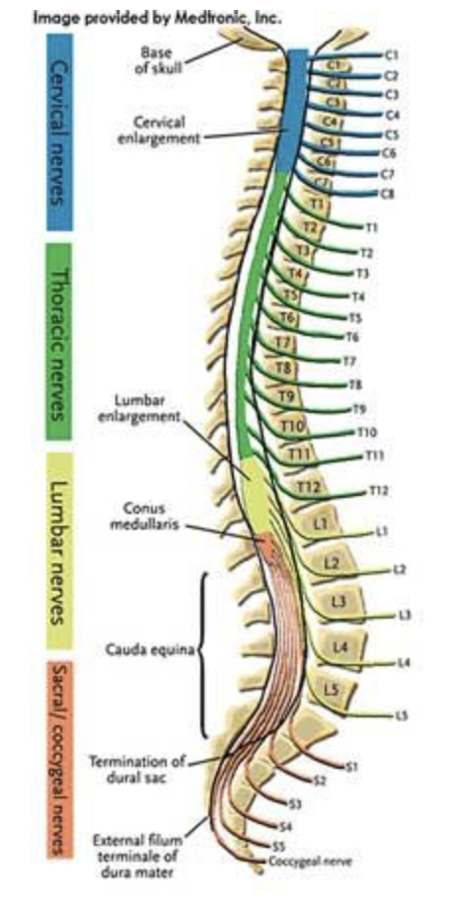
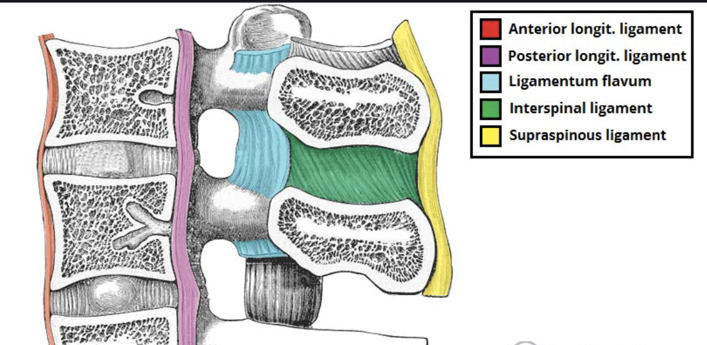
Anatomy
Spine
  Total vertebrae = 33
  Four curves
Spinal cord
  Extends from brain to L1
  Cauda Equina
Ligaments
Notes:
*CAUDA EQUINA = The cauda equina (from Latin horse's tail) is a bundle of spinal nerves and spinal nerve rootlets, consisting of the second through fifth lumbar nerve pairs, the first through fifth sacral nerve pairs, and the coccygeal nerve, all of which arise from the lumbar enlargement and the conus medullaris of the spinal cord.
THREE COLUMN INJURY → INSTABILITY!

Slide 6
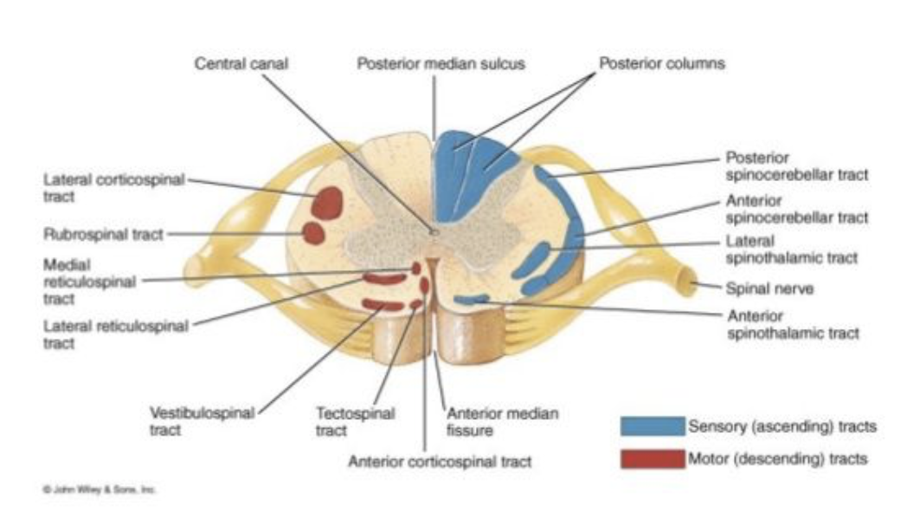
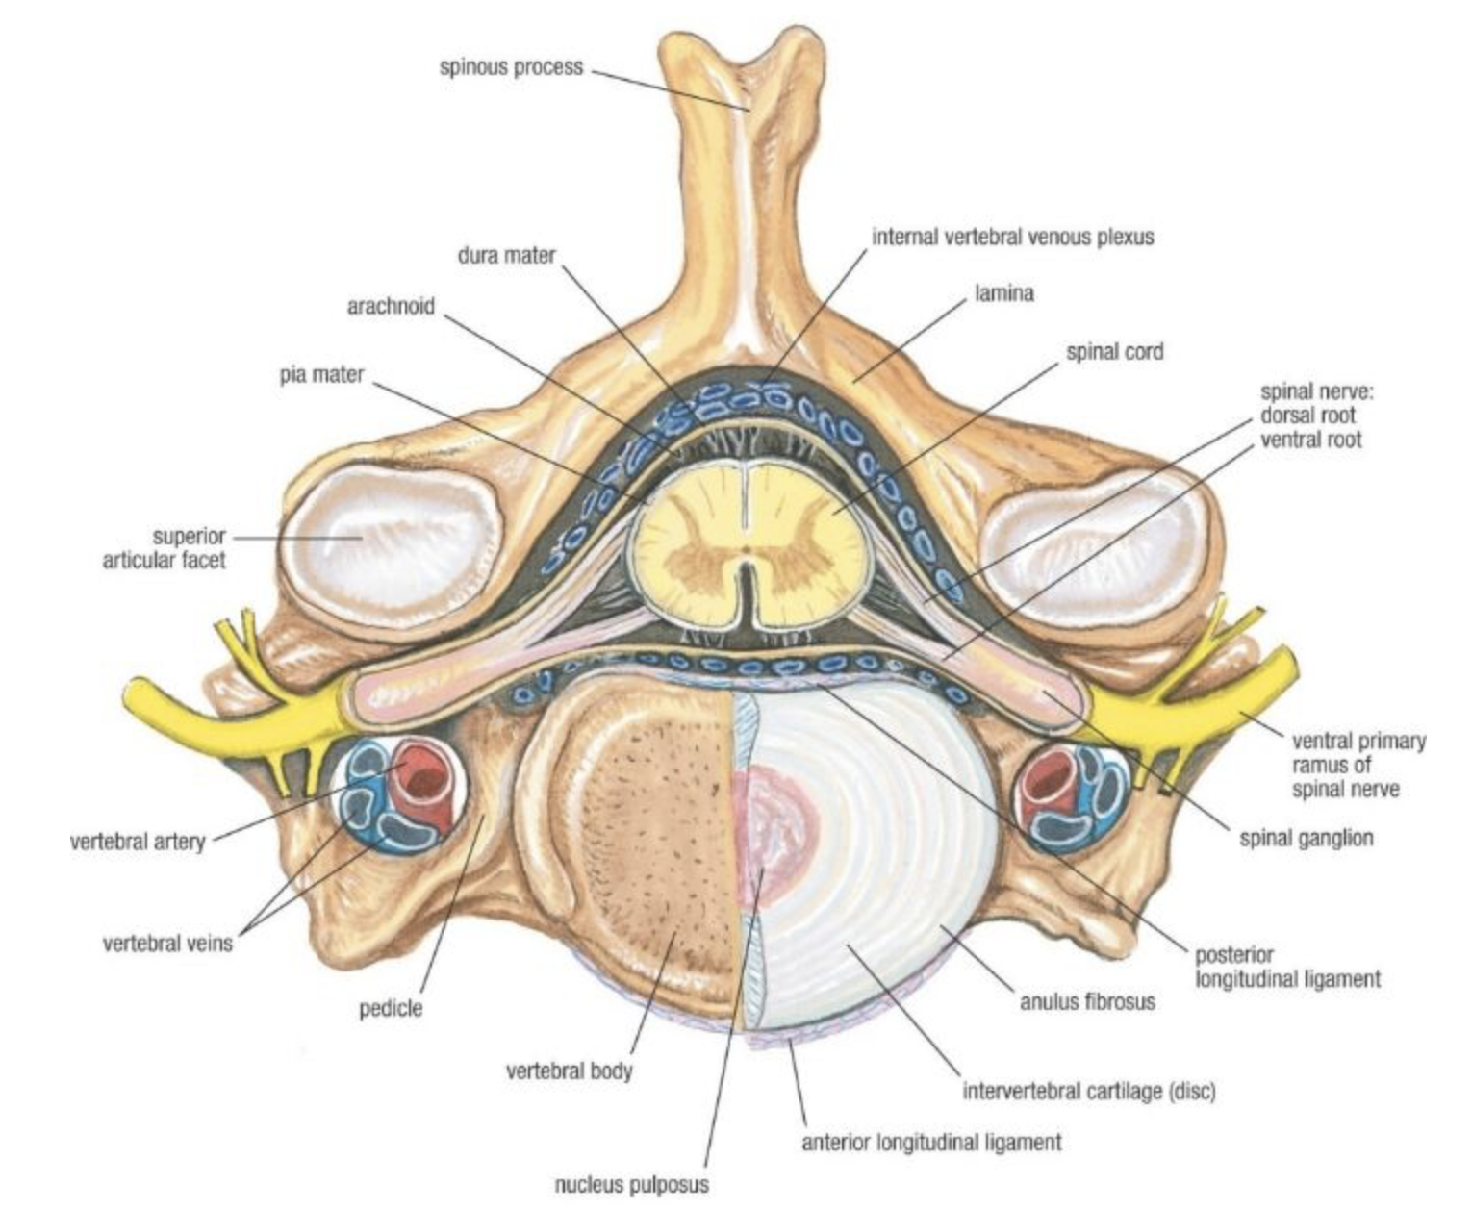
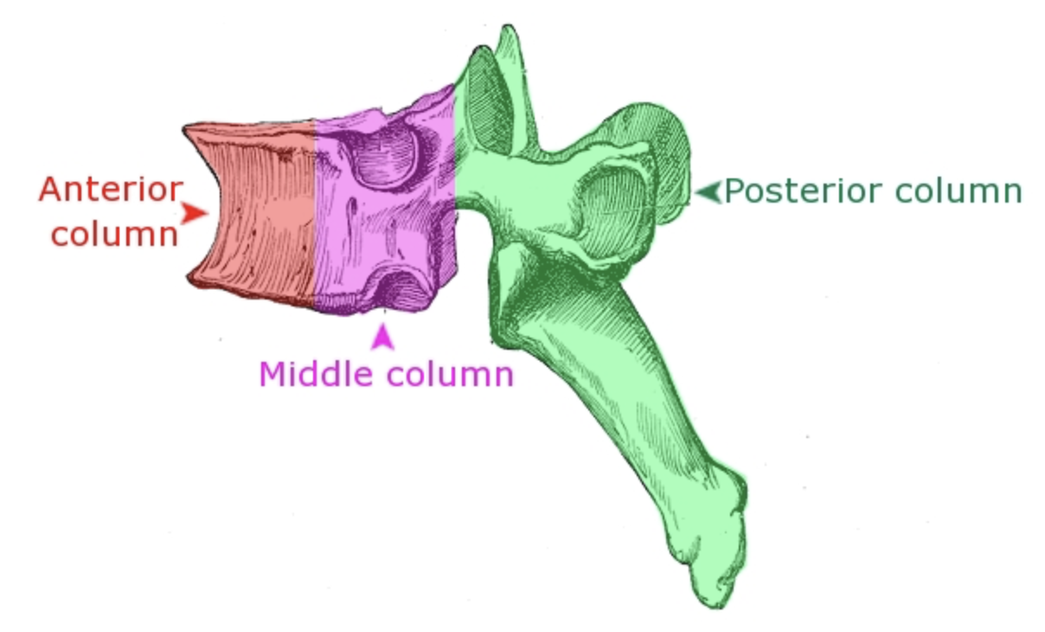
Anatomy
Three column concept
  Stable vs unstable fracture
Spinal cord
Notes:
THREE COLUMN INJURY → INSTABILITY!
WHY UNSTABLE VS STABLE CORRELATES WITH SPINAL CORD INJURY??...
*IS THERE ASSOC? AND ASSOC WITH COMPLETE VS INCOMPLETE?
**NOT REALLY GOING TO GO OVER THE PHYSIOLOGY, BC THE ANATOMY AND INTIMATE CONNECTION OF THE BONES AND SC ARE WHAT REALLY DRIVES THE INJURY PATTERN…?

Slide 7
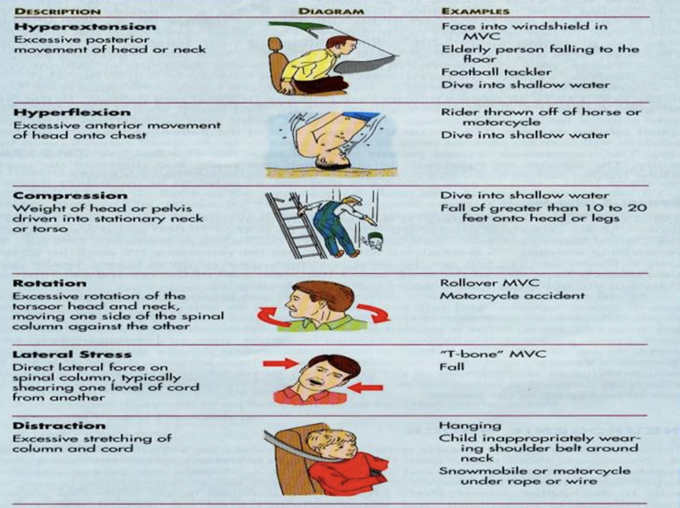
Mechanism of SCI
Notes:
**MECHANISM CAN BE VERY IMPORTANT…LOOKUP EAST GUIDELINES??
**SO THEN AFTER A PATIENT SUSTAINS ONE OF THESE INJURIES, HOW DO WE CARE FOR THEM?...

Slide 8
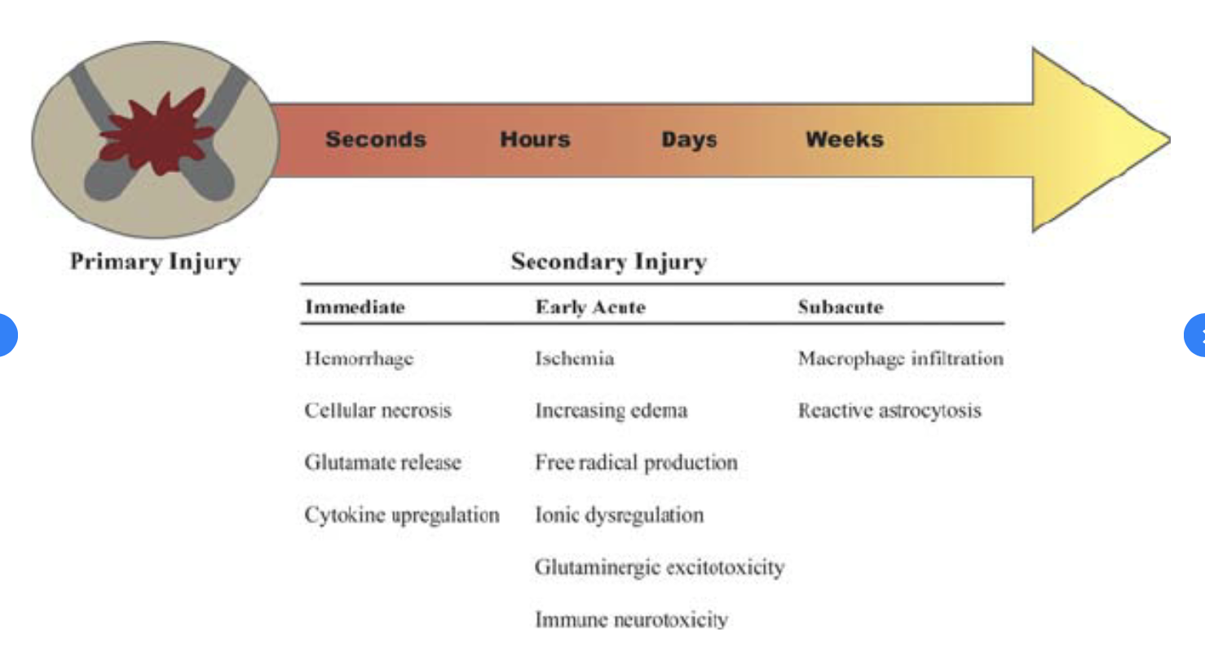
Pathophysiology of sci
Primary Injury
  Direct damage to the axons and neural membranes in the intermediolateral nucleus, lateral grey mater, and anterior root that lead to disrupted sympathetic tone
Secondary Injury
  Vascular insult, electrolyte shifts, and edema that lead to progressive central hemorrhagic necrosis of grey matter
  Excitotoxicity from NMDA accumulation, mitochondrial injury, and reperfusion injury which all lead to uncontrolled apoptosis
Notes:
**JUST LIKE MOST THINGS IN TRAUMA, THE INITIAL INSULT ISNT ALWAYS…THE PART YOU WORRY ABOUT MOST…

Slide 9
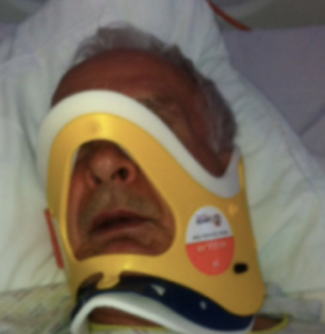
Initial stabilization and resuscitation
Early intubation and ventilation
Circulatory- rule out and treat sources of hemorrhage/hemorrhagic shock FIRST
  Prevent early spinal cord hypoperfusion
Associated Injuries
  24% Chest wall injuries
  26% Head injury
  23% Long Bone fractures
  Lumbar spine fx → splenic (54%), renal (41%), hepatic (32%) and small bowel (23%) injuries
  Blunt Cerebrovascular injury
  ***A focal neurologic deficit is not necessary for the diagnosis of neurogenic shock
Notes:
*ALWAYS BE THINKING ABOUT AIRWAY, THE BASICS, EXPECIALLY IN A HIGH CERVICAL SPINE INJURY → above C5
**OTHER CONCOMMITENT INJURIES → CANT JUST FOCUS ON THE SPINE
Tracheostomies?- needed in 50% of Cervical SCI (even incomplete) → move to later?
**up to 5%of patient suffer worsening neurological injury even after proper spinal immobilization
**FIRST LINE TX FOR HYPOTENSION (AFTER R/O HEMORRHAGE) → FLUIDS! VASOGENENIC DILATION!...then levo

Slide 10
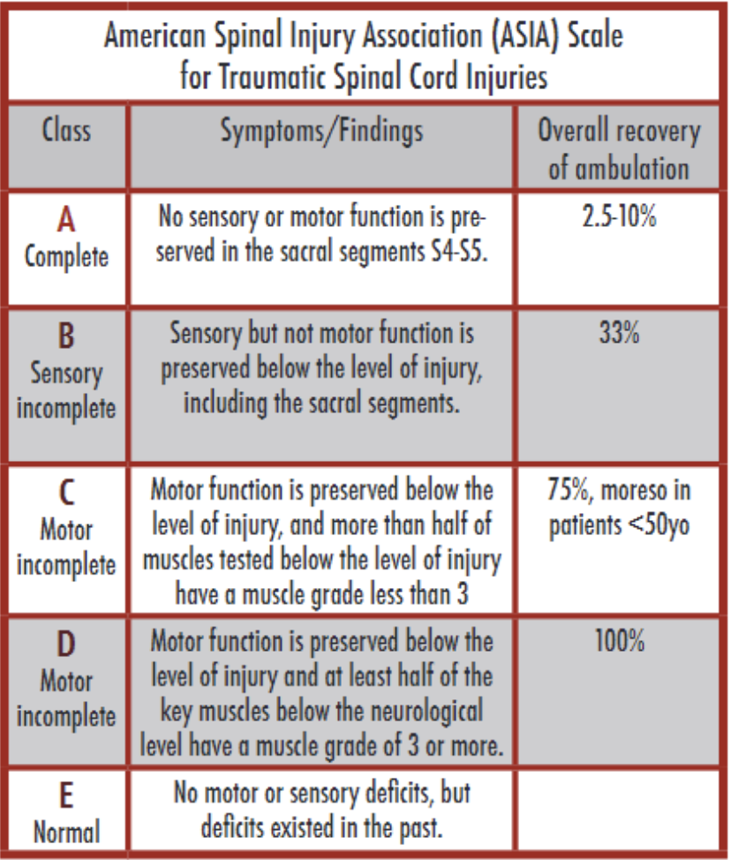
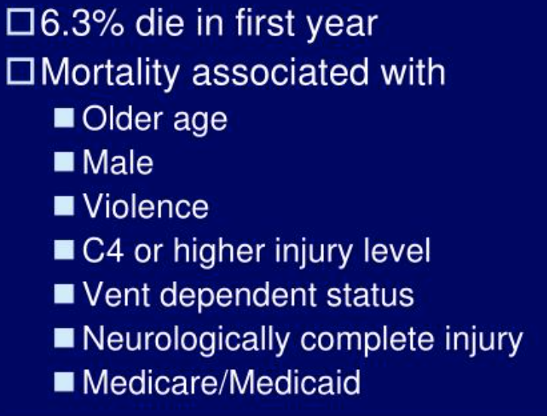
Classification
Complete vs Incomplete
Notes:
**OVERALL RECOVERY OF AMBULATION → CAN UTILIZE THIS ASIA SCORE TO GIVE PATIENTS AND FAMILIES LIKELIHOOD OF AMBULATION

Slide 11
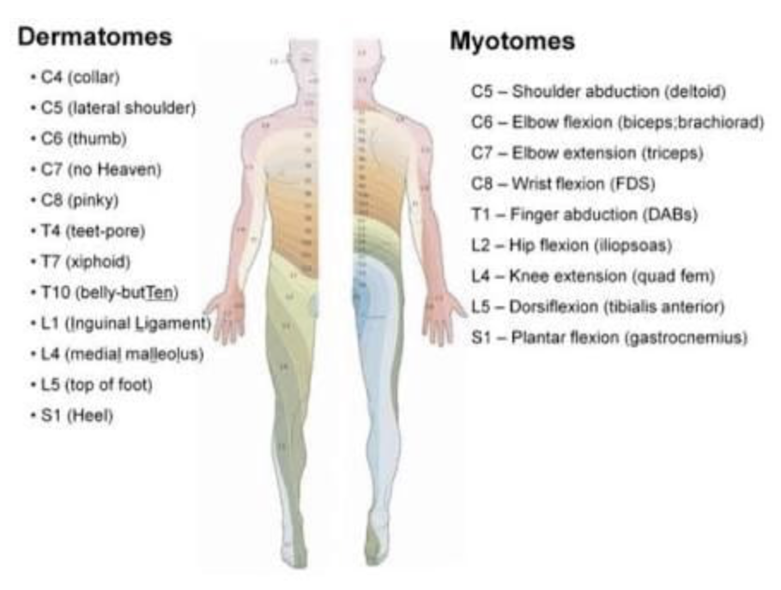
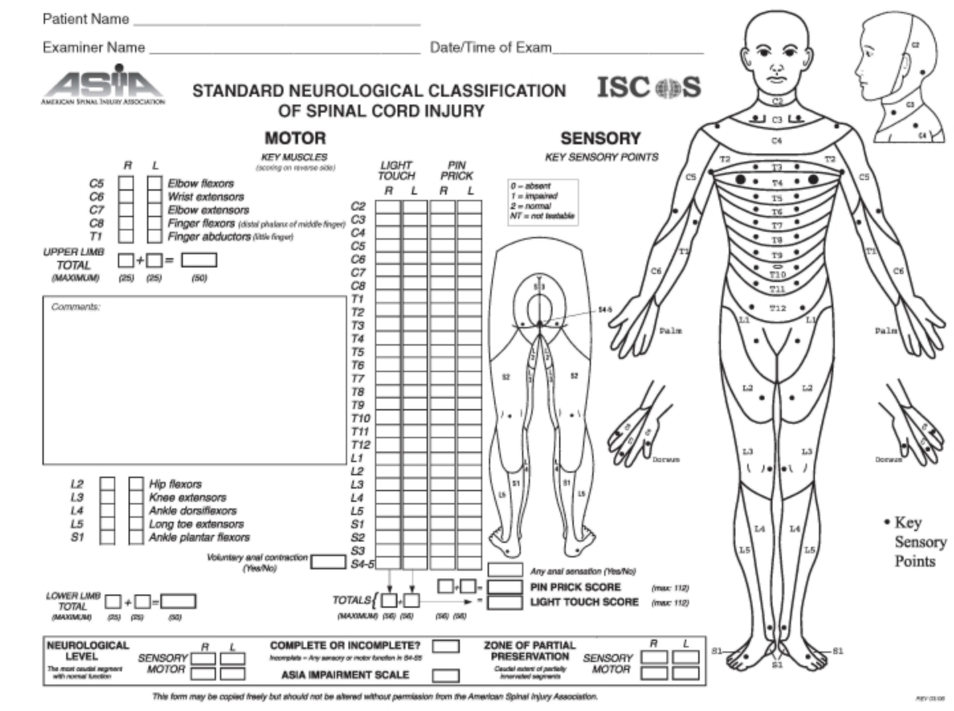
Evaluation
Notes:
CAN DO THIS INITIALLY, BUT REALLY MOST HELPFUL at 72 hours….HELP FOR PROGNOSIS?? AND CONSISTENCY OF EXAMS AMONGST PROVIDERS.
**better 72 hours to ONE week than earlier…for prognostication
*sensory exam better for predicting motor recovery in UE than in LE → MOTOR RECOVERY DOCUMENTED FOR UP TO 2 YEARS

Slide 12
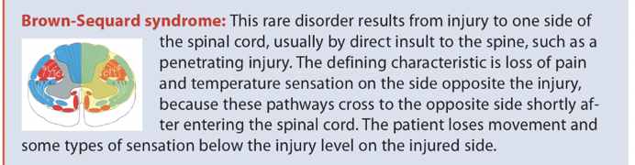
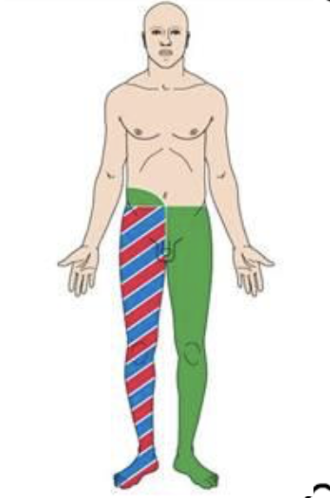
2-4% of all incomplete SCI
50-66% recovery motor function in the first 1-2 months
Recovery continues slowly up to 2 years
Most important prognostic factor is completeness of lesion

Slide 13
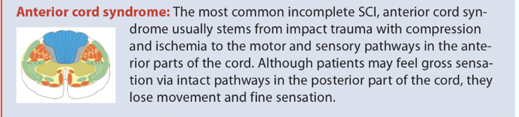
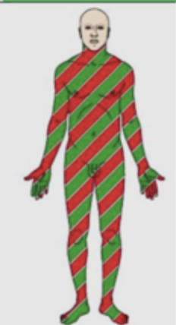
About 5% of all SCI
Artery of Adamkiewitz?
Poor prognosis

Slide 14
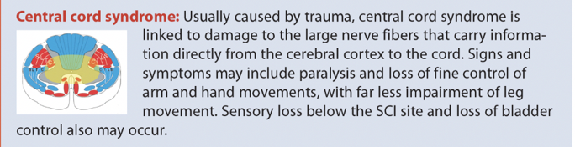
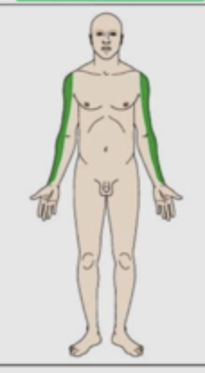
The most common incomplete SCI
  11,000 cases/year
Bladder dysfunction will present as urinary retention
Older, pre-existing spondylosis/stenosis

Slide 15
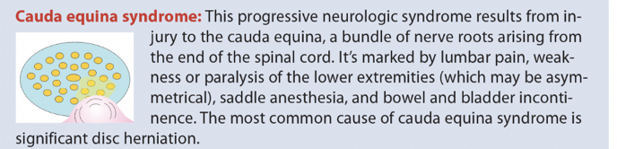
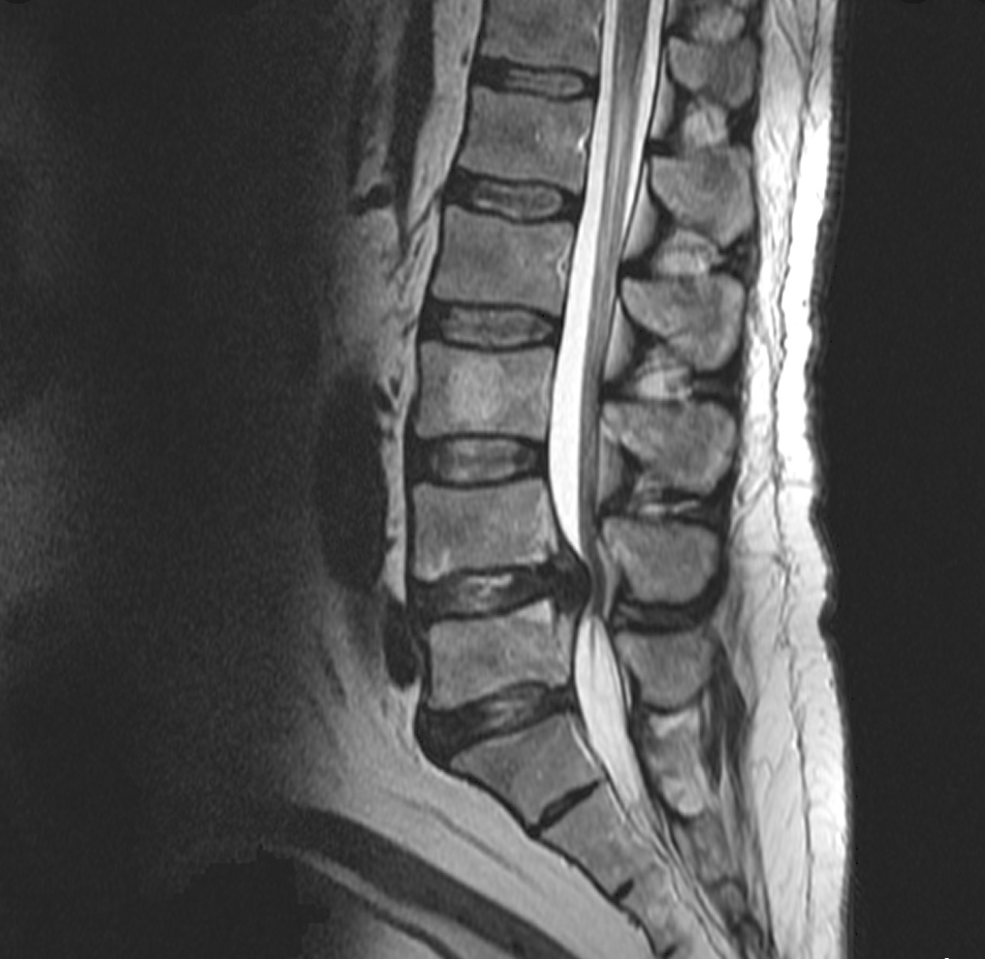
Incidence 0.04%
Variable loss of motor and sensory
MYTHS
  If no loss of bowel or bladder, not cauda equina
  If anal tone is normal, not cauda equina
MRI is GOLD STANDARD FOR DX
Notes:
**MOST COMMONLY FROM SIGNIFICANT DISK HERNIATION

Slide 16
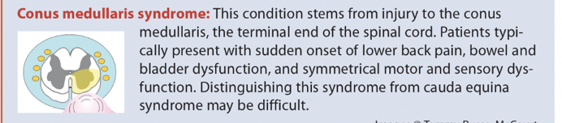
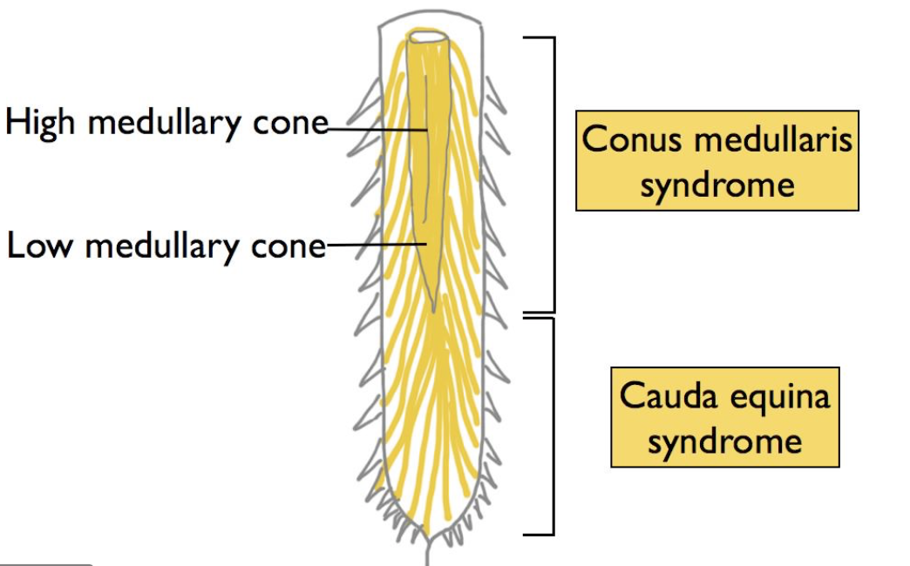
Very rare secondary to trauma
Reflexes DIMINISHED AT level of injury
Reflexes INCREASED below level

Slide 17
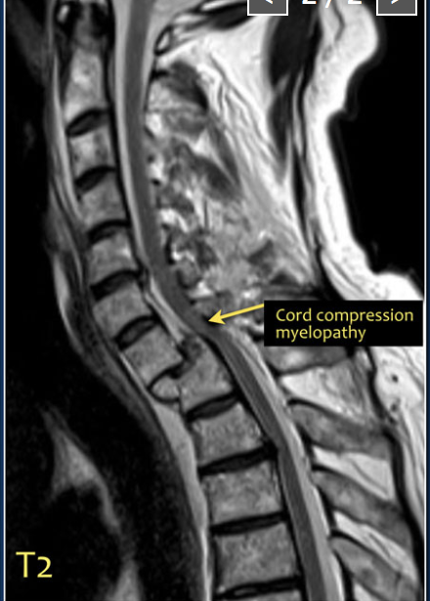
IMAGING METHODS
Who?
  High risk presentation → male, age < 45, GCS impairment, chest injury from falls > 10ft, or MVC > 45 MPH
Computed Tomography (CT) - first line imaging
Magnetic Resonance Imaging (MRI) - Sagittal T2 weighted= GOLD STANDARD
  Spinal cord compression
  Vascular injury (hemorrhage, contusion, ischemia, infarct, edema)
  Ligamentous injury

Slide 18

Physiologic changes after sci
Cardiovascular
Respiratory
Gastrointestinal
Metabolic
Other
Notes:
**NOW THAT WE HAVE THE ANATOMY DOWN…WHAT I MOSTLY WANT TO FOCUS ON…!!!! PHYSIOLOGY OF SPINAL CORD INJURY AND TREATMENT WHILE IN THE ICU
**THE CHALLENGE OF THE WHOLE PATIENT…

Slide 19
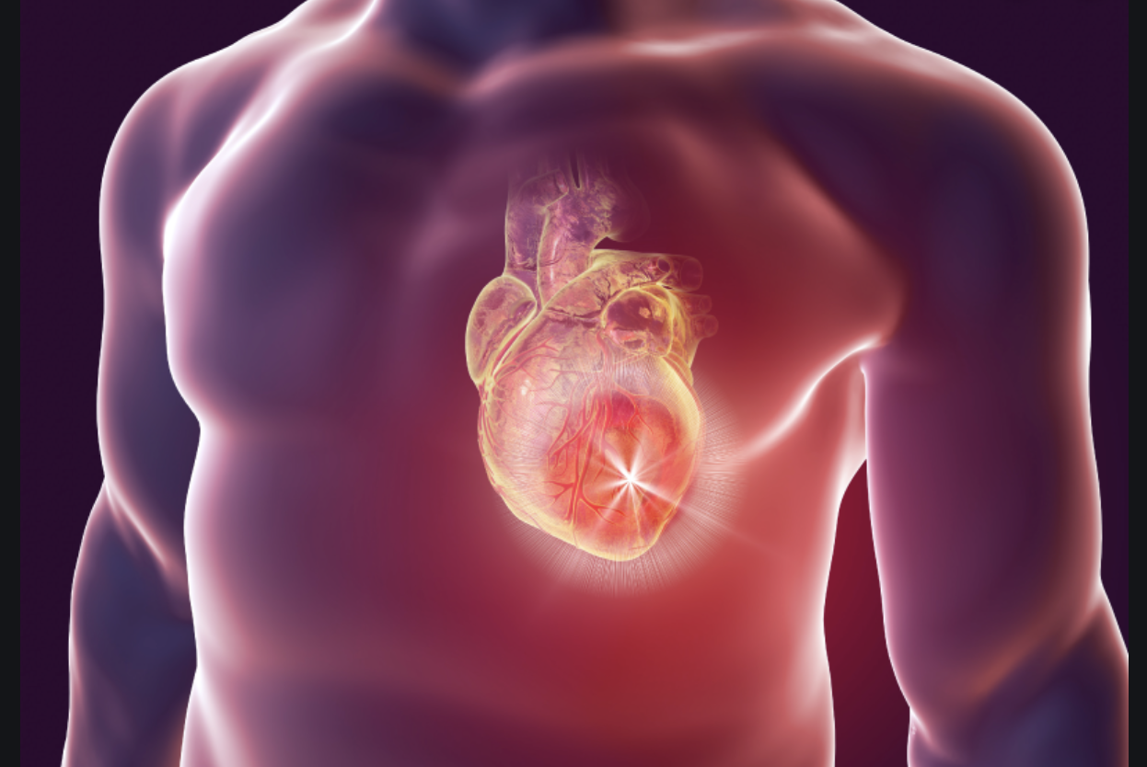
Cardiovascular changes
Neurogenic Shock
  Hypotension when lesion above T6 due to loss of sympathetic autonomic function/unopposed parasympathetic function
    19.3% Cervical SCI
    7% Thoracic SCI
  Loss of cardiac accelerator fibers (T1-T2) → bradycardia
  Loss of Vasoconstrictor tone → venous pooling
  Symptoms can persist up to 6 weeks
Spinal shock
  Reversible reduction in sensory and motor function below the injury level
Notes:
**ADD DEFINITIONS → A LOT OF WHAT I WANT TO FOCUS ON (AND OFTEN ONE OF THE MAIN REASONS THESE PATIENTS WITH SCI NEED TO REMAIN IN THE ICU, IS FOR TX OF THEIR NEUROGENIC/VASOGENIC SHOCK…) → Neurogenic shock is a devastating consequence of spinal cord injury (SCI), also known as vasogenic shock. Injury to the spinal cord results in sudden loss of sympathetic tone, which leads to the autonomic instability that is manifested in hypotension, bradyarrhythmia, and temperature dysregulation.
Spinal cord injury is not to be confused with spinal shock, which is a reversible reduction in sensory and motor function following spinal cord injury. Neurogenic shock is associated with cervical and high thoracic spine injury. Early identification and aggressive management are vital in neurogenic shock to prevent secondary spinal injury.

Slide 20
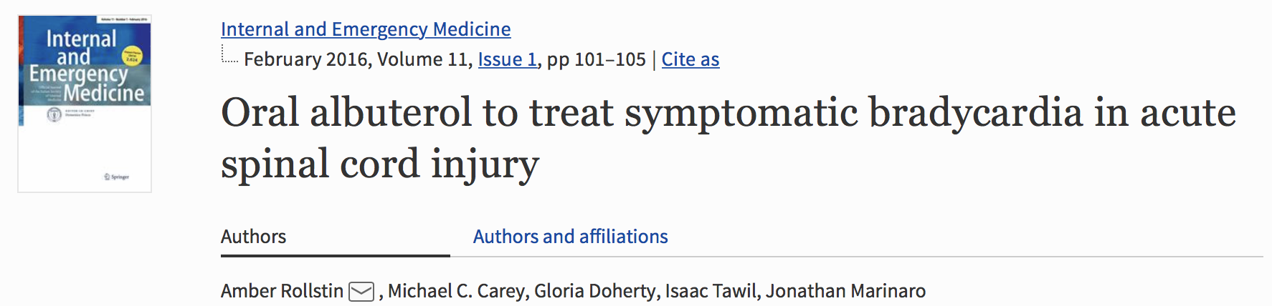
Adjunctive treatment for neurogenic shock
  Cardiovascular disturbances remain a leading cause of morbidity and mortality in patients with Acute SCI
  One series of 28,239 patients with acute SCI found cardiac dysfunction responsible for 23% of deaths within the first year of injury.
    For patients with severe cervical SCI, persistent, symptomatic bradycardia is nearly universal, and this rhythm disturbance often precedes cardiac arrest.
    Usually develops within 3-5 days after SCI → resolves within 6-8 weeks
  Treatment with oral albuterol → B adrenergic receptor target
    INITIAL 4mg PO Q 6 hours
    Ability to avoid need for pacemaker placement, given bradycardia is usually self/time-limited
Notes:
**OBVIOUSLY WANT TO START THIS AFTER RESUSCITATION…USUALLY SEEN AFTER 3-5 DAYS
**DEFINE SYMPTOMATIC
**ACTUAL STUDY WAS? → 2016 → RETROSPECTIVE CASE SERIES…first described in which year?
**INITIAL 4MG Q6, CAN INCREAE TO 6 Q 4HRS

Slide 21
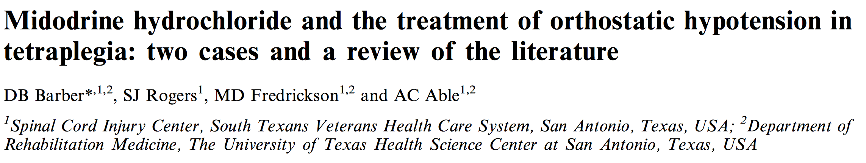
Alpha 1 agonist
Prodrug → desglymidodrine (sympathomimetic) → Rapidly absorbed, reached peak @ 1-2 hours
Starting dose → 10mg PO TID
Recommended for 2-3 mo after SCI
MIDAS Trial- recruitment phase
  International, multicenter, randomized, double-blind, placebo-controlled clinical trial
  USA and Australia, 120 patients.
  Primary outcome is time (hours) from initiation of midodrine or placebo to discontinuation of IV vasopressors.
  Prior study → 1.2 days of pressor vs 2.2 days of IV pressors without midodrine (Levine et al)
Notes:
*MIDAS TRIAL → REASONING? → 2010, FDA proposed to withdraw approval of midodrine because of lack of studies that verify the clinical benefit of the drug. We obtained Investigational New Drug (IND 113,330) approval to study its effects in critically ill patients who require IV vasopressors but are otherwise ready for discharge from the ICU…
**WHY DO WE CARE IF PATIENT ARE ON IV PRESSORS?? → RISK OF BOWEL ISCHEMIA (AND NOT JUST TALKING ABOUT MAP PUSHES EITHER, JUST TO GET NORMAL MAPS TO PERFUSE THE KIDNEYS)…

Slide 22
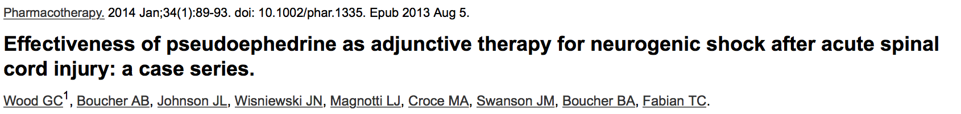
Acts on alpha adrenergic receptors (and beta) to cause vasoconstriction
Bradycardia HR < 50, hypotension SBP < 90 and receiving IV vasopressors
Average days from initiation of pseudoephedrine to no longer requiring IV vasopressors = 7d
  Daily maximum pseudoephedrine doses ranged from 60-720 mg
Mean duration of dose 32 days
64% of patients discharged on pseudoephedrine
Notes:
**CONCLUSIONS → ADJUCT, BUT WOULD TRY MIDODRINE FIRST…and can then add fludrocortisone too??
**SHOULD ADD SIDE EFFECTS AND CONTRAINDICATIONS FOR BOTH??

Slide 23
Cardiovascular changes continued
Thromboembolism
  Vessel wall damage, stagnant blood flow, increased viscosity/hypercoagulable state secondary to trauma (Virchow’s Triad)
  Risk of DVT increased THREE FOLD in trauma patients with SCI compared with trauma patients without SCI
  Lovenox preferred in the acute setting +/- mechanical prophylaxis
Sympathetic Hyperreflexia
  Triggered by somatic or visceral stimuli below the level of the injury
  Bladder or rectal distension
  Usually seen after 4-6 weeks (after neurogenic shock has resolved and reflexes return)
  Common in lesions above T6 (above splanchnic sympathetic outflow), rare with lesions below T10
Notes:
Malignant hypertension with reflex bradycardia…
Triggering stimuli generate an ascending sensory nerve impulse (spinothalamic and posterior columns) that stimulates the sympathetic nervous system below the level of the injury → normal inhibitory mechanisms cannot pass below the level of the injury → sympathetic outflow continues UNCHECKED → results in profound vasoconstriction below the level of injury, with compensatory baroreceptor mediated vasodilation above

Slide 24
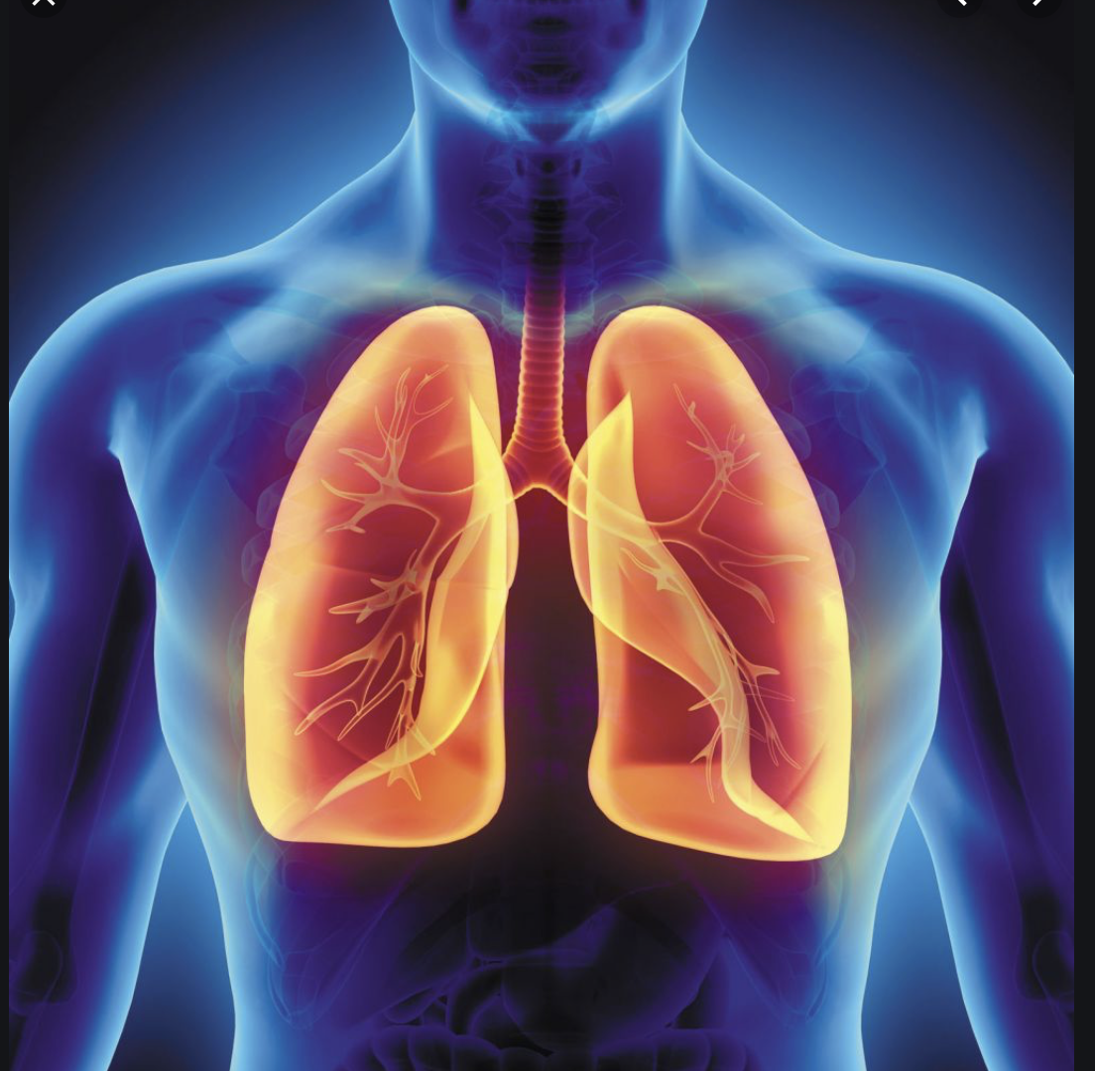
Respiratory changes
What is the normal diaphragm action?
After SCI, intercostal muscle function is lost, with consequent failure of the AP expansion of the ribcage.
  As diaphragm contracts, chest wall is sucked inward, causing paradoxical movement.
Degree of loss of function depends upon location of lesion
  Innervation to diaphragm usually intact in lesions below C3
Rapid shallow breathing typically ensues
Loss of abdominal muscle activity, decrease in max expiratory force, reduced ability to cough, clear secretions, and protect the airway.
Atelectasis, V/Q mismatch, respiratory failure…
Notes:
*How do we fix this? → abd binder, “quad cough”/cough assist

Slide 25
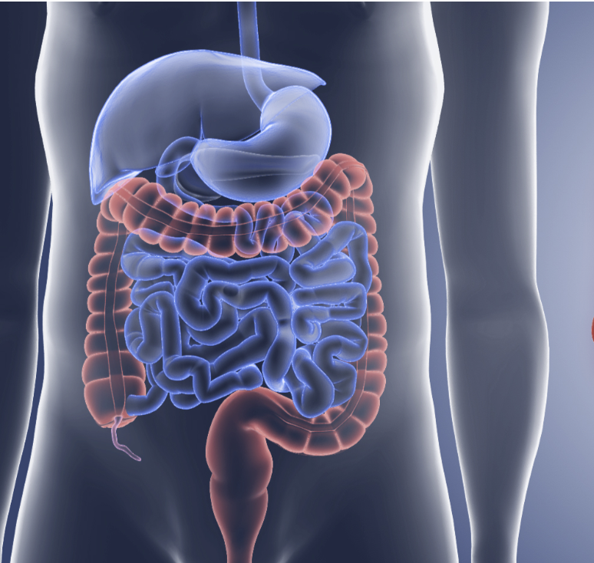
Gastrointestinal changes
Delayed gastric emptying, paralytic ileus
  Common, may last 2-3 weeks
  Prevention of aspiration
  Prokinetics, early bowel regimen
Gastric Stress ulcer
  Secondary to unopposed vagal activity below the level of injury
  H2 or PPI
Constipation
  Sensation of defecation typically lost
  Pseudo-obstruction
  Bowel regimen, stimulation
Notes:
suppository

Slide 26
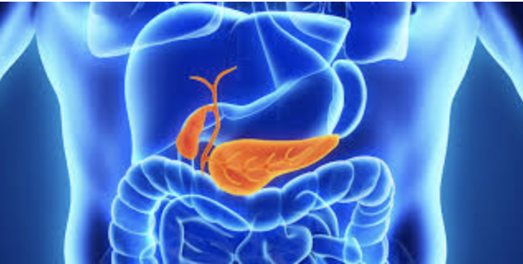
Metabolic changes
Temperature regulation
  Vasodilation → aberrant temp regulation and hypothermia
  Warming blankets, warm fluids for resuscitation
Hyperglycemia
  Can aggravate ischemic neurological injury
  Stress response
Steroids are NO LONGER recommended
  NASCIS III Trial, 2013
Notes:
**STEROIDS --. NO BENEFIT, INCREASED RISKS, INFECTION, ETS…NASCIS 3 TRIAL? = LOOK UP!
**2013 → Administration of methylprednisolone (MP) for the treatment of acute spinal cord injury (SCI) is not recommended. Clinicians considering MP therapy should bear in mind that the drug is not Food and Drug Administration (FDA) approved for this application. There is no Class I or Class II medical evidence supporting the clinical benefit of MP in the treatment of acute SCI. Scattered reports of Class III evidence claim inconsistent effects likely related to random chance or selection bias. However, Class I, II, and III evidence exists that high-dose steroids are associated with harmful side effects including death.^{[1]}

Slide 27
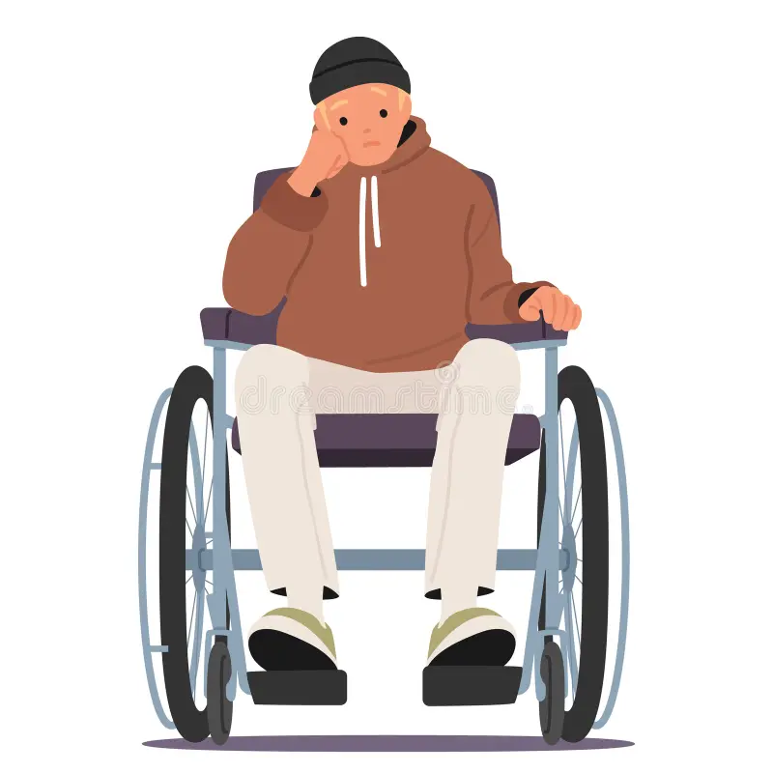
Other changes/considerations
Psychological
  Depression, anxiety, confusion, lack of dignity in ability to self-care
Pain Management
  Mismatched sensory and motor loss
  Acute somatic pain vs. chronic neuropathic pain
    Gabapentin, amitriptyline effective for neuropathic pain but must be implemented early
    Oral ketamine → NMDA receptor antagonist
Spasticity
  Risk of contractures
  Decrease function, compromise posture, reduce functional capacity.
  Stretching, splinting, casting, pain control
    Baclofen, dantrolene, gabapentin

Slide 28

Spinal cord perfusion and vasopressor support
“MAP pushes”
  NEJM → 2016 guidelines recommend MAP > 85- 90 for 7 days
    Based on limited, low-quality evidence
    Improved neurologic recovery seen when SCPP targeted
      Lumbar drain for targeted SCPP of 60-65
      Associated with most stable improvement in neurologic improvement
  JAMA 2025 → RCT, MCT → NO benefit of targeting MAP > 85 vs 65
  Journal of Critical Care 2025 → “Low BP is bad for SCI”
Notes:
*FOR NEUROGENIC SHOCK → BRADYCARDIA AND HYPOTENSION…OFTEN NECESSITATING NEED FOR VASOPRESSORS (MAP PUSHES ASIDE) → MIDODRINE- ALPHA ADRENERGIC AGONOST…
**add reference for SCPP
**INITIALY RESPONSE TO SCI → TACHY AND HYPERTENSION…THEN OVER TIME…Following this first phase, a massive decrease of sympathetic activity occurs, due to the disruption of descendent sympathetic tracts.
**LESS TIME ON IV VASOPRESSORS (THUS LOWER RISKS OF THESE!...GUT ISCHEMIA, ETC), ABILITY TO PARTICIPATE IN REHAB QUICKER, SHORTER LENGTH OF ICU STAY
***ADD STUDIES REGARDING MAP PUSHES WITH LUMBAR DRAINS!

Slide 29
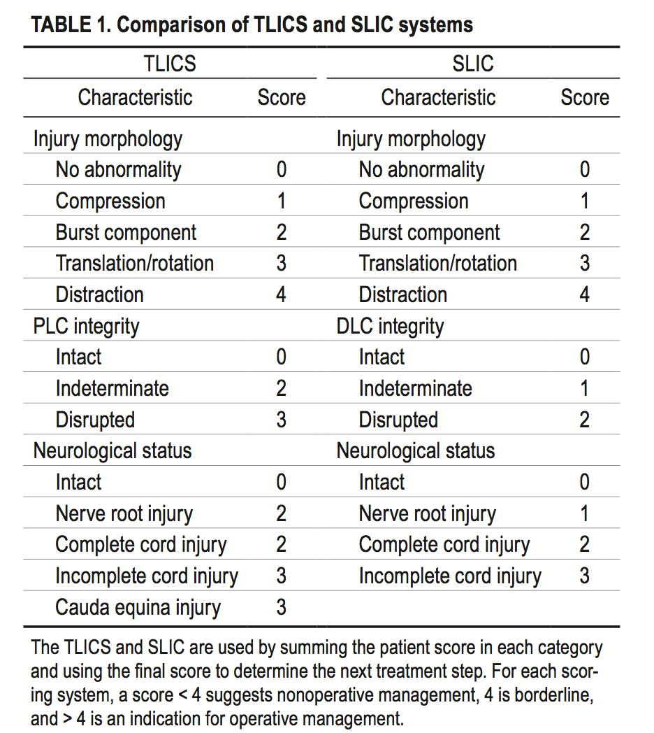
SURGICAL CANDIDACY and Timing
Widely adopted guidelines
  2005 Thoracolumbar Injury Classification and Severity Score (TLICS)
  2007 Subaxial Cervical Spine Injury Classification and Severity Score (SLIC)
  Studied in both adult and pediatric populations
    Score < 4 → suggests NOM
    Score of 4= borderline
    Score > 4 → indication for operative intervention
Timing?
  Level II recommendations for early decompression (< 24 hours post injury)
  Improved AISA grades, earlier ICU discharge, improved non-neurologic outcomes, more cost-effective
Notes:
**LOOKS AT INJURY MORPHOLOGY, PLC AND DLC INTEGRITY, NEURO STATUS

Slide 30
BIOMARKERS FOR EARLY DIAGNOSIS?
Candidate markers for traumatic SCI
  Glial Fibrillary Acidic Protein (GFAP)
  Neurofilaments
  Cleaved Tau
  Myelin basic protein
  Neuron-specific enolase
  S100-B***
  Soluble CD95 ligand
S100- B= The most studied → elevated after traumatic SCI or vertebral fractures.
  Use in treatment response vs. diagnosis…
Notes:
*DON’T ADD ANY MORE ABOUT THIS….
*add pic!

Slide 31
Long Term Morbidity
Infection Risk
  Disruption of neuroimmune axis
  Polytrauma and SCI = highest predictors of surgical site infection and rehospitalization
Venous Thromboembolism (VTE)
  Up to 40% of patients with SCI diagnosed with DVT within first 12 weeks after injury
  Lovenox within 72 hours of injury (AANS/CNS recs) → continuation for 8- 12 weeks
Inpatient Rehabilitation Services
  Lifetime healthcare cost of $1.1- $5.4 Million
Notes:
*VALSALVA, STIMULANTS, STIMULATION…COLOSTOMY…PATIENT PREFERENCES…

Slide 32
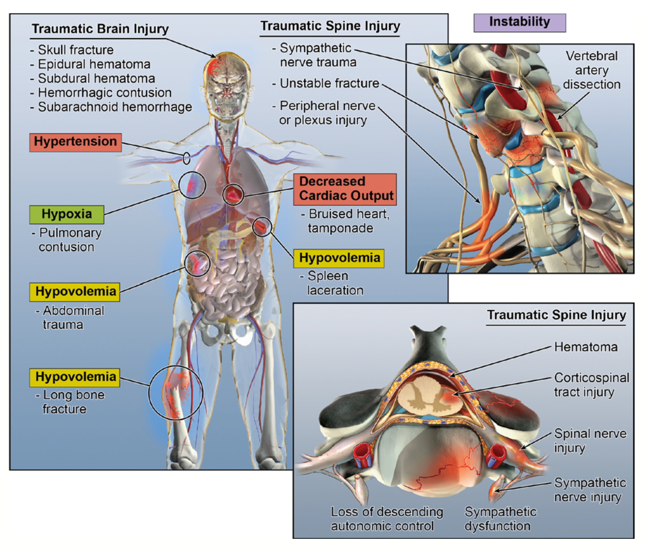
TAKE HOME POINTS
Spinal cord injury with polytrauma poses uniquely challenging considerations due to the increased risk of secondary insults to the spinal cord.
Initial assessment and management focuses on optimizing spinal cord perfusion.
SCI can affect every system within the body.

Slide 33
Questions?
Notes:
Add pic

Slide 34
references
Rollstin, Amber & Carey, Michael & Doherty, Gloria & Tawil, Isaac & Marinaro, Jonathan. (2015). Oral albuterol to treat symptomatic bradycardia in acute spinal cord injury. Internal and emergency medicine. 11. 10.1007/s11739-015-1324-3.
Hollenberg SM. Vasoactive drugs in circulatory shock. American journal of respiratory and critical care medicine.183(7):847-855.
McMahon D, Tutt M, Cook AM. Pharmacological management of hemodynamic complications following spinal cord injury. Orthopedics. 2009;32(5):331.
Whitson MR, et al. Chest 2016;149:1380-3. Hammond DA, et al. Chest 2016;149:1582-3.
Reader response: Spinal cord perfusion pressure predicts neurologic recovery in acute spinal cord injury
Guru Dutta Satyarthee. Neurology May 2018, 90 (19) 904; DOI:10.1212/WNL.0000000000005466

