Slide 1
Diagnosis and Management of Shock

Slide 2
Topics to discuss
General principles of shock
  Definition
  Pathophysiology
  Recognition
Types of shock
  Evaluation
  Management

Slide 3
What is Shock?
®
Notes:
Shock is defined as any state in which tissues do not receive sufficient oxygen or perfusion. The causes are variable, as we will discuss later.
The imbalance between oxygen demand and supply may be due to insufficient supply, as in hemorrhagic shock; ineffective delivery, as in cardiogenic or obstructive shock; or ineffective utilization of oxygen by tissues, as in distributive shock. The most commonly encountered form of distributive shock is septic shock.

Slide 4
What is Shock?
Hypoperfusion with inadequate
oxygen delivery and/or extraction to tissues
Cellular hypoxia
Organ dysfunction
Death
®
Notes:
Shock is defined as any state in which tissues do not receive sufficient oxygen or perfusion. The causes are variable, as we will discuss later.
The imbalance between oxygen demand and supply may be due to insufficient supply, as in hemorrhagic shock; ineffective delivery, as in cardiogenic or obstructive shock; or ineffective utilization of oxygen by tissues, as in distributive shock. The most commonly encountered form of distributive shock is septic shock.

Slide 5
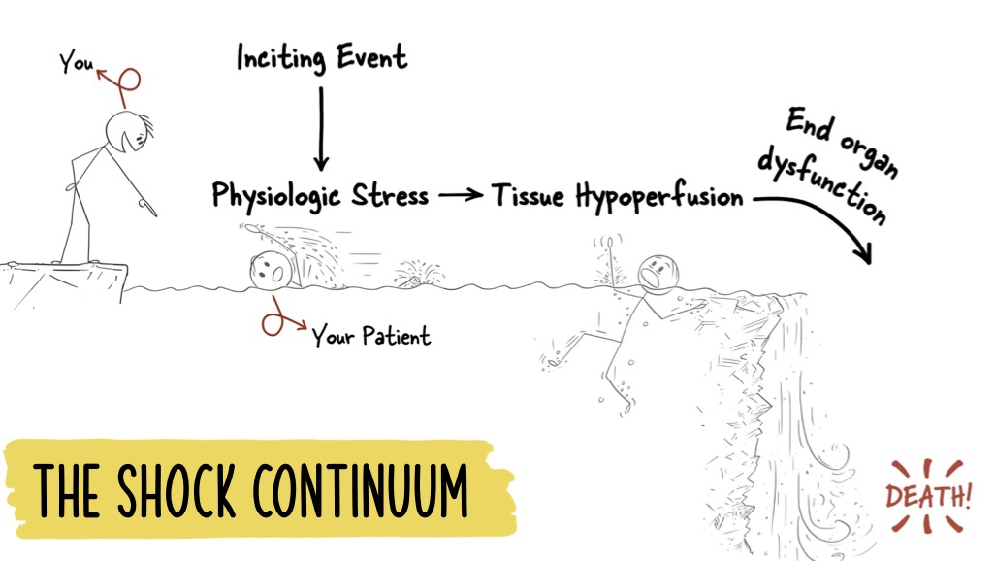

Slide 6




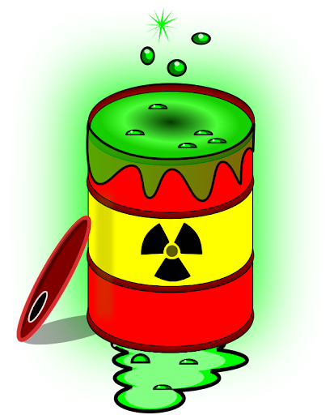




Oxygen
SvO₂
>95-97%
70%
50%
Go faster
Add more trains
Add extra boxcars
Pack boxcars full
CO (SV x HR)
Lactate
Hb
SaO2
DO₂ = CO x Hbg x SaO₂ x 1.34
Sepsis
ATP
VO₂ = CO x (CaO₂ - CvO₂)

Slide 7
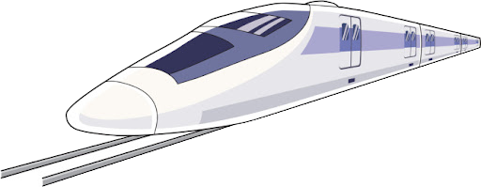
Oxygen
SvO₂
95-97%
Shock is due to inadequate oxygen delivery and/or extraction to tissues and cells
70%
50%
Go faster
Add more trains
Add high speed rail
Add extra boxcars
Pack boxcars full
CO (SV x HR)
Lactate
MAP (CO x SVR)
Hb
SaO2
Sepsis
DO₂ = CO x Hbg x SaO₂ x 1.34
ATP
VO₂ = CO x (CaO₂ - CvO₂)

Slide 8
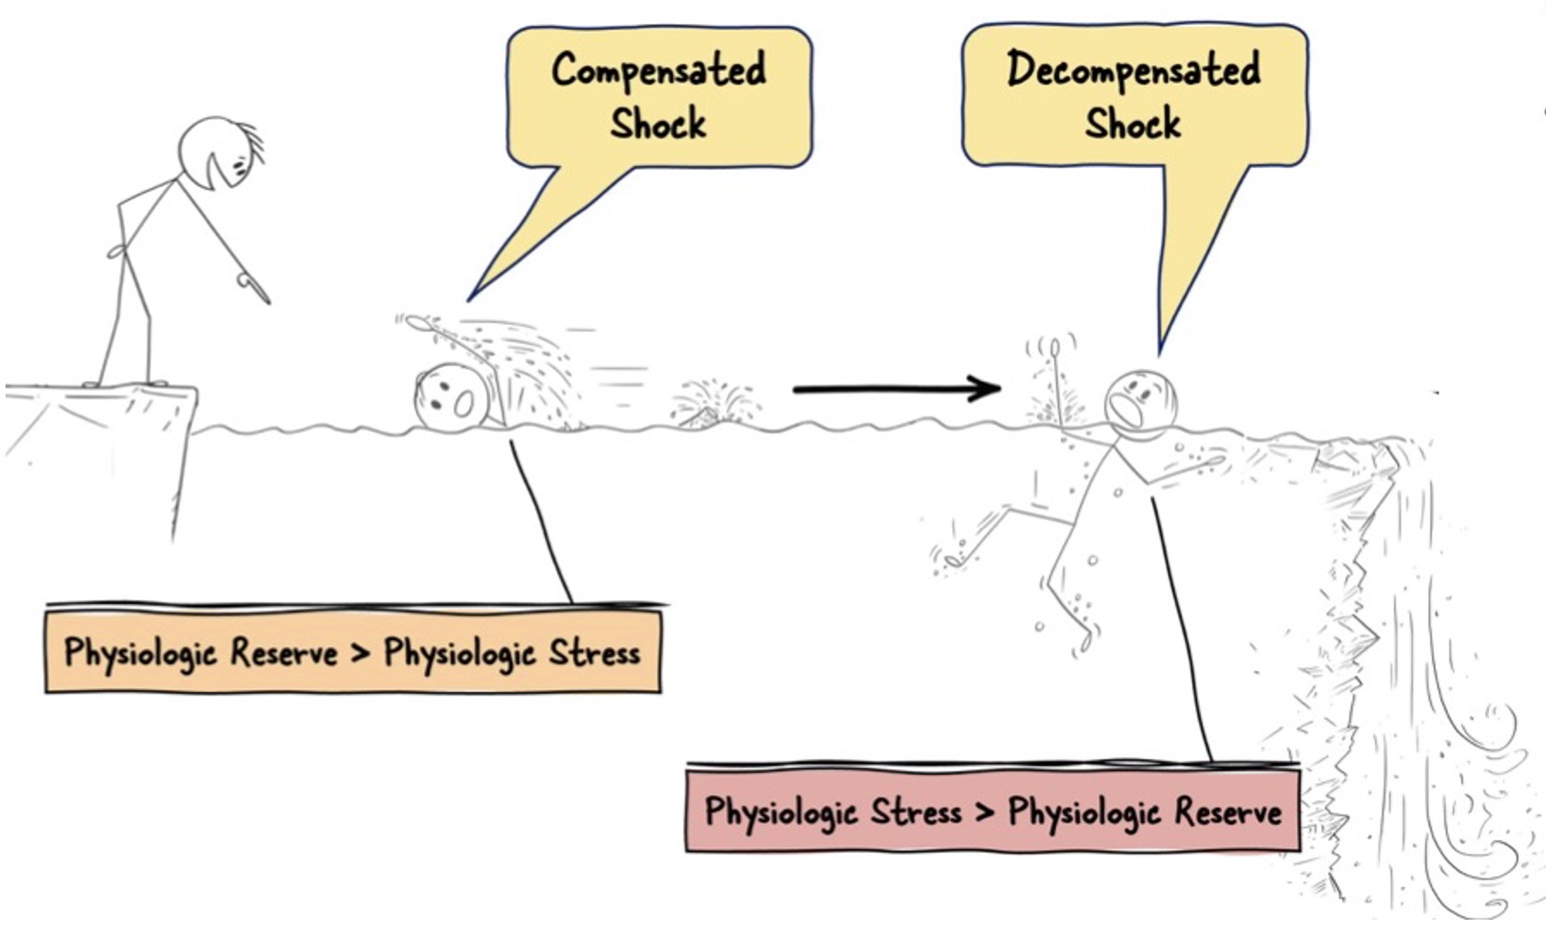
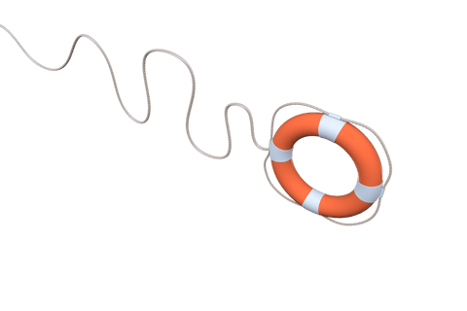

Slide 9
HYPOTENSION ≠ SHOCK
HYPOTENSION
Defined by MAP
Easy to measure
Determined by:
CO, SVR, CVP
SHOCK
Defined as tissue
Oxygen supply < demand
Harder to measure
Determined by:
CO, Hbg, O2 sat,
Peripheral O2 utilization
SHOCK = HYPOPERFUSION
NEARLY ALL HYPOTENSIVE
PATIENTS ARE IN SHOCK
DO₂ = CO x Hbg x SaO₂ x 1.34
Hypotensive,
but not in shock
In shock, but
not hypotensive

Slide 10
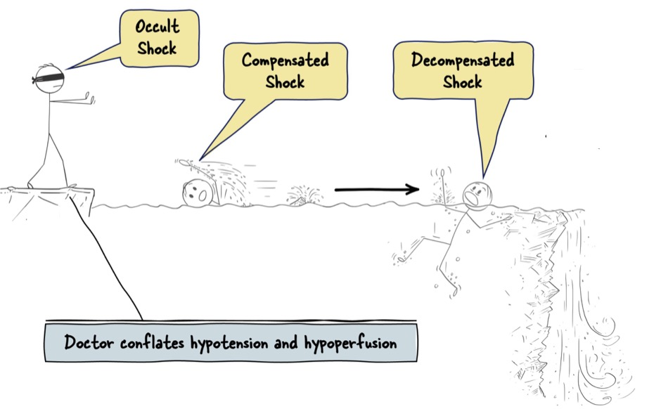

Slide 11



Recognize Clues to Shock

Slide 12
Recognize Clues to Shock

Slide 13
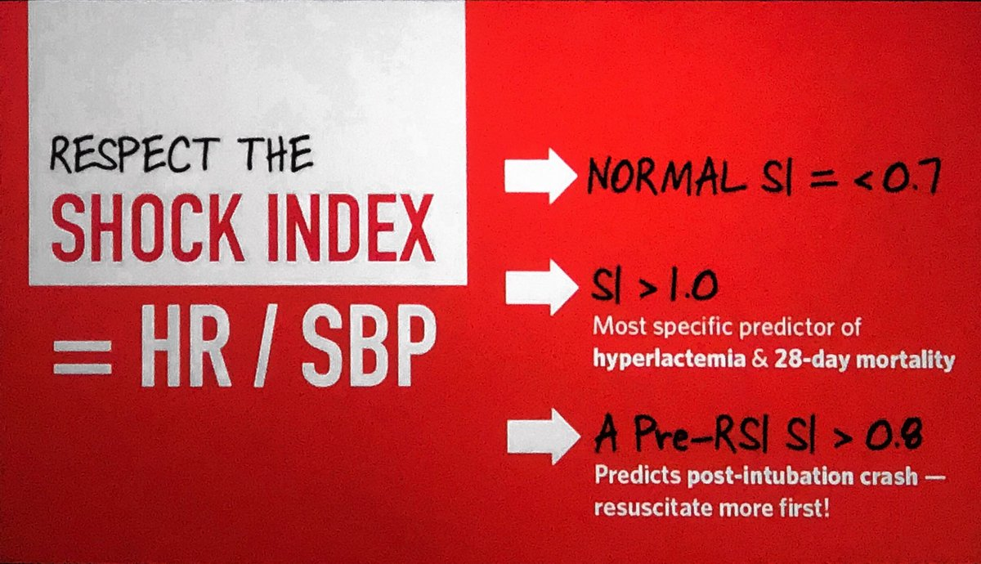
Recognize Clues to Shock
General appearance
Vital signs
Signs of organ dysfunction
  Altered mental status
  Work of breathing
  Low urine output (or dark urine)
  Slow capillary refill time
  Skin perfusion
    Cool hands and knees
    Mottling
    Warm, flushed, urticaria, angioedema, pruritic
Elevated lactate

Slide 14
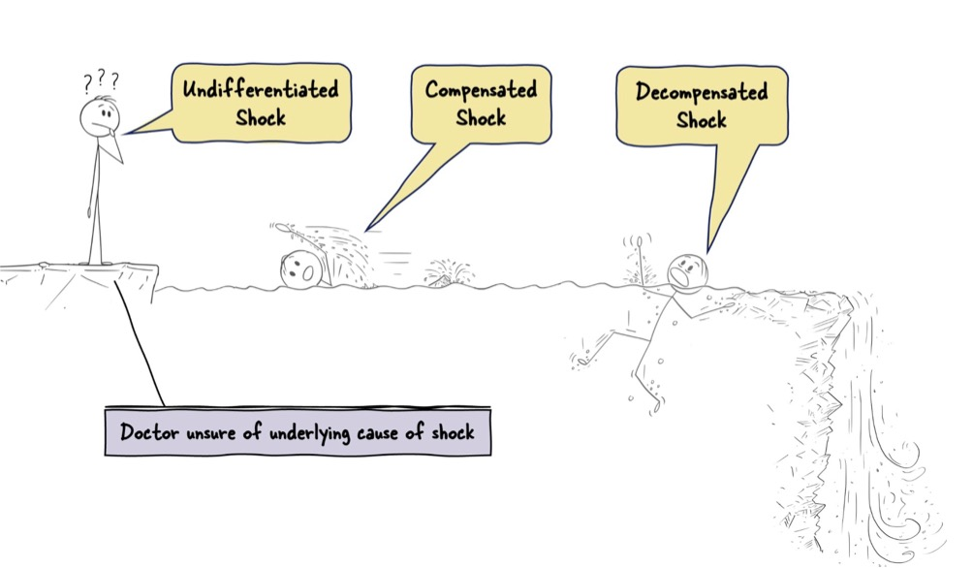

Slide 15
Types of Shock
Notes:
This slide depicts one method of classifying the types of shock. Such a system is useful because it allows consideration of appropriate treatment based on the underlying cause of shock. As previously noted, the treatment of all types of shock, except some forms of cardiogenic shock, starts with administration of intravenous fluids.
Hypovolemic and distributive, or septic, shock are the most commonly encountered types of shock in the clinical setting; obstructive shock occurs less frequently.

Slide 16
Types of Shock
Septic
Neurogenic
Adrenal crisis
Anaphylactic
Liver Failure
Endocrine (AI, thyrotox)
DISTRIBUTIVE
HYPOVOLEMIC
Hemorrhagic
Nonhemorrhagic: Skin losses, GI losses, Third-spacing, Renal losses, Low PO intake
Arrhythmia
LV failure (e.g. MI, myocarditis)
Valves: Acute AVR or MVR (e.g. endocarditis, pap muscle rupture, aortic dissection)
RV failure due to PE, decompensated chronic PH, or RV MI
Toxins (CCB, BB, BRASH syndrome)
Trauma (myocardial contusion)
CARDIOGENIC
Massive pulmonary embolism
Cardiac tamponade
Outflow obstruction (HOCM, crit AS)
Tension pneumothorax
Constrictive pericarditis
Abdominal compartment syndrome
Dynamic hyperinflation (auto-peep)
OBSTRUCTIVE
Notes:
This slide depicts one method of classifying the types of shock. Such a system is useful because it allows consideration of appropriate treatment based on the underlying cause of shock. As previously noted, the treatment of all types of shock, except some forms of cardiogenic shock, starts with administration of intravenous fluids.
Hypovolemic and distributive, or septic, shock are the most commonly encountered types of shock in the clinical setting; obstructive shock occurs less frequently.

Slide 17
 | Cardiac Output | Filling Pressures | SVR | Svo₂ Scvo₂
Cardiogenic | ↓ | ↑ | ↑ | ↓
Obstructive | ↓ | ↑ or N | ↑ | ↓
Hypovolemic | ↓ | ↓ | ↑ | ↓
Distributive | ↑ > > ↓ (or var) | ↓ or var | ↓ | ↑, N, or ↓
®
Notes:
Hemodynamic profiles can characterize the various types of shock. Although these specific parameters may not be measured in many patients, knowledge of the expected responses may be helpful in determining management. Note that cardiac output is diminished in all types of shock except for distributive (or most commonly septic) shock, where it is elevated. Another hallmark of septic or distributive shock is warm extremities despite a low blood pressure. This is due to a decrease in vascular resistance, which also leads to lower diastolic pressures and a widened pulse pressure. Yet another hallmark of distributive shock is shunting of blood past the capillary bed, which is the underlying reason for the low vascular resistance. This shunting causes an inability to metabolize oxygen. The unused oxygen results in an increased or normal central or mixed venous oxygen saturation, something not seen in other forms of shock.
Cardiac filling pressures are diminished in all forms of shock other than cardiogenic and obstructive shock. Cardiogenic and obstructive shock are caused by pump, or heart, failure that leads to elevated cardiac filling pressures.

Slide 18
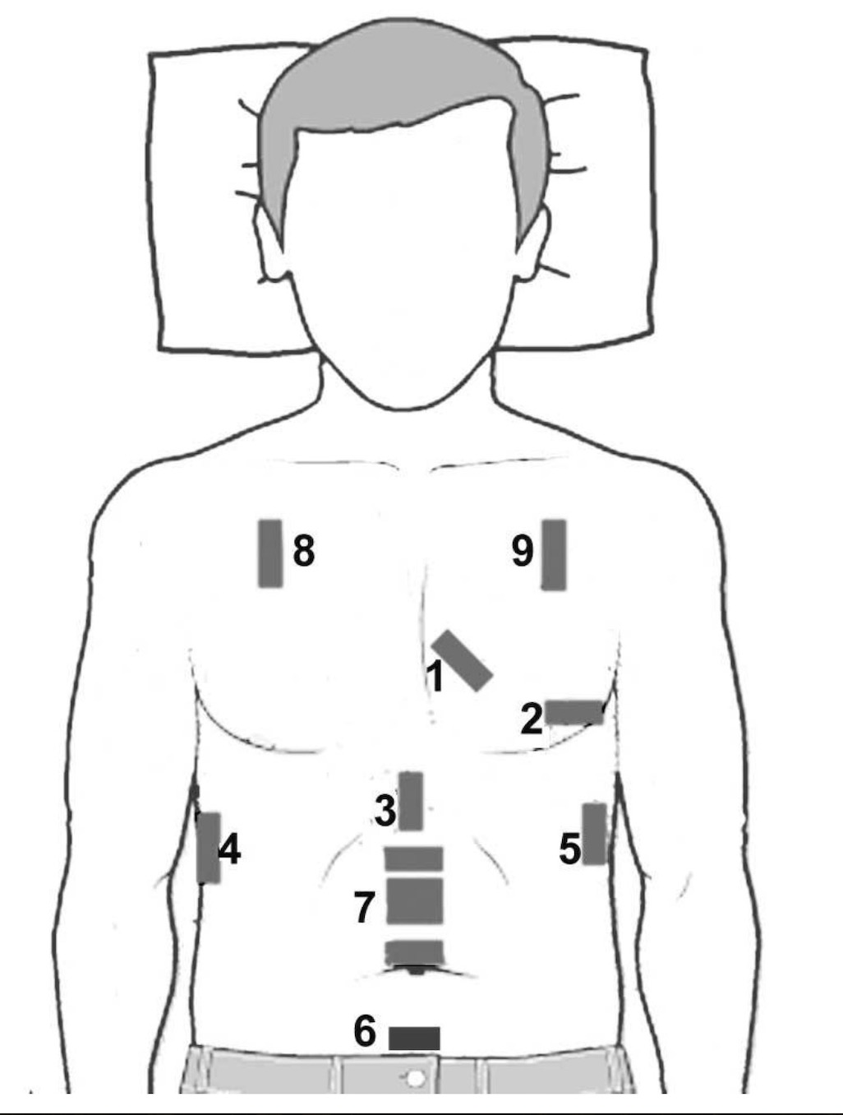
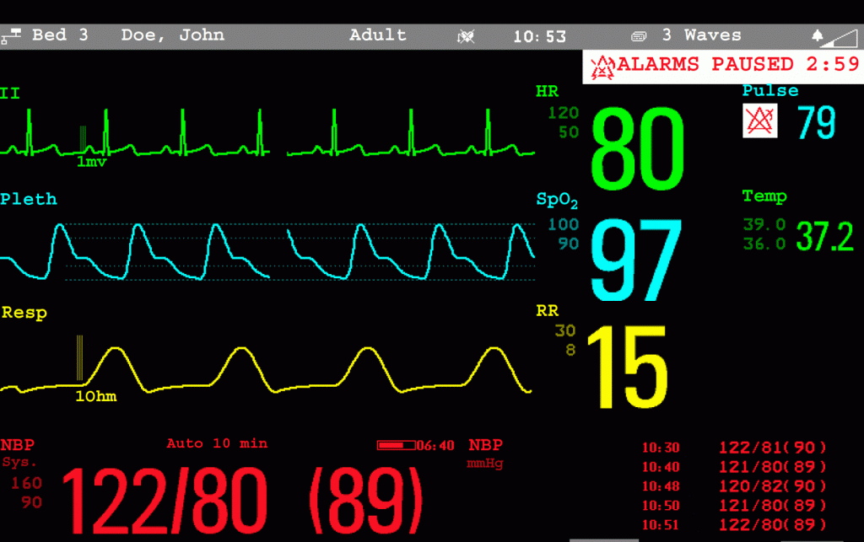

Bedside Evaluation
Monitors
General appearance
Mental status
Neck veins
Work of breathing
Lung ultrasound
Echocardiogram
Abdominal ultrasound
Skin exam, pulses, cap refill
Urine output

Slide 19
Labs
Blood gas
Lactate
Base excess
HCO₃
WBC
Glucose
Creatinine
NT-BNP
INR
LFTs

Slide 20
Goals of Resuscitation
Recognize shock physiology early
Restore tissue perfusion, oxygenation delivery, and extraction
Identify and treat the underlying shock precipitants
Monitor end-points
Continually reassess

Slide 21
Septic Shock (Distributive)
 | Cardiac Output | Filling Pressures | SVR | SvO2/Scvo₂
Septic | ↑ > > ↓ (or var) | ↓ or var | ↓ | ↑
Extraction/utilization problem: shunt, mitochondrial dysfunction
Exam: warm, flushed, usually hyperdynamic, wide pulse pressure (low diastolic)
Obtain cultures
Early appropriate, empiric antibiotics
Source control
Fluids → vasopressors (1st line norepinephrine) → vasopressin → angiotensin II?
Hydrocortisone (if refractory shock, use of 2+ pressors)
POCUS
Heart | Hyperdynamic (hypodynamic in late sepsis)
IVC | Variable IVC
Lungs | A line pattern
Other | Evidence of infxn (cholecystitis, endocarditis, cirrhosis)

Slide 22
Cardiogenic Shock
 | Cardiac Output | Filling Pressures | SVR | SvO2/Scvo₂
Cardiogenic | ↓ | ↑ | ↑ | ↓
Delivery (or pump) problem
Exam: cold, JVD, pulmonary edema (B-lines), weak pulses, +/- peripheral edema
Vasopressor: inopressor (norepinephrine) + inodilator (dobutamine)
Mechanical support: IABP, Impella
Definitive intervention
POCUS
Heart | ± Reduced contractility, ± RV dilation ± WMA, ± Valvulopathy
IVC | Plethoric IVC, reversal of flow in HV
Lungs | B line pattern + pleural effusions
Other | Pleural effusions (LV failure)

Slide 23
Hypovolemic Shock
 | Cardiac Output | Filling Pressures | SVR | SvO2/Scvo₂
Hypovolemic | ↓ | ↓ | ↑ | ↓
Delivery (or tank) problem: Low CO due to decreased preload
Exam: Cold, dry mucosa, decreased skin turgor, weak pulses, decreased cap refill
Volume expansion: LR > NS, colloid… maybe
Bleeding
  Replace with blood
  Utilize ROTEM here at VCMC (or TEG)
  Source control!
  Keep patient warm
POCUS
Heart | Hyperdynamic
IVC | Small/collapsing IVC
Lungs | A line pattern
Other | Blood or fluid in abdomen (FAST), Ectopic pregnancy, Aortic dissection

Slide 24
Obstructive Shock
 | Cardiac Output | Filling Pressures | SVR | SvO2/Scvo₂
Obstructive | ↓ | ↑ or N | ↑ | ↓
Careful with fluids
Norepinephrine, inopressor, inhaled vasodilator (NO, prostanoid)
Treat underlying problem
  PE: thrombolytics
  Tamponade: pericardiocentesis
  Tension pneumo: needle decompression
  Dynamic hyperinflation (auto-peep): disconnect from vent, fix I:E ratio)
  ACS: notify surgery for decompression
Don’t drop preload or increase pulmonary afterload
POCUS
Heart | Reduced contractility, RV dilation (PE) ± septal D sign, Pericardial effusion, RA collapse (tamponade)
IVC | Plethoric IVC, reversal of flow in HV
Lungs | Lack of lung sliding ± lung point (ptx)
Other | DVT or clot in transit (PE)

Slide 25
Shock can be heterogeneous

Slide 26
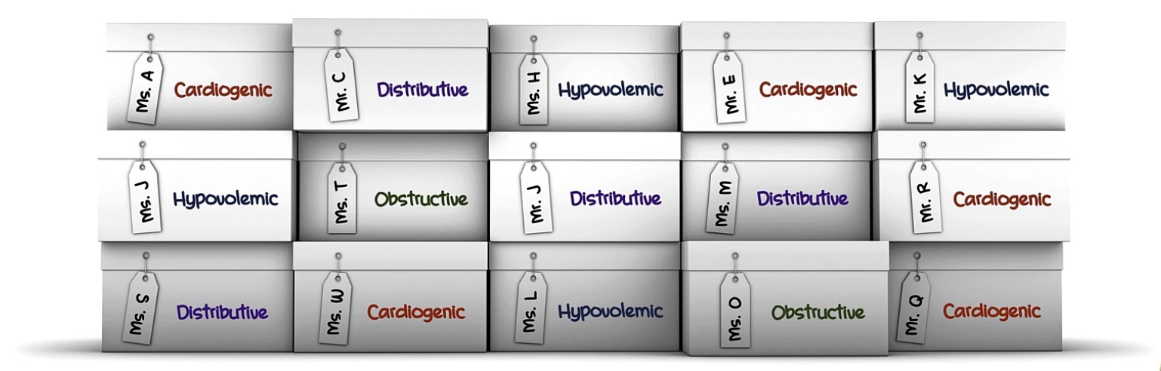

Slide 27
Management: Optimize the volume status
Usually give fluids, with following exceptions:
  B-lines may indicate LV dysfunction and pulmonary edema
  Elevated filling pressures are unlikely to benefit
    (e.g. dilated IVC without respirophasic variation)
Give bolus and monitor response
  Passive leg raise
  Pulse pressure variation
  Stroke volume variation

Slide 28
Management: Protect the MAP
Start vasopressors immediately if volume status is optimized and MAP is inadequate
Ok to start in peripheral vein or IO
  Norepinephrine (Levophed) ok to start peripherally for a limited amount of time (daily documentation)
  Consider epinephrine, which has a lower risk of extravasation and may be safer to use

Slide 29
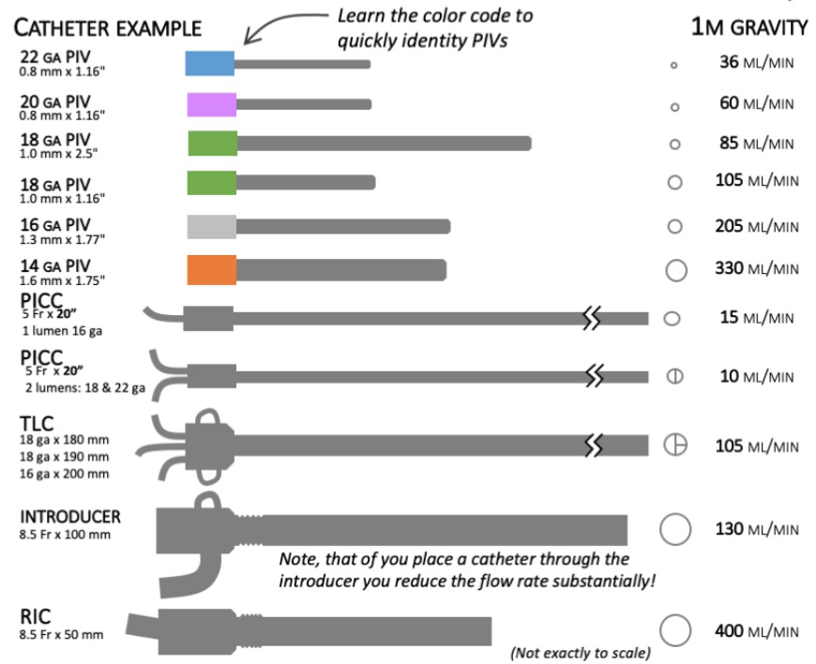
Management: Resuscitation Tips
If not responding to IVFs & escalating pressors, consider the ”septic heart”
  Reassess
  POCUS, obtain formal echo
Caution! Normal EF may be low in septic shock with vasopressors
For CHF, ESRD, peri-intubation
  Small boluses at a time
  Continually reassess hemodynamics

Slide 30
Take Away Points
Shock = Hypoperfusion = inadequate DO₂ or VO₂ to maintain cell/organ function
Recognize shock early… look for clues
4 types of shock: Cardiogenic, Hypovolemic, Distributive, Obstructive
  It’s not always sepsis
  Can be heterogeneous, multiple and/or changing phenotypes
Go to the bedside and see the patient.
  Gather and interpret data at the bedside
  Continually reassess
Interventions: Fluids, vasopressors, protect the MAP, obtain cultures, and early antibiotics in sepsis
Source control
Identify and treat the underlying cause

Slide 32
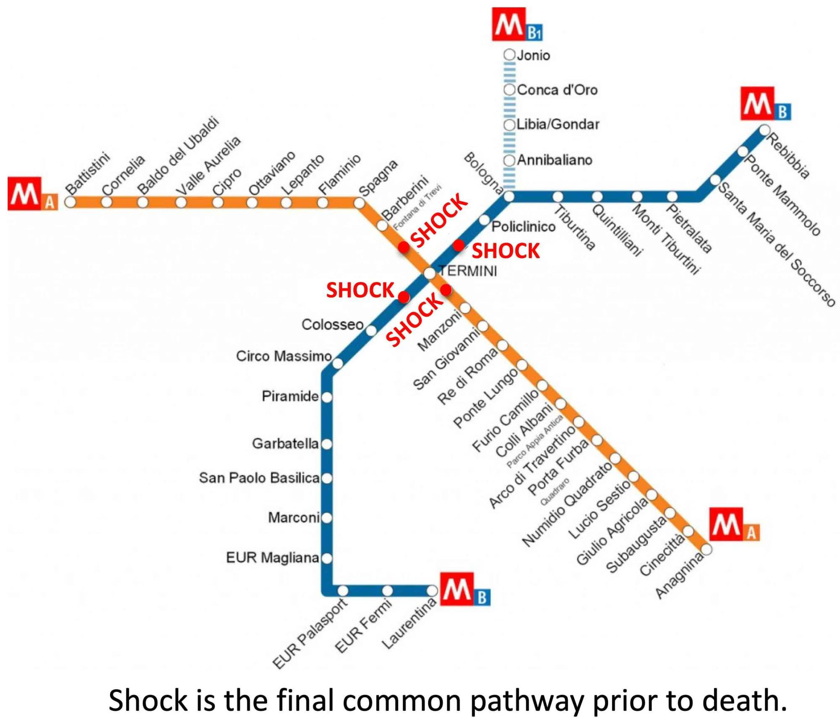

Slide 33
Resources
FCCS Fundamentals of Critical Care Support
SCCM Society of Critical Care Medicine
EMCrit Project
IBCC Internet Book of Critical Care
ICUedu.org

