Slide 1
This is a sample M&M presentation by Jong Kim which was touted as being an excellent presentation, and can be used as a model.
Slide 20 has been used to analyze the case. Please change that slide and incorporate it in your presentations.
I believe presentations should be 20 minutes or less if possible. It is to happen the 3rd week, Wednesday at 11:30. More details are in the intro email just sent.
Resident going to clinic should likely present their case first

Slide 2
ICU Rotation June 2018
Morbidity and Mortality
Jong Kim MD,MPH PGY1
6/27/2018

Slide 3
? of Delay in appropriate care
Admitting Diagnosis:
Acute massive pulmonary embolism
Procedure Performed/Care Provided:
Catheter Directed Thrombolysis, Systemic Anticoagulation
Complication
No significant bleeding or HD compromise

Slide 4
Patient Background and HPI
Mr. **
73yo M
PMHx of
  Depression
  DM2,
  HTN,
  CKD,
  Chronic pain
FH
  No Hx of DVTs, other clotting disorders
  DM Mother and Father
Surgical Hx
  No significant procedures.
Presented to SPH ED on 6/16 @ 1432
30 minutes prior to presentation had syncopal event while rummaging through recycling dumpster. Witnessed by wife.
Prior to event 2 week history of fatigue and somnolence.

Slide 5
Exam Findings
GEN: Alert. NAD
HEENT: EOMI, PERRL
Cardiac: RRR. No M/R/G.
Pulm: CTA
Abd: Soft. NT, ND
Ext: LLE 2+ Pretibial edema. RLE 1+ Pedal edema
Skin: Warm, Dry
Neuro: AOx4. No focal Neurological Deficits
T: 98F.
HR: 92
BP: 70/30s in field. 72/56 Initially in ED
RR: 15
O2: 70% in field. 75% RA in ED. (Required Non rebreather mask)
Within 20 minutes of presentation patient awake, alert and normotensive with BP 120/80s.
Received 1L NS bolus as well as Naloxone

Slide 6
Initial Labs
10.4
140
105
25
10.9
8.3
167
292
0.9
3.6
26
2.00
25
32.3
AST: 17 ALT: 18 Alk Phos: 143 T Bili: 0.3 TSH1.53 T4 Free: 1.17
D-Dimer: 7278 Troponin: <0.017 BNP: 67 (Cardiac Panel Not trended)
UDS: Negative. Acetaminophen, Salicylate, Ethanol: Neg. HgA1c: 12.3
VBG: pH: 7.37 pCO2:44.7 pO2:31. 6 Lactate: 2.20 A-a gradient: 539.2 on 100 FiO2

Slide 7
Diagnostic Studies
Pre Intervention
EKG
No ST-T changes, normal PR & QRS. Sinus Tachy. Occasional PVCs
Rad Chest
Mild hypoventilation. No other obvious aculte abnormality on portable exam
CT Head w/o Contrast
Noted is a 1.5m non calcified rounded mass arising out of the sella into the suprasellar cistern. This most likely represents evidence of a macroadenoma, however, other etiologies including aneurysm or meningioma cannot be ruled out…
Impression: 15mm mass suprasellar cistern. Question pituitary adenoma versus meningioma versus aneurysm. MRI is recommended for more definitive diagnosis

Slide 8
Radiological Studies
Pre Intervention
CTA Chest
There are elongated filling defects within the distal right main pulmonary artery extending into the right lower lobe pulmonary artery and right upper lobe pulmonary artery as well as primary intersegmental branches of the right upper and right lower lobe pulmonary arteries.
There is filling defect within the distal left main pulmonary artery extending into the left lower lobe pulmonary artery and primary intersegmental branches as well as into the left upper lobe pulmonary artery and primary intersegmental branches.
There is mild dilatation of the central pulmonary arteries consistent with pulmonary arterial hypertension. There is reflux of contrast into the distal inferior vena cava consistent with right heart strain and failure.

Slide 9
Intervention
IR Catheter guided Thrombolysis and Mechanical Lysis
… Initial left pulmonary angiogram demonstrated filling defects within the proximal left upper lobe and lower lobe pulmonary artery branches with poor flow distally….. 10 mg of TPA was administered over 2 minutes followed by mechanical lysis with the pigtail catheter.
[Similar for right side]
...Follow-up pulmonary angiogram demonstrated significant improved flow into the left pulmonary branches and mildly improved flow into the right pulmonary artery branches.
The patient tolerated the procedure well. Minimal bleeding. No immediate complications. He reports significant improvement in respiratory symptoms with less chest pain and shortness of breath. Normal blood pressure and heart rate at the end of the procedure.

Slide 10
Timeline
Presented to the ED @1442
CT Angio Chest results called @ 1610
Heparin Drip Started @ 1710
90 min
60 mins
180 mins
15 mins
CT Head Signed @1616
IR Catheter Guided TPA @ 2008
Total of 150 minutes from arrival to start of Heparin Drip
Total of 330 minutes from arrival to receiving catheter directed TPA

Slide 11
Literature Review

Slide 12
AHA Scientific Statement
Management of Massive and Submassive Pulmonary Embolism, Iliofemoral Deep Vein Thrombosis, and Chronic Thromboembolic Pulmonary Hypertension
2011
Antithrombotic Therapy for VTE Disease
CHEST Guideline and Expert Panel Report
2016

Slide 13
Classification of PE (From AHA)
Submassive PE
Acute PE without systemic hypotension (systolic blood pressure ≥90 mm Hg) but with either RV dysfunction or myocardial necrosis.
RV dysfunction means the presence of at least 1 of the following:
  —RV dilation or RV systolic dysfunction on echocardiography
  —RV dilation on CT
  —Elevation of BNP (>90 pg/mL)
  —Elevation of N-terminal pro-BNP (>500 pg/mL); or
  —Electrocardiographic changes
Myocardial necrosis is defined as either of the following:
  —Elevation of troponin I (>0.4 ng/mL) or
  —Elevation of troponin T (>0.1 ng/mL)
Massive PE
Acute PE with sustained hypotension (systolic blood pressure <90 mm Hg for at least 15 minutes or requiring inotropic support, not due to a cause other than PE
Low Risk PE
Acute PE and the absence of the clinical markers of adverse prognosis that define massive or submassive PE

Slide 14
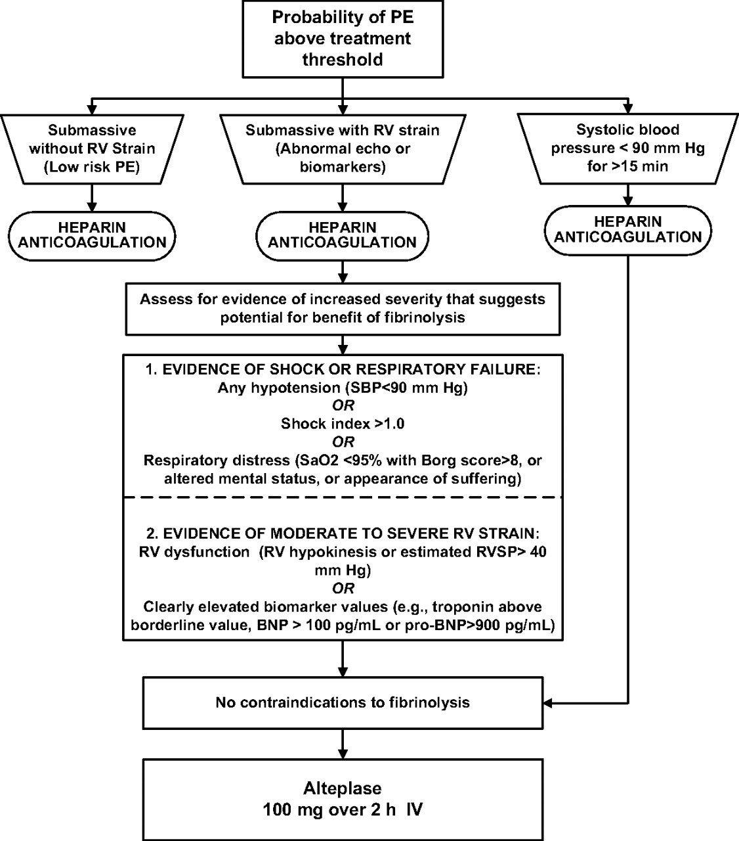
*25. In patients with acute PE associated with hypotension and who have (i) a high bleeding risk, (ii) failed systemic thrombolysis, or (iii) shock that is likely to cause death before systemic thrombolysis can take effect (eg, within hours), if appropriateexpertise and resources are available, we suggest catheter-assisted thrombus removal over no such intervention (CHEST)

Slide 15
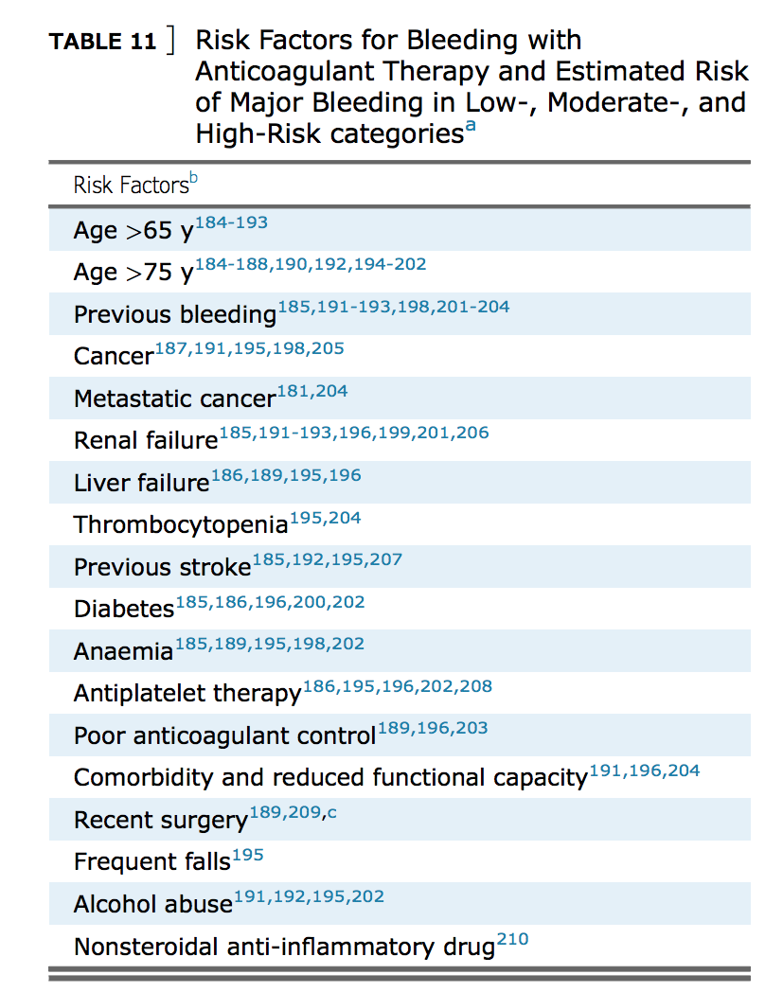
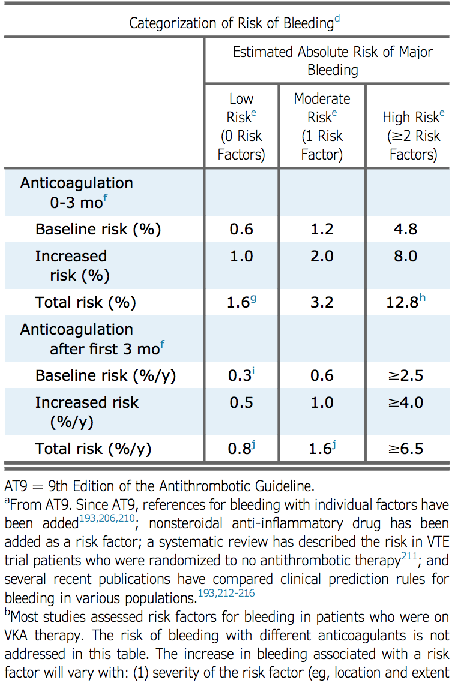
Contraindications to Anticoagulation Therapy

Slide 16
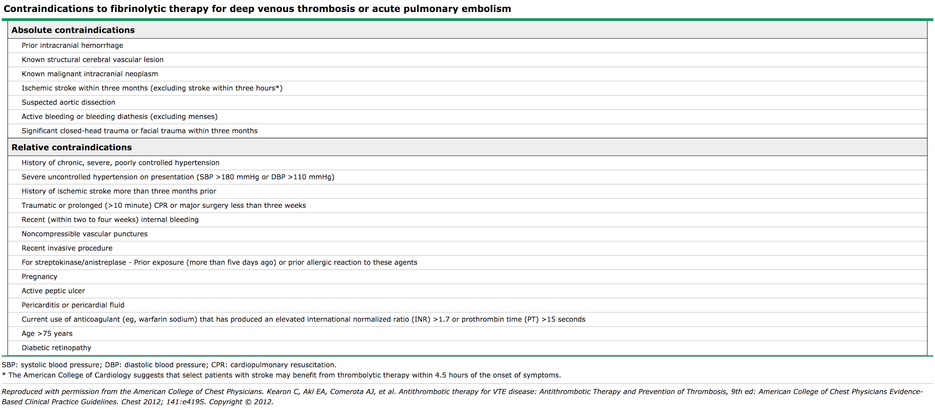
Contraindications to Fibrinolytic Therapy

Slide 17
Why Thrombolytic Therapy?
At least 4 registries have documented the outcomes of patients with PE (MAPPET, ICOPER, RIETE and EMPEROR [Emergency Medicine Pulmonary Embolism in the Real-World Registry]). The data suggest a trend toward a decrease in all-cause mortality from PE, especially massive PE in those patients treated with fibrinolysis.
However, risk of intracranial bleeding around 1.9-2.2%

Slide 18
Why is timing important
Early Anticoagulation Is Associated With Reduced Mortality for Acute Pulmonary Embolism (CHEST 2010)
In-hospital and 30-day mortality rates were 3.0% and 7.7%, respectively. Patients who received heparin in the ED had lower in-hospital (1.4% vs 6.7%; P = .009) and 30-day (4.4% vs 15.3%; P < .001) mortality rates as compared with patients given heparin after admission. Patients who achieved a therapeutic aPTT within 24 h had lower in-hospital (1.5% vs 5.6%; P = .093) and 30-day (5.6% vs 14.8%; P = .037) mortality rates as compared with patients who achieved a therapeutic aPTT after 24 h. In multiple logistic regression models, receiving heparin in the ED remained predictive of reduced mortality, and ICU admission remained predictive of increased mortality.

Slide 19
How much should we worry about contraindications to thrombolysis?
Most contraindications to thrombolysis should be considered relative in patients with life-threatening, high-risk PE. (2014 ESC Guidelines)
All contraindications to thrombolysis for life-threatening pulmonary embolus should be considered relative. (BMJ Case Report 2013)
77-year-old man who received thrombolysis for a massive PE 4 weeks following admission with a significant intracerebral bleed. There was rapid resolution of hypotension and hypoxia and he survived to be discharged home.

Slide 20
Case Analysis

Slide 21
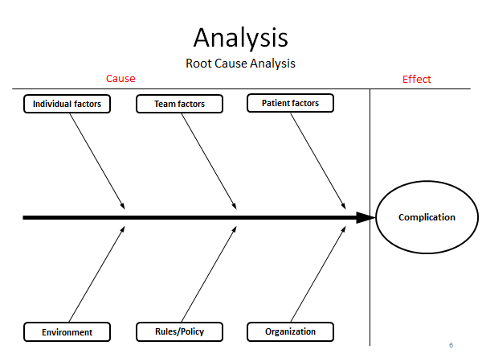
Individual clinical decision making.
Risk Benefit Analysis
Radiologist not aware of whole clinical picture.
Evolving clinical status of patient
Lack of concrete national guidelines for massive PE with possible contraindications.
Time required for transfer
No formal hospital policy
Possible delay in treatment.
Misunderstanding between care teams.

Slide 22
Outcome
No more respiratory distress. Weaned to 98% O2 saturation in RA
MRI Brain w and w/o contrast 6/18
“Sellar and suprasellar solid mass lesion is most consistent with macroadenoma”
“No intracranial hemorrhage”
ECHO report 6/18: 66% EF. Grade 1 diastolic dysfunction.
PESI score of 133. Class IV with 4-11.4% 30 day mortality
Bridged with enoxaparin to warfarin 5mg daily.
Discharged with f/u with PCP, Neurosurgery, Heme, Endocrine

Slide 23
Resources
http://circ.ahajournals.org/content/123/16/1788#sec-15
https://www.ncbi.nlm.nih.gov/pmc/articles/PMC3021363/
https://academic.oup.com/eurheartj/article/35/43/3033/503581
https://www.uptodate.com/contents/image?topicKey=PULM%2F1362&view=machineLearning&search=contraindication%20to%20anticoagulation&sectionRank=1&imageKey=PULM%2F97160&rank=1~150&source=machineLearning&sp=0
https://journal.chestnet.org/article/S0012-3692(15)00335-9/pdf
https://www.ncbi.nlm.nih.gov/pmc/articles/PMC3863107/

